Slide 1
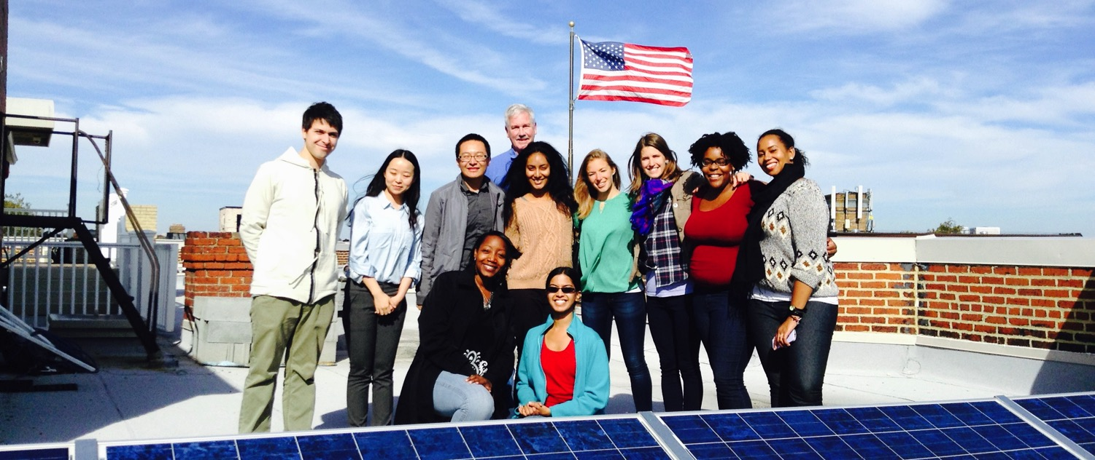
Solar information Session

Slide 2
Overview
1. Who we are
2. How we got started

Slide 3
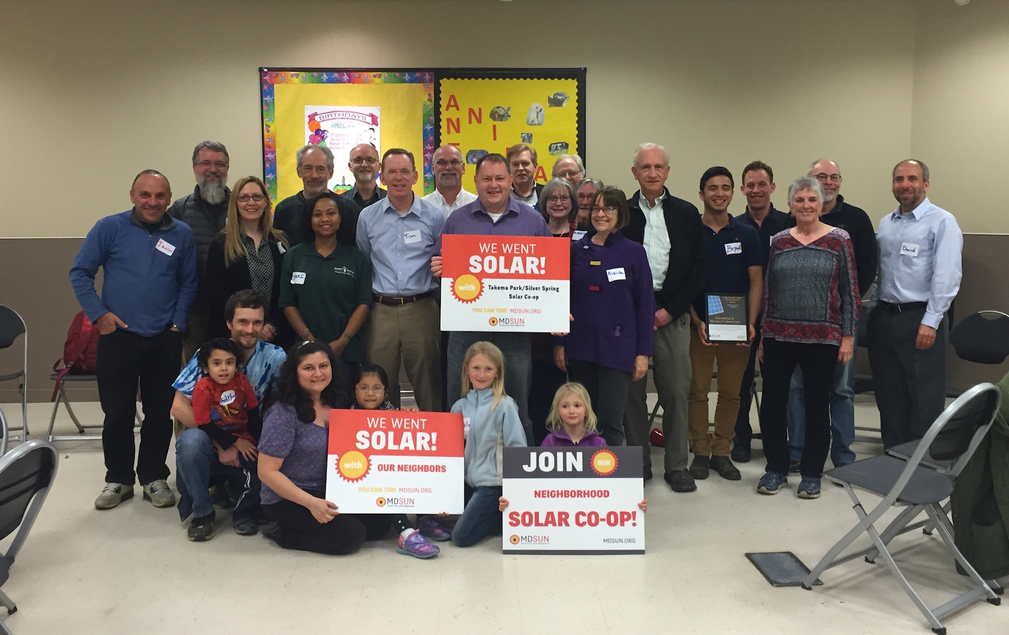
Who We Are
We are a network of people taking control of our energy by installing solar and generating our own electricity.

Slide 4
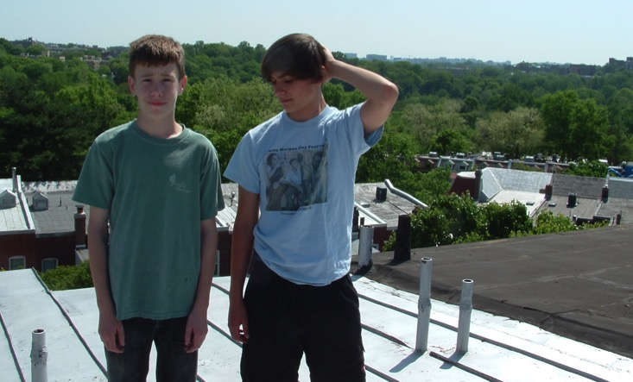
How We Got Started
Started in 2007 and it wasn’t easy!

Slide 5
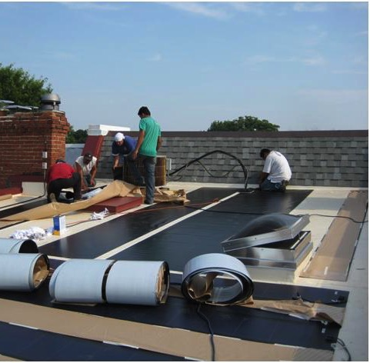
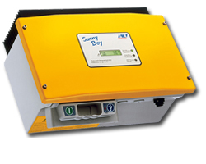
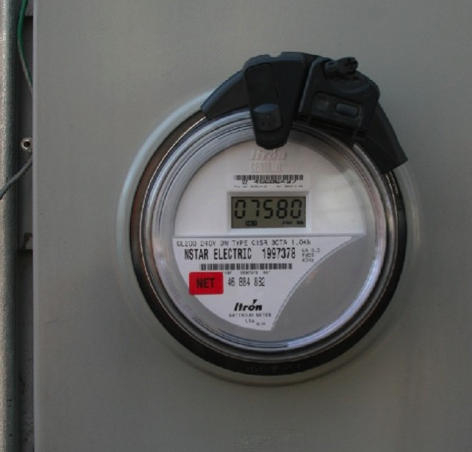
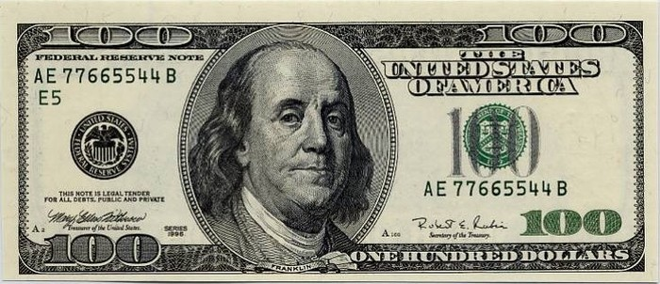
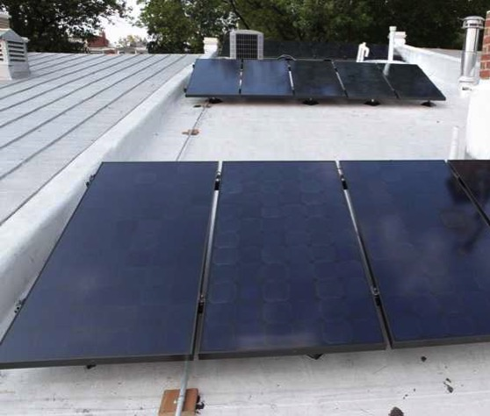
It was harder than we thought!
How We Got Started
Notes:
There were only two companies working in DC. They told us totally different things about how to install PV on our roof, and then there were the issues of Cost, equipment, taxes, regulations, rules, permits, meters, billing, historic association, SRECs, PSC

Slide 6
Helping Communities Go Solar

Slide 8
Presentation in Three Parts
Solar technology
How solar co-ops work
Solar economics

Slide 9
Part 1: Solar technology

Slide 10
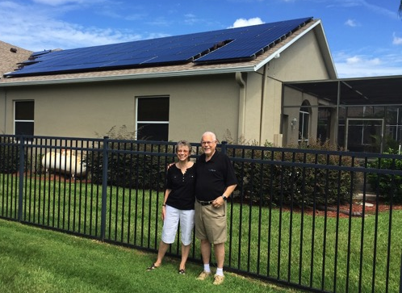
Part 1: Solar Technology
How does a solar panel work?
Solar photovoltaic (PV)
Converts solar energy to electricity

Slide 11
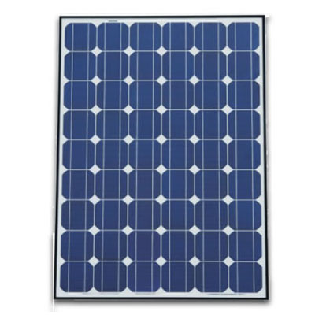
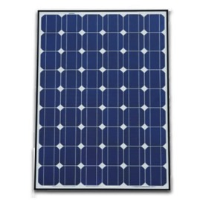
Part 1: Solar Technology
System components: Panels
Cell
Panel / Module
Solar Array

Slide 12
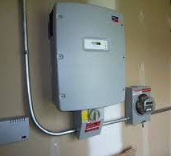
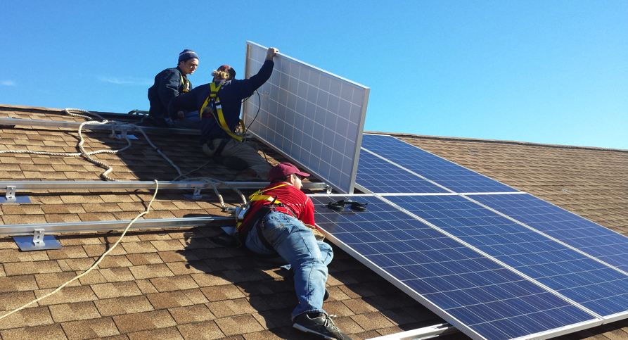
Part 1: Solar Technology
System components:
Inverter & Racking
Inverter
Racking system

Slide 13
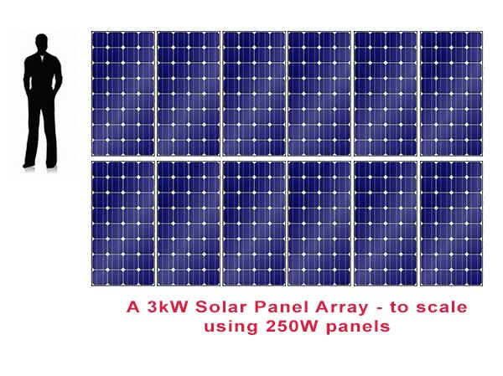
Part 1: Solar Technology
Terminology: Kilowatts (kW) & Kilowatt-hours (kWh)
System measured in kW
Electricity production in kWh
Most homeowners install between 2 kW – 12 kW

Slide 14
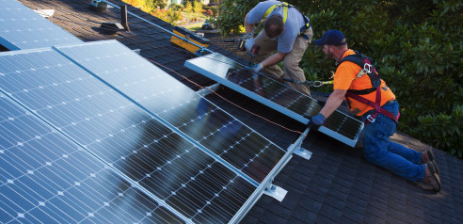
Part 1: Solar Technology
How does solar connect to my roof?
Source: Huffington Post

Slide 15
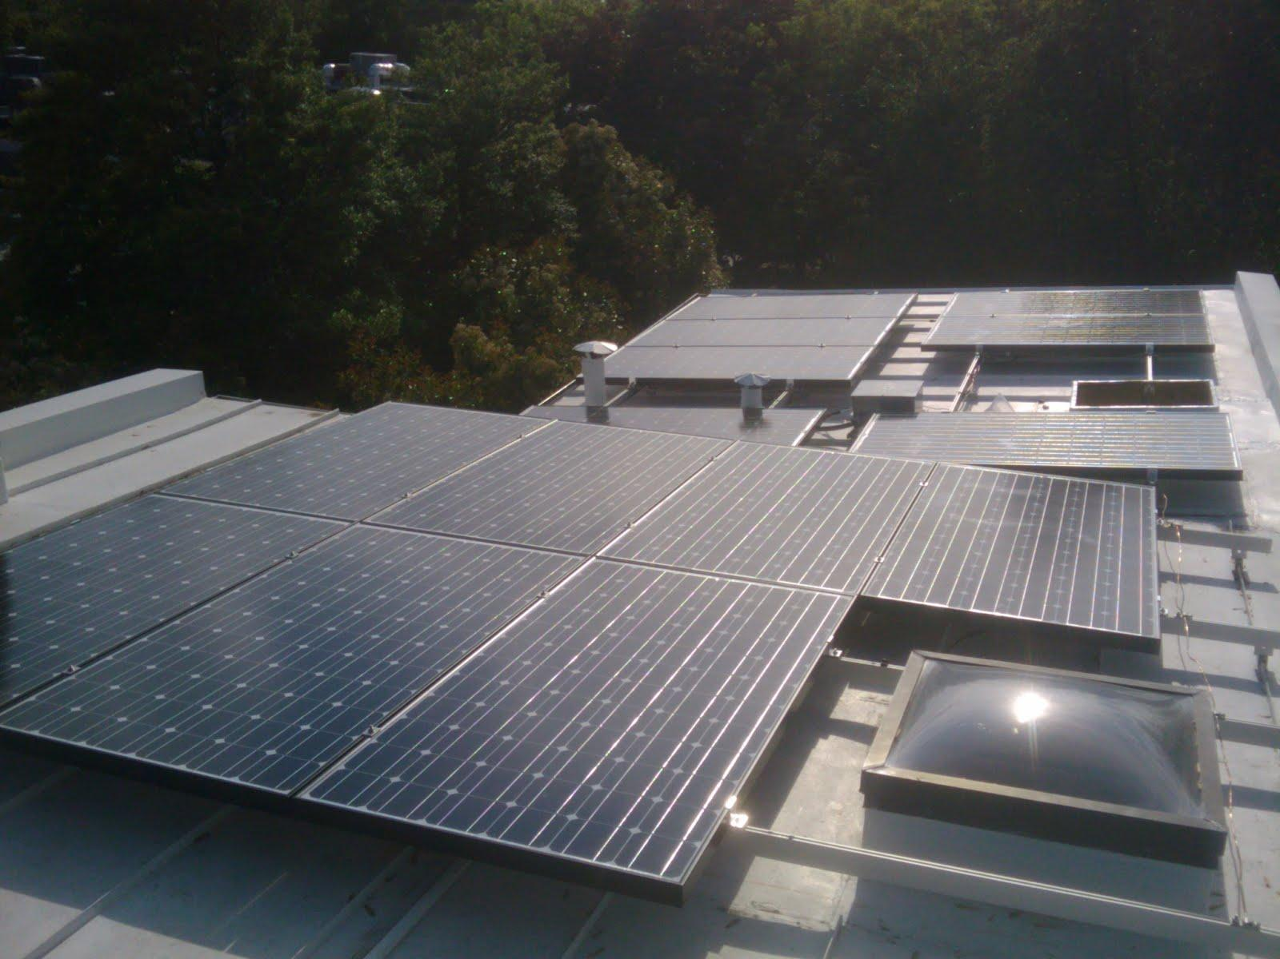
Part 1: Solar Technology

Slide 16
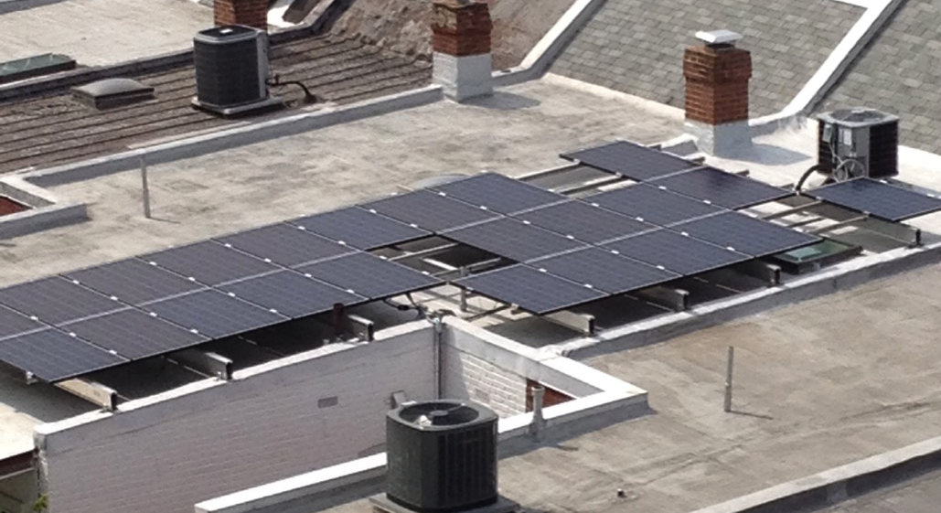
Part 1: Solar Technology

Slide 17
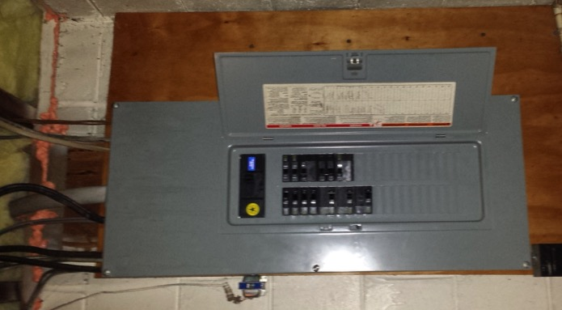
Part 1: Solar Technology
How does it connect to my electrical panel?
Simple connection, most home electric systems don’t need upgrades before solar

Slide 18
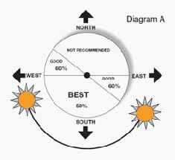
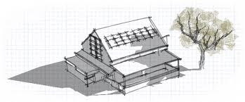
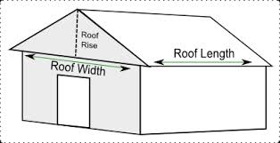
Part 1: Solar Technology
What makes a site good for solar?
No shading
Roof faces southerly direction
Enough space to mount panels

Slide 19
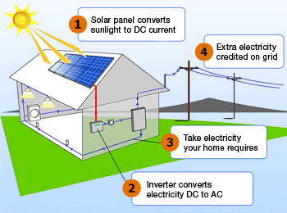
Part 1: Solar Technology
How a solar PV system works (grid tied)
Via wattpatrol.com

Slide 20
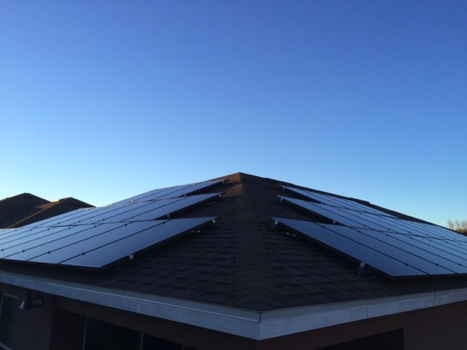
Part 1: Solar Technology
What is net metering?
Allows flow of electricity to AND from customer
When generation is more than use, extra electricity flows back through meter
You receive a credit on your power bill for that excess production

Slide 21
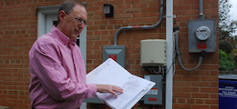
Part 1: Solar Technology
Net metering, continued
Monthly electric bill:
[Amount electricity used] – [Amount electricity produced]
Utilities required by law to let you net meter

Slide 22
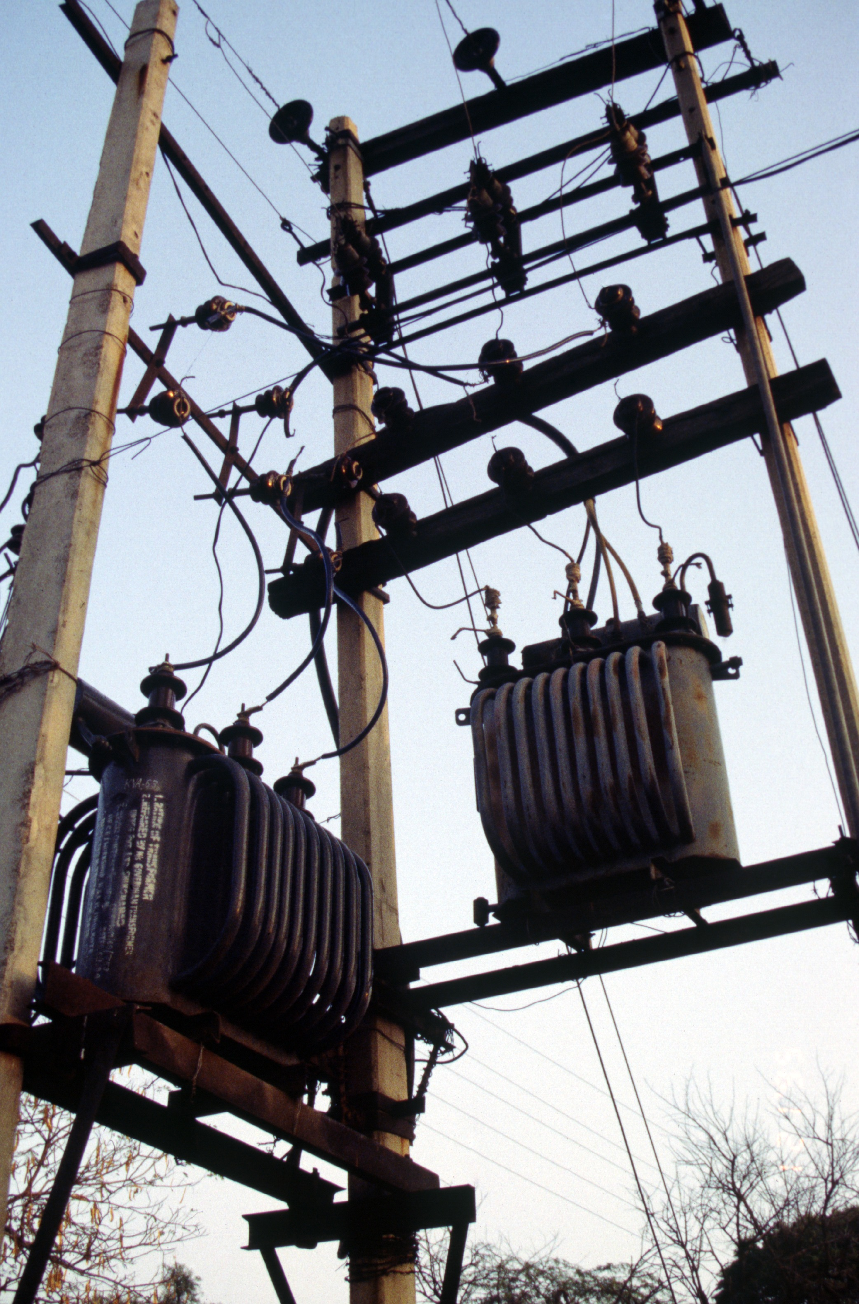
Part 1: Solar Technology
What happens when the power goes out?
When grid is down, solar shuts off (safety mechanism)
Need batteries if you want you want power during outages

Slide 23
Part 1: Solar Technology
Frequently asked questions
Warranties?
Homeowners’ insurance?
Maintenance?
How long do systems last?
Will HOA allow solar on my home?
What if I’m In a historic district?

Slide 24
Part 2: How Solar Co-ops Work

Slide 25
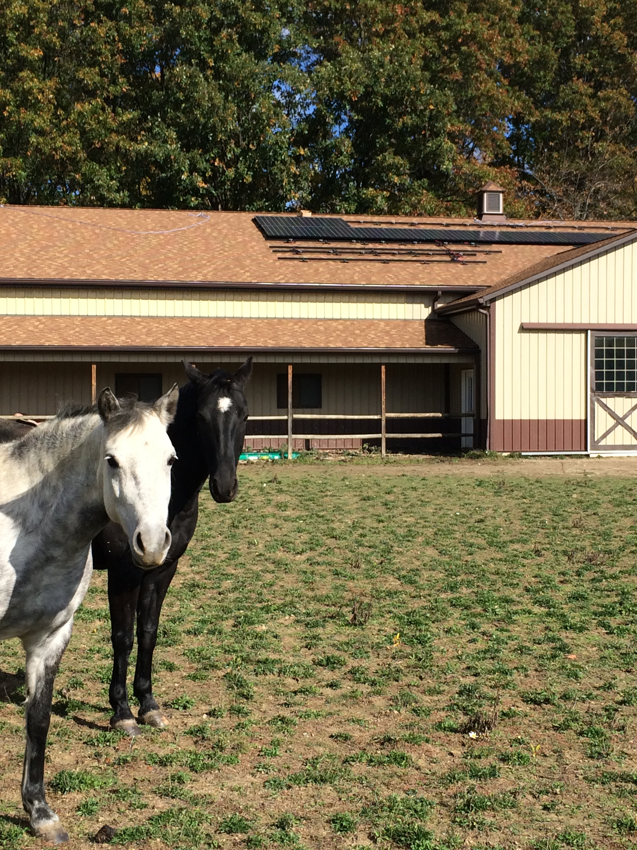
Part 2: How Solar Co-ops Work
Solar co-op benefits
Get best value on installation and support throughout the process
Connect with fellow solar enthusiasts
Become part of the growing solar movement
Peggi Ignagni’s install in Oberlin.

Slide 26
Part 2: How Solar Co-ops Work

Slide 27
Part 2: How Solar Co-ops Work
Who picks the installer? Co-op members
Co-op participants select specific installer criteria including:
Price
Equipment quality
Warranties
Are a local company

Slide 28
Part 3: Solar Economics

Slide 29
Part 3: Solar Economics
A few considerations
Solar is priced by the watt (not by panel)
$9000 / 3000 Watts (i.e. 3kW) = $3/Watt
Solar is long-term
No moving parts & 20-25 year lifespan
Average residential electricity rate
Rising energy prices
increased value for your solar array

Slide 30
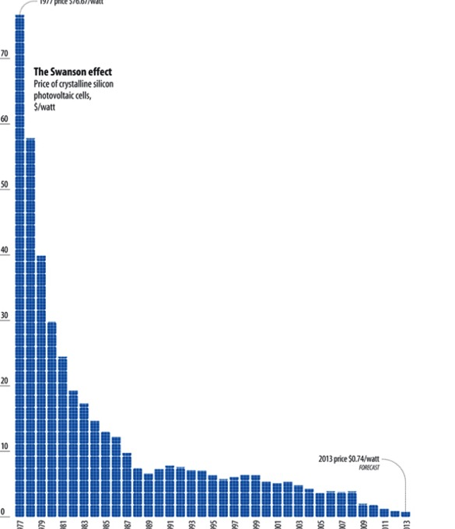
Part 3: Solar Economics
Solar is increasingly affordable
Costs have dropped 90% since the 1970s
Solar is no longer a specialty, expensive, or boutique project
But, can still be daunting to tackle
1970’s 2013

Slide 31
Part 3: Solar Economics
Electricity costs example over 20 years
Monthly purchase of solar kWh
One time purchase of solar array
years
years

Slide 32
Part 3: Solar Economics
Financing
Loans
Standard loans
Solar loans & bridge loans
HELOC

Slide 33
What’s Next?

Slide 34
What’s Next?
NEW URL
Join the CO-OP NAME
Join the listerv
Spread the word

Slide 35
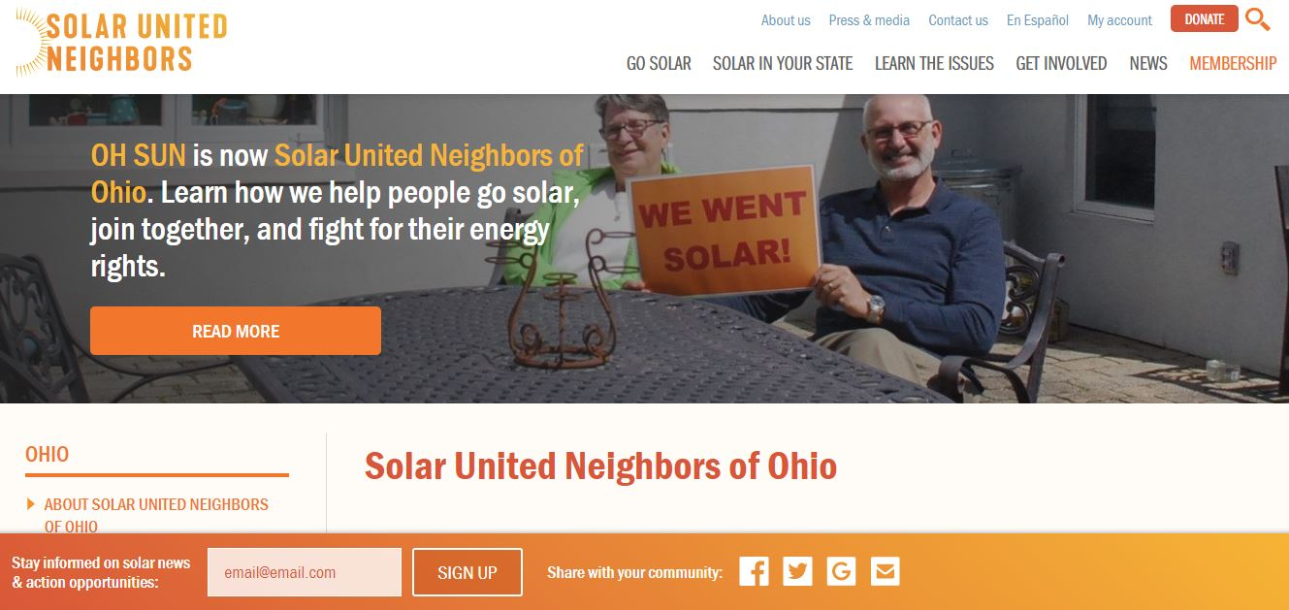
Useful Resource

Slide 36
Thank You!
PRESENTER NAME
Solar United Neighbors of Ohio

