Slide 1
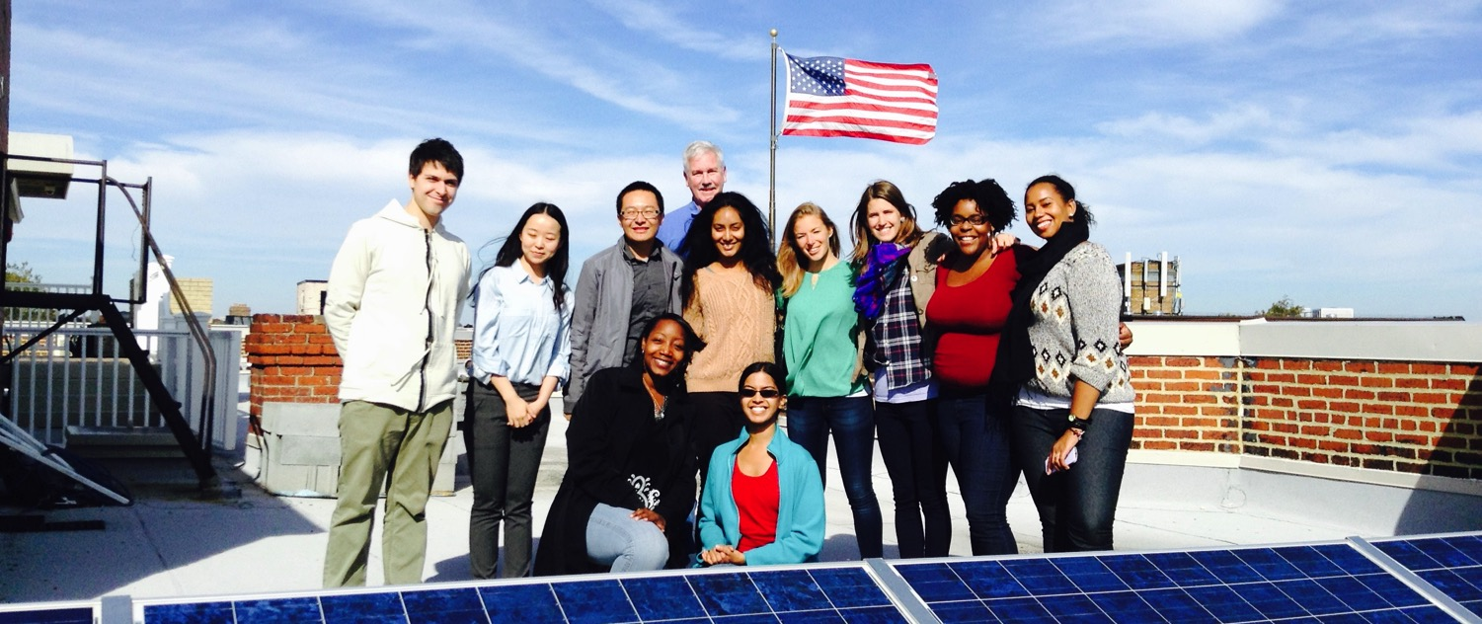
Solar 101

Slide 2
Overview
1. Who we are
2. How we got started

Slide 3
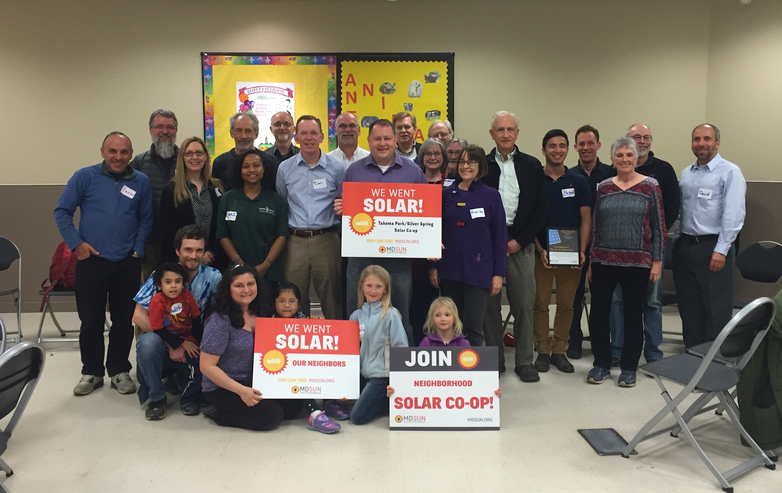
Who we are
We are a network of people taking control of our energy by installing solar and generating our own electricity.

Slide 4
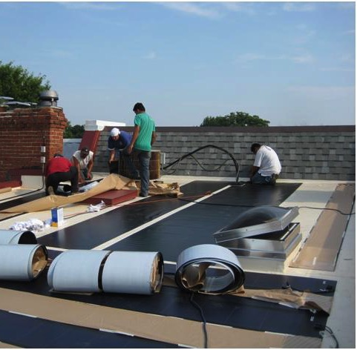
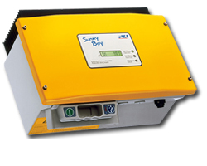
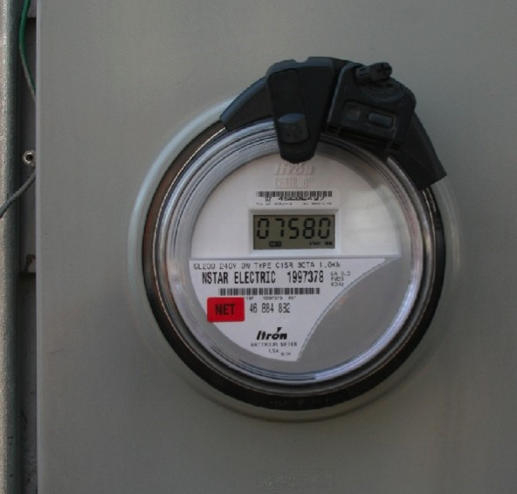
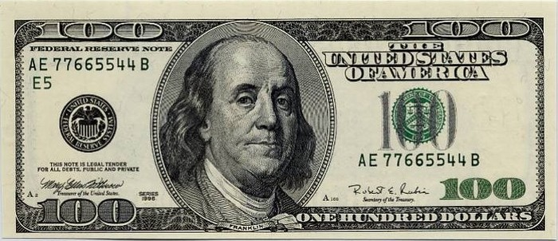
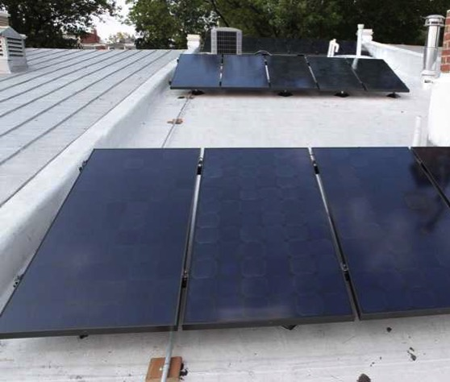
It was harder than we thought!
How we got started
Started in 2007 and it wasn’t easy!
Notes:
There were only two companies working in DC. They told us totally different things about how to install PV on our roof, and then there were the issues of Cost, equipment, taxes, regulations, rules, permits, meters, billing, historic association, SRECs, PSC

Slide 5
Helping communities go solar

Slide 7
Presentation in three parts
Solar technology
Solar economics
How solar co-ops work

Slide 8
Part 1: Solar technology

Slide 9
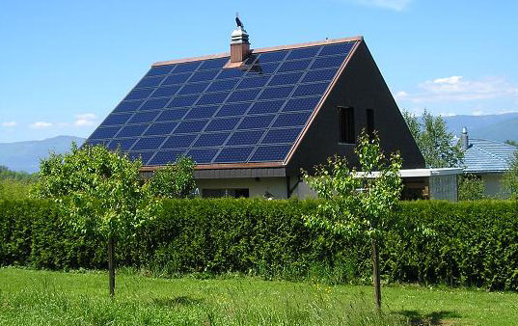
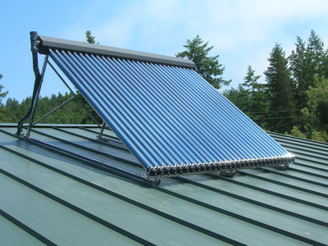
Part 1: Solar technology
Solar photovoltaic (PV)
Converts solar energy to electricity
Solar thermal / solar hot water
Uses solar energy to heat air or water

Slide 10
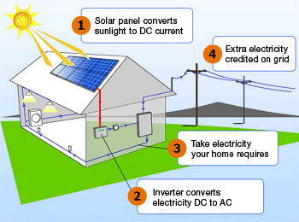
Part 1: Solar technology
How a solar PV system works (grid tied)
Via wattpatrol.com

Slide 11
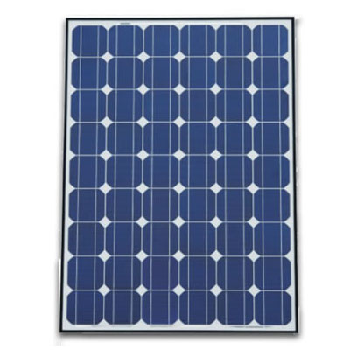
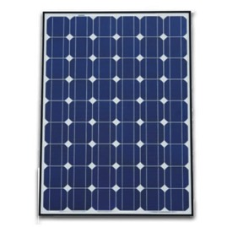
Part 1: Solar technology
System components: Panels
Cell
Panel / module
Solar array

Slide 12
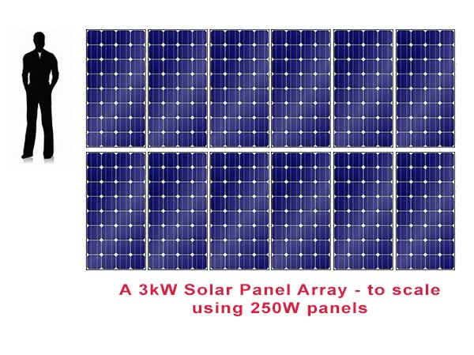
Part 1: Solar technology
Terminology: Kilowatts (kW) & kilowatt-hours (kWh)
System measured in kW
Electricity production in kWh
Most homeowners install between 2 kW – 12 kW

Slide 13
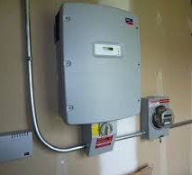
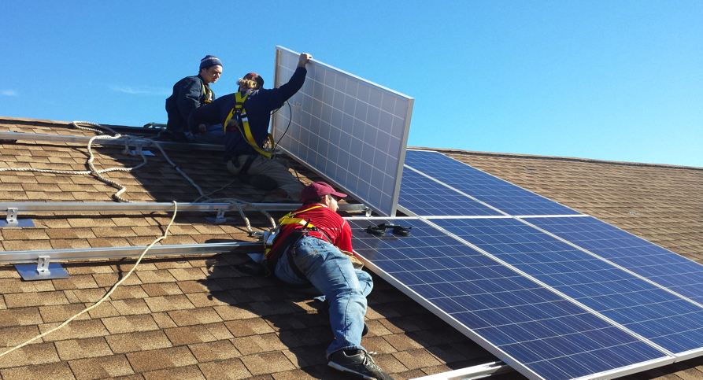
Part 1: Solar technology
System components:
Inverter & racking
Inverter
Racking system

Slide 14
Part 1: Solar technology
How does solar connect to my roof?

Slide 15
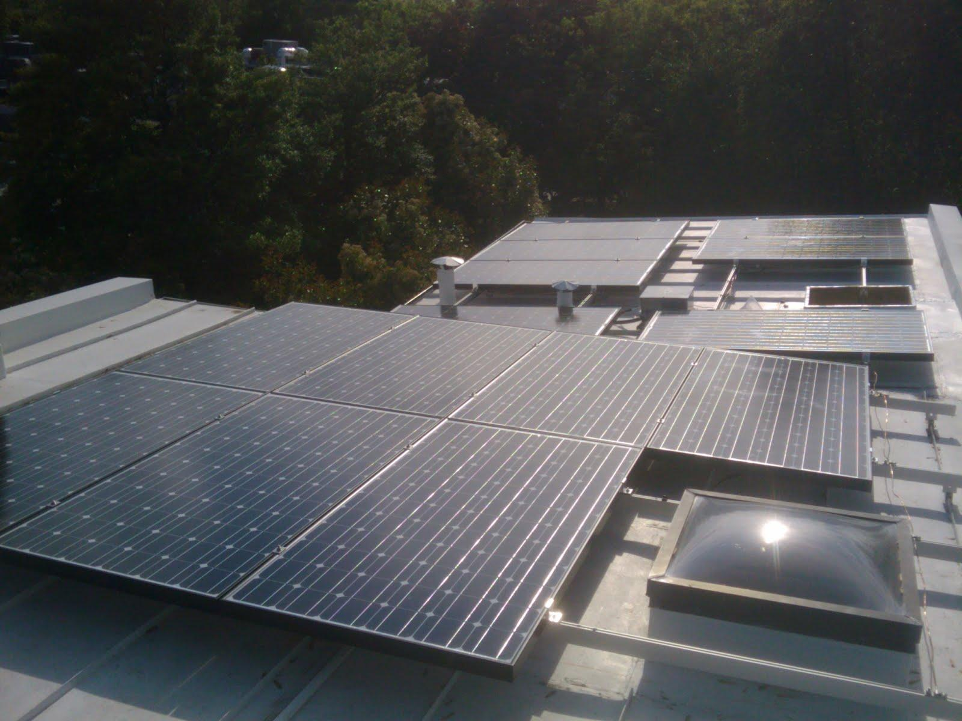
Part 1: Solar technology

Slide 16
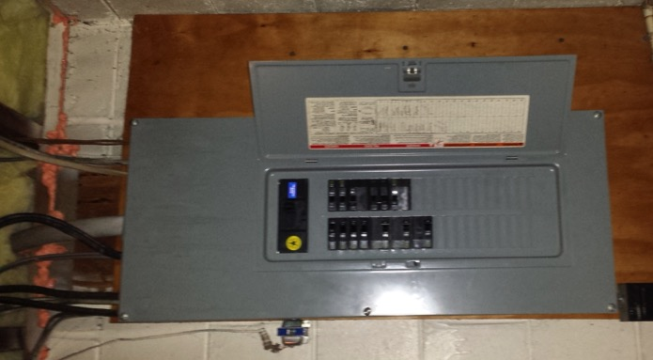
Part 1: Solar technology
How does it connect to my electrical panel?
Simple connection, most home electric systems don’t need upgrades before solar

Slide 17
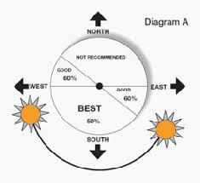
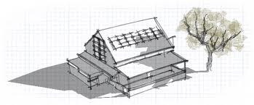
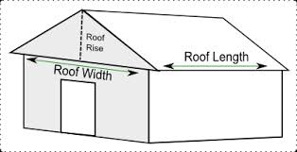
Part 1: Solar technology
What makes a site good for solar?
No shading
Roof faces southerly direction
Enough space to mount panels

Slide 18
Part 1: Solar technology
How a solar PV system works (grid tied)
Via wattpatrol.com

Slide 19
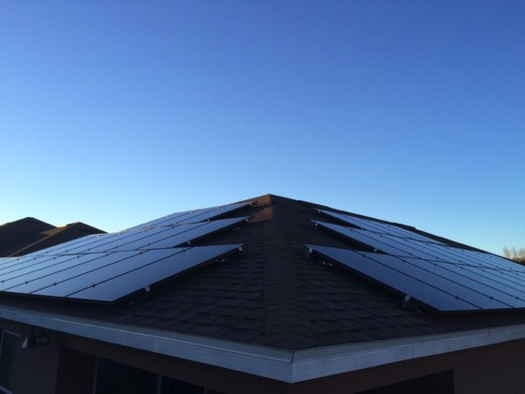
Part 1: Solar technology
What is net metering?
Allows flow of electricity to AND from customer
When generation is more than use, extra electricity flows back through meter
You receive a credit on your power bill for that excess production

Slide 20
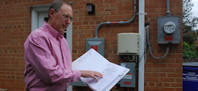
Part 1: Solar technology
Net metering, continued
Monthly electric bill:
[Amount electricity used] – [Amount electricity produced]
Utilities required by law to let you net meter

Slide 21
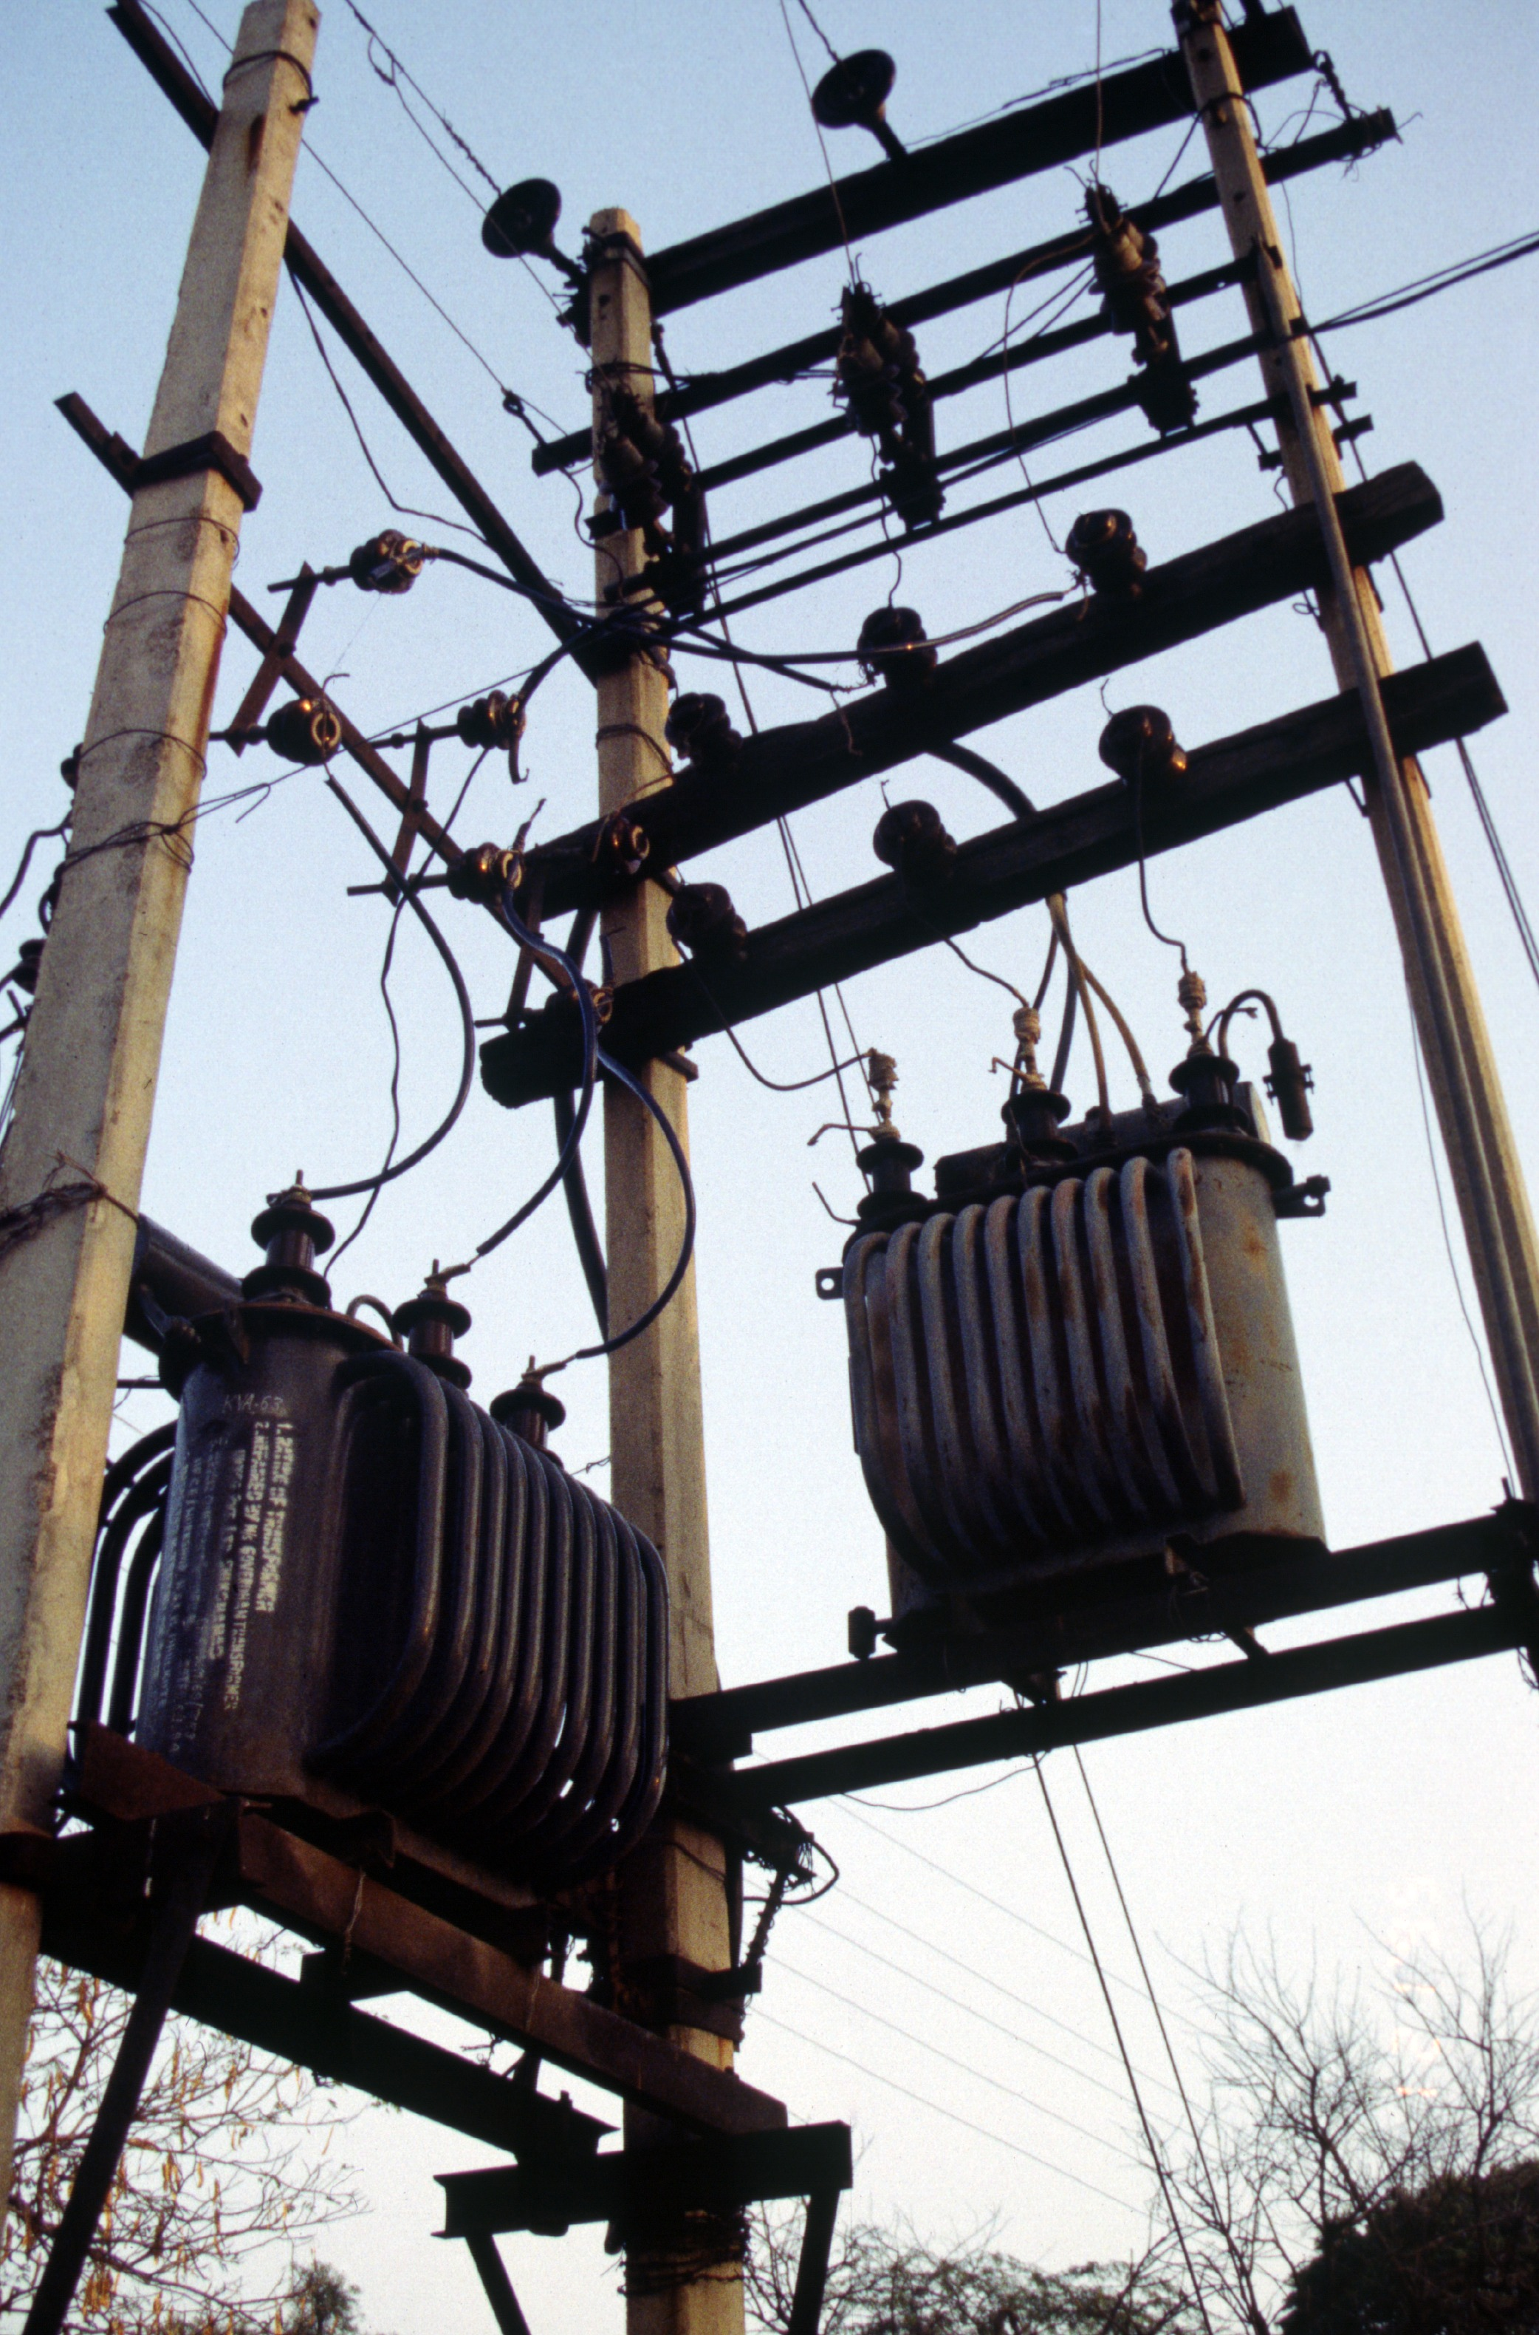
Part 1: Solar technology
What happens when the power goes out?
When grid is down, solar shuts off (safety mechanism)
Need batteries if you want you want power during outages

Slide 22
Part 1: Solar technology
Frequently asked questions
Warranties?
Homeowners’ insurance?
Maintenance?
How long do systems last?
Will HOA allow solar on my home?
What if I’m In a historic district?

Slide 23
Part 2: Solar economics

Slide 24
Part 2: Solar economics
A few considerations
Solar is long-term
No moving parts & 20-25 year lifespan
Average residential utility rate
Rising energy prices
Dominion: 20% rate increase in last seven years

Slide 25
Part 2: Solar economics
Pricing and investment
Solar is priced by the watt (not by panel)
Average 9 – 13 year return on investment in Virginia
Depends on site and pricing

Slide 26
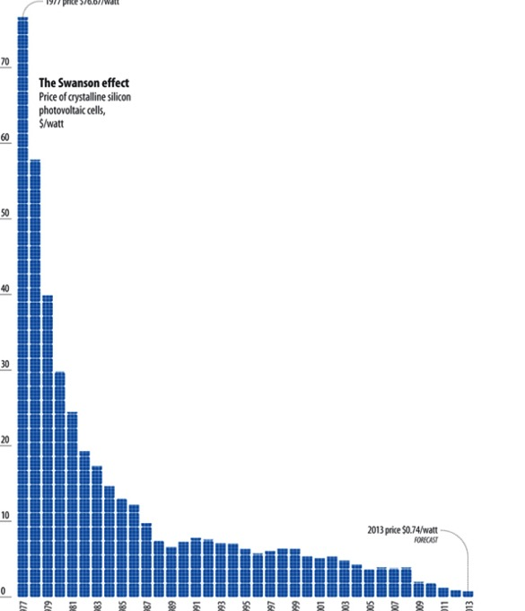
Part 2: Solar economics
Solar is increasingly affordable
Costs have dropped 90% since the 1970s
Solar is no longer a specialty, expensive, or boutique project
But, can still be daunting to tackle
1970’s 2013

Slide 27
Part 2: Solar economics

Slide 28
Part 3: Solar economics
Financing
Loans
Standard loans
Solar loans & bridge loans
Third party ownership
Leases

Slide 29
Part 3: How solar co-ops work

Slide 30
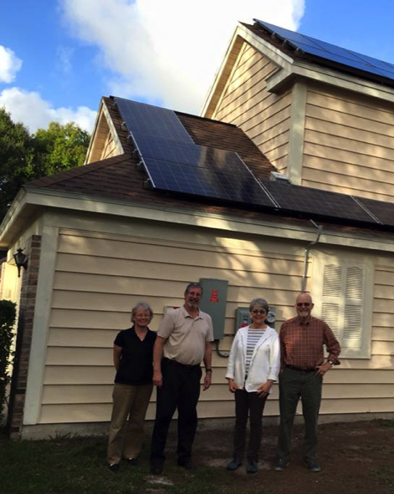
Part 3: How solar co-ops work
Solar co-op benefits
Get best value on installation and support throughout the process
Connect with fellow solar enthusiasts
Become part of the growing solar movement

Slide 31
Part 2: How Solar Co-ops Work
Insert new timeline graphic

Slide 32
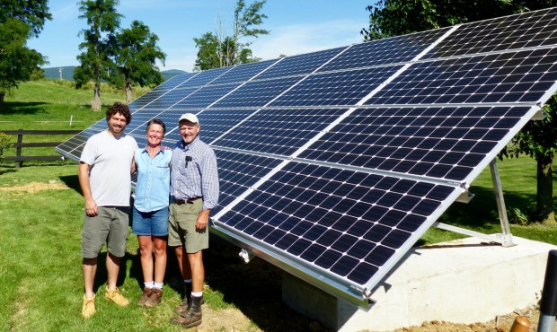
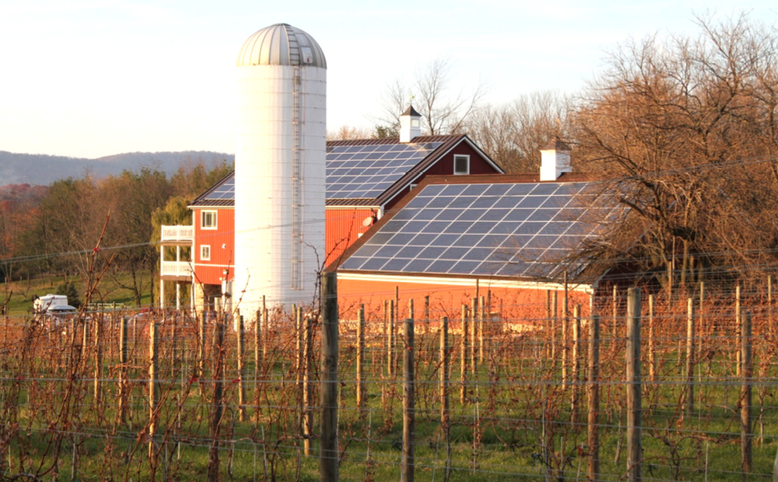
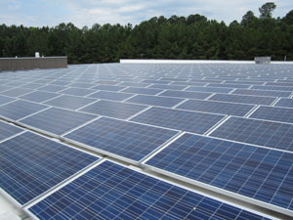
Part 3: How solar co-ops work
Who can join?
Homeowners
Businesses
Nonprofits
Farms

Slide 33
What’s next?

Slide 34
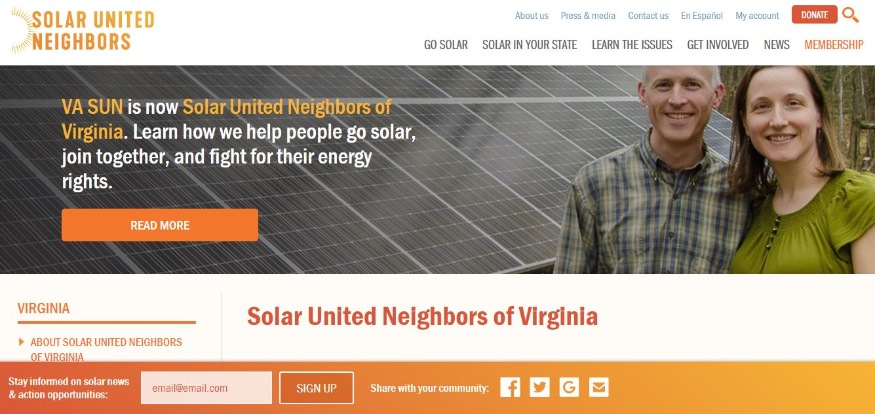
Useful Resource

Slide 35
What’s next?
Visit our website!
SolarUnitedNeighbors.org
Join the listerv
Spread the word

Slide 36
Upper Piedmont Solar Co-op
SolarUnitedNeighbors.org/UpperPiedmont
Winchester, Loudoun, Fauquier, Clarke, Warren, Frederick, & Rappahannock Counties
Sign up deadline: October 31

Slide 37
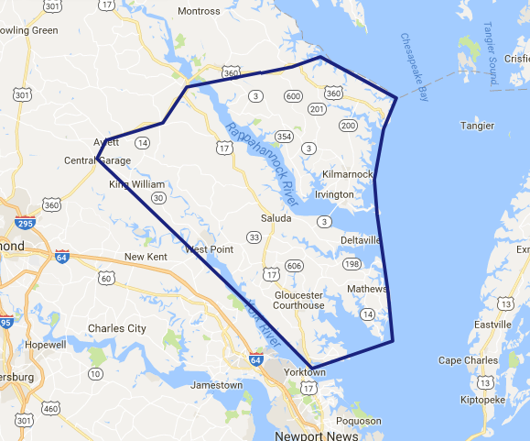
Three Rivers Solar Co-op
SolarUnitedNeighbors.org/ThreeRivers

Slide 38
Become a member!
Go solar on your own
We’ll review your proposals
Access to our Solar Help Desk
solarunitedneighbors.org/membership

Slide 39
Thank You!
Ian Reichardt
Solar United Neighbors of Virginia

