Slide 1
How to get paid
by having
Energy Storage
Will.Gathright@Tumalow.com

Slide 2
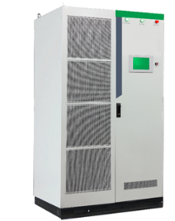
I want energy storage…
…and I have a budget to invest in it.
…and I’m not ready to make the upfront investment.
No Problem!
We install storage with no upfront cost. You’ll still get resilient, on-site power and better power quality.
Lower electric bills. We’ll share in the savings with you.
You’ll be cash flow positive from day one.
Great!
You’ll get resilient, on-site power and better power quality.
You’ll also get paid back 3 ways.
Lower electric bills
Tax credits
A lease payment from Tumalow

Slide 3
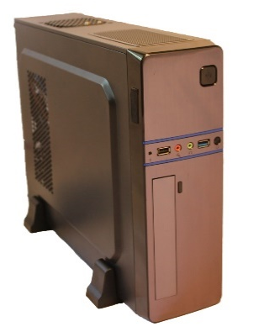
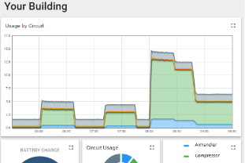
Step 1. Plug and play.
Install a Tumalow SmartTile into a your building – the world’s fastest and least expensive energy meter.
This takes 10 minutes.
Step 2. Gather data.
The SmartTile gathers and uploads electricity usage info.
This happens automatically.
Step 3. Analytics.
Storage “Test Drive” – a real time simulation of storage performance.
Financial projections using your real data.
Step 4. Install and Operate.
No-upfront cost financing through partners for qualifying projects.
After storage is installed, the Tile controls it. This happens automatically.

