Slide 1
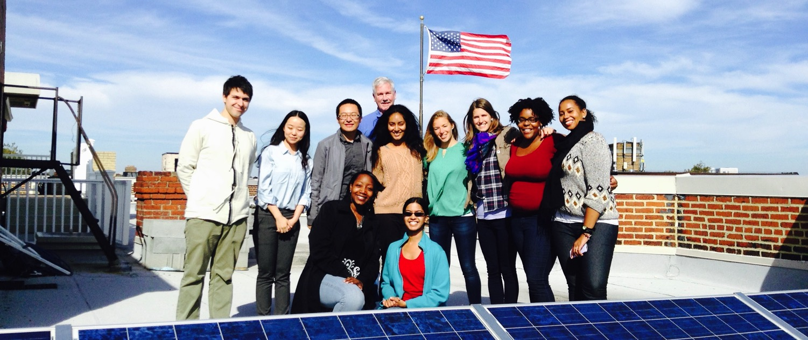
Storage Info Session
Notes:
This was designed for the Maryland program. The majority of the slides are applicable broadly but there’s also some state-specific content during the presentation and at the end

Slide 2
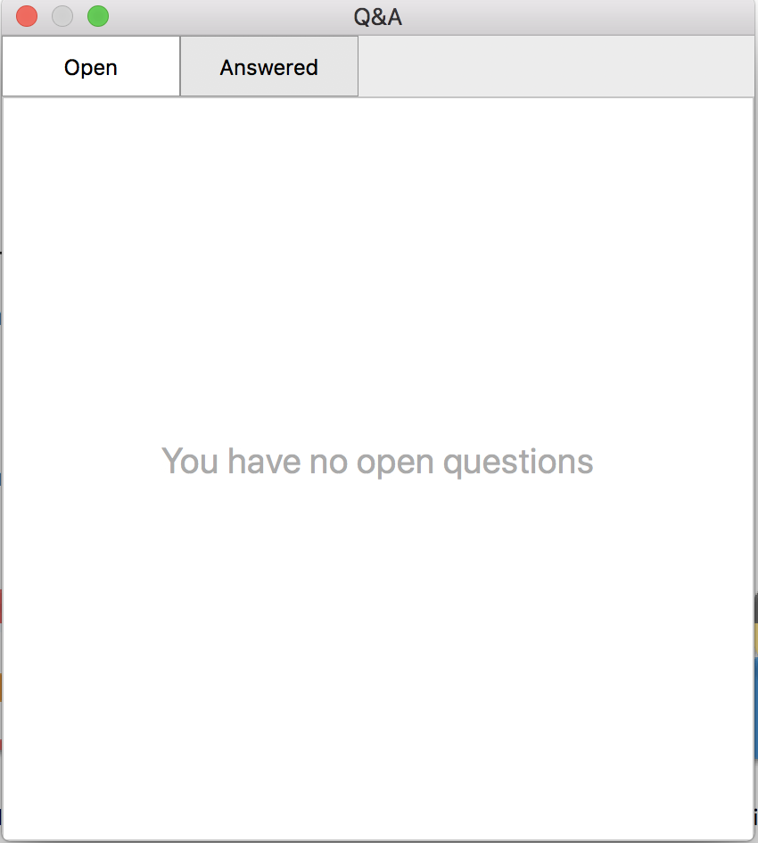
Housekeeping
45 minutes + Q&A
Send us questions via the Q&A feature
We’ll post a recording + slides on our website
Notes:
We’ll also stop to answer questions in between sections
We’ll be posting a recording of this webinar and a copy of the slides to our website

Slide 3
Overview
Who we are
How we got started

Slide 4
Who we are
We are a network of people taking control of our energy by installing solar and generating our own electricity.

Slide 5
Helping communities go solar

Slide 6
How we got started
Started in 2007 and it wasn’t easy!

Slide 7
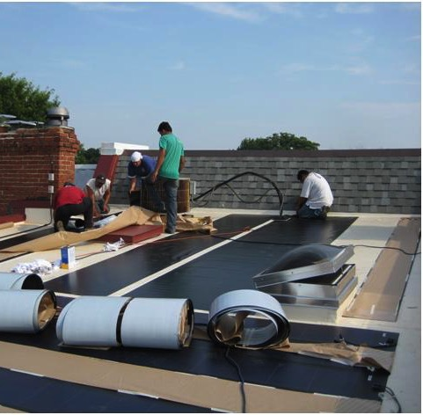
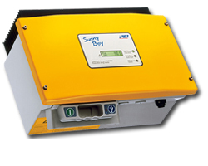
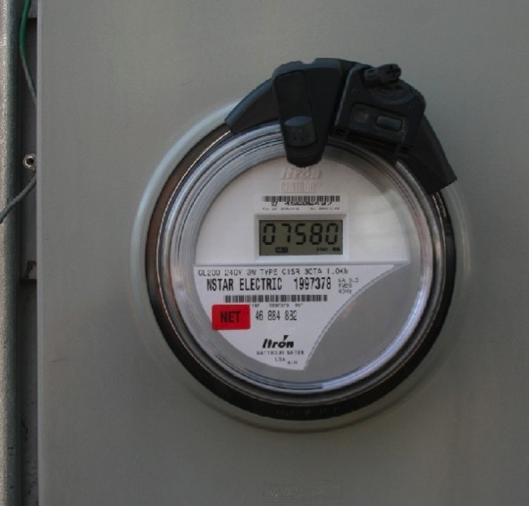
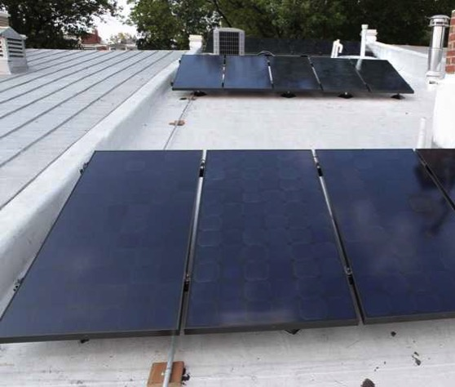
It was harder than we thought!
How we got started
Notes:
Main messages:
We do this for solar and have for years
Storage is new for us but we recognize that it’s becoming a bigger part of the market and people need information
Narrative:
There were only two companies working in DC. They told us totally different things about how to install PV on our roof, and then there were the issues of cost, equipment, taxes, regulations, rules, permits, meters, billing, historic association, SRECs, PSC. We worked through the co-op process to help people figure it out. Storage is right now in many ways where solar was back then with confusion about equipment, costs, permitting, incentives, etc. Gathering people together empowers participants, educates them as a group and enables them to work collectively

Slide 8
Presentation in three parts:
Technology
Economics
Our co-ops

Slide 9
Part 1: Technology

Slide 10
Two things to consider
Backup
Power for you
Save money or get paid to help the Grid
Notes:
Main messages:
Backup is what you can get now and there are different technologies that provide that.
Backup power does not make you any money. It will also make your solar array a little less efficient due to energy needed to keep batteries topped off.
Some storage technologies are resources that are flexible in how they can be used and their value may change if the rules of the grid change
Narrative:
Energy storage can do many things from providing backup power to supporting the expansion of renewable energy on the grid. However, it’s very important for you to understand that right now in {STATE}, the only thing that energy storage like batteries can do for you is to provide backup power and it will not make you any money. In fact, if you have solar it will actually reduce the economic impact of your solar for you because some of that solar energy will be used to top off your batteries and keep them ready for use instead of powering other things in your home or generating kilowatt-hour credits for you.

Slide 11
Batteries similar to generator
Source: alarmcentralsecurity.com
Source: Sonnen
Notes:
Main messages:
Currently in the states we work in, storage acts similarly to a backup generator.
Batteries are cleaner and can run with sun as the fuel.
Fossil-fuel powered backup generators can also be an economic source of backup power.
We’re talking about battery backup for grid-tied homes and not about homes that do not have utility electricity service (“Off Grid”)
“Off Grid” systems are similar but include other considerations we don’t cover here
NOTE: “Off Grid” has to be designed to have your full electric load run completely (day in and day out) on a combination of solar, batteries, generators, and possibly other sources like wind and hydr

Slide 12
What can batteries power?
Critical home loads
Storage during a utility outage
Seamless backup power
Typically only power critical loads
Matched to battery size/amount
“Critical loads sub-panel”
Source: SolarCity
Notes:
Main messages:
When the power goes out the batteries kick in seamlessly
It’s uneconomical for people to power their entire home on batteries right now so you will likely need to choose what to run in an outage
A “backed up or critical loads” sub-panel is installed and circuits you want to power in your home during the outage are put there
When the grid goes out the battery backup system disconnects that sub-panel from the grid and powers it until the grid comes back up

Slide 13
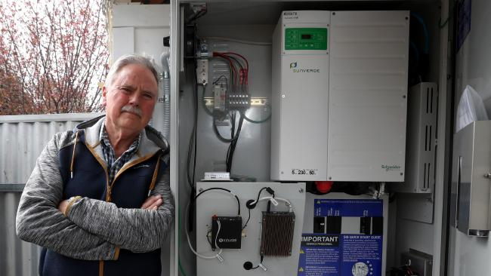
What can batteries power? (small example)
6 kWh Battery Bank
Fully re-charged by solar (5.6 kW) daily
NOTE: No solar = 1 day only
What will run when the power is out:
Refrigerator; small microwave
Some lights; some outlets
Cable modem
What they chose not to power:
Stove; dryer; electric water heater
The Johnsons lose power from the utility several times a year.
Each time the power is out for at least a day.
Notes:
Main messages:
It’s important to limit your expectations on how much your energy storage can cover while the power is out
What you power depends on your budget and the space you have for batteries
Your installer will help you figure out the right solution for you
This example would only power a couple of circuits in your home
NOTE: The Johnsons are a fictional example
Narrative:
Energy storage in the home is right now all about backup power. That means when the power from the utility goes out the energy storage will kick on and run part or all of your home until the utility power returns. How much of your home can run on batteries? That depends on how much you want to spend. It’s very common for homeowners to over-expect how much they can run on their energy storage system. Because energy storage like batteries is still expensive you’re probably going to only power the really important stuff while the grid power is out. Here’s an example of the kinds of things someone might typically power in an emergency power outage.

Slide 14
How does storage work with solar?
Installation:
Same time as solar or retrofitted
May require additional hardware
Solar + Storage:
Solar charges batteries for later use
Grid energy can also charge batteries
Small amounts of energy keep batteries “topped off”
Batteries only kick in (automatically!) when power is out
Source: Sunrun
Notes:
Main Messages:
Solar is the fuel to keep batteries charged up when the power is out
Batteries can be installed at the time of solar installation or retrofitted later.
If storage is of interest for later talk to your installer about a battery-ready solar system.
There may be some considerations in the design of your solar system to make installing batteries easier later down the road.
{Only mention for multi-state audiences}
In places where it makes sense economically, solar can charge energy during the day and you can use it at night
Narrative:
Just like a generator, when the power goes out your batteries kick in. There’s no need to flip switches. The power just comes on instantaneously and powers the parts of your house you chose to run off your batteries. The solar charges your batteries by day and powers your house too when there’s excess energy. The batteries power your house by night and when there’s not enough solar power to meet your energy needs while the grid is down. When the grid comes back up the batteries shut off and you back to using the grid and solar automatically.

Slide 15
How is storage sized?
Energy vs Power
Energy
Amount of work the battery can do over time
Measured in kWh
Power
Maximum work it can do at any given time
Measured in kW
Your storage system will be custom for you:
How much energy do you consume?
What do you need to power during an outage?
Available space for storage?
Source: SimpliPhi
Notes:
Main Messages:
Your installer will help you size your system appropriately based on what you want or need to power when the grid is out and your budget
Systems are measured in how much energy they can hold (kWh) and how much power they can put out at one time (kW)
Your installer will help you size your system appropriately but we’ll give an example of an average system later
NOTES:
Example to clarify difference between energy and power. Only use this if someone asks and there’s time to provide during the presentation
Running a 100 Watt light for 25 minutes and running a 1500 Watt microwave for one minute use the same amount of energy (25 Watt-hours)
But the microwave needs 1500 Watts of power all at once and the light bulb only needs 100 Watts at any given moment
If your battery could only produce 1500 watts of power at once you couldn’t run the light bulb and the microwave at the same time

Slide 16
Connecting your batteries to your home
“AC Coupled”
“DC Coupled”
Solar
Panels
Standard Home
Electrical System
Solar
Panels
Standard Home
Electrical System
Inverter
Inverter
Inverter(s)
Batteries
Batteries
Notes:
Main Messages:
There are two ways batteries are connected to solar arrays and to the main electrical system of the home
Most battery systems that already have PV will be configured by AC-coupling.
What you end up with depends on a number of factors including:
If you install it with solar
The location of your batteries and solar array
Narrative:
This gets technical very quickly but high level, know there are two main ways battery storage can be connected to your solar array. The solar installer will help you determine which one makes the most sense for you and your circumstances.

Slide 17
Most common home batteries
Lead-acid
Lithium Ion
But wait, there’s more!
Pros:
Lower upfront cost
Tried and true
Cons:
Maintenance requirement
Slow energy discharge (power)
High space requirement
Shorter lifespan
Less usable energy per cycle
Pros:
High energy density
Lower lifetime costs
Longer lifespan
Small space requirement
More usable energy per cycle
Cons:
Higher upfront cost
Newer to market
There are other chemistries used in battery applications, but their deployment is much less common
Notes:
Main Messages:
Lead acid has been around a while, costs less and can be a great form of backup power
Lithium ion is newer but lasts longer, comes with better warranties and costs more upfront
There are other battery chemistries out there but so far the ones that have been around the longest and/or are being produced at scale are Lead-acid and LiOn
Examples of others (flow batteries, Nickel-Iron (NiFe), others?)
Narrative:
We want you to know the different options out there but don’t worry about becoming an expert in them. It’s important to know what options your installer offers, some basic differences between them and the benefits/drawbacks of each.
NOTES:
Usable Energy = Depth of Discharge
Can both batteries be “recycled”? – yes but lead acid recycling is much more commonly available due to automotive batteries
If someone asks about the two different kinds of Lithium Ion available:
Li-ion-NMC = Lithium Nickel Manganese Cobalt Oxide
- More common and less expensive but also the same form that can experience thermal runaway. No examples we about of this happening with home storage though
- Tesla and LG use this
Li-ion-LFP = Lithium Ferrophosphate (LiFePO)
- Less common in currently available offerings, more expensive, and more stable
- Sonnen and Enphase use this

Slide 18
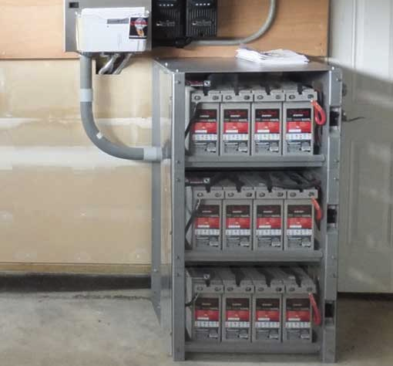
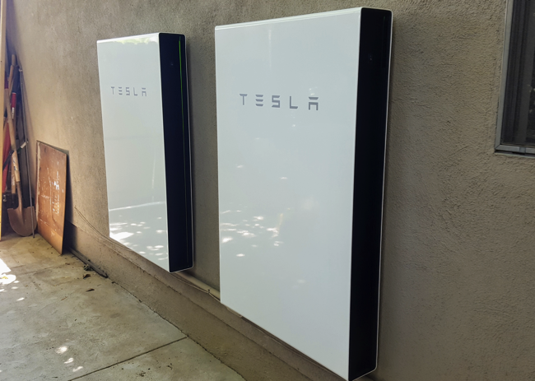
Operations and Maintenance
Space Requirements
Lead Acid
Small, shoe box-sized battery
Wired together in a group
Can sit directly on floor or shelf
Requires more space
Lithium Ion
Single, larger box
Wall-mounted or floor-mounted
Can often also be wired together
Source: Fire Mountain Solar
Source: Clean Technica
Notes:
Main Messages:
Lead-acid batteries take up more space and depending on local codes, may require special venting

Slide 19
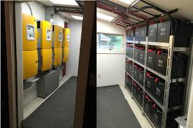
Operations and Maintenance
Siting Considerations
Batteries function best in controlled environments
Specific conditions depends on chemistry:
Lead-acid
Stable temperatures (ideal: 50℉ – 80℉)
No extreme heat or freezing air
Often installed indoors (garage/basement)
Special ventilation required for unsealed batteries
Lithium Ion
Wider temperature range (~32℉ - 100℉)
Some can be installed outdoors in stable climates
Notes:
Main Messages:
Your installer will help you decide the best place to put your batteries based on available space, electrical codes, and battery type requirements
NOTES:
Tesla Powerwall and LG Chem can go outside

Slide 20
Operations and Maintenance
Warranties
Two common warranty types:
Specific time period (years) OR duration of use (cycles)
Typical Li-ion warranty: 10 years
Examples:
Sonnen: 70% of max. capacity for 10,000 cycles (or 10 years)
Tesla: Free of defects for 10 years with unlimited cycles
Typical lead acid warranty: 2 to 5 years
Installer’s labor should be warranted (wiring)
Note: Solar panels are warranted for 25 years
Source: https://blog.pickmysolar.com/home-battery-backup-comparison-tesla-sonnenbatterie
Notes:
Main Messages:
Warranties can vary across battery type and manufacturer
10 year warranty is common for Lithium Ion but there are variations (cycles, % of capacity still available by 10 years)

Slide 21
Other considerations
Insurance
Local permitting requirements
Utility requirements
Installer qualifications
Equipment availability
EVs
Source: www.24hplans.com
Notes:
Main Messages:
Batteries are not very common for residential homes so codes have not necessarily caught up.
Be prepared that there may be snags during permitting. Your installer will navigate this with you.
For backup power you shouldn’t need utility approval but that may vary by utility
It’s important to understand the experience level of your installer. Are they new to this too? Are you okay with that?
Equipment availability can be a challenge. Ask your installer to clarify if they can quickly get the equipment you want
Do you have an EV? it may be possible to use your EV storage as a temporary backup generator but you should research your options carefully to make sure you can do this with your EV safely and without voiding any warranties

Slide 22
Part 2: Economics

Slide 23
Installing Storage with Solar vs. Later
With Solar
Immediate backup power benefits
May reduce some shared labor and admin costs by paying a contractor once instead of twice
Eligible for solar Federal Tax Credit
Later
Solar now and wait for battery prices to fall further
Most likely AC-coupled
Requires an additional inverter
Uncertain eligibility for solar Federal Tax Credit
Notes:
Main Messages:
Battery prices and technology are changing quickly. If you wait, be aware that your “battery ready” solar array may still require some changes to work with batteries
Sometimes “additional inverter” is built into the battery product so be sure you are comparing the full installation price that includes additional equipment
Batteries must be charged 100% by solar to take 100% of solar tax credit
This isn’t tax advice. Confirm with a tax advisor to understand your situation.
NOTES:
Tidbit: Electric vehicle batteries may start getting re-purposed for home storage in the future as well which will add to cost declines. They still have life, just aren’t usable for car’s needs

Slide 24
How is storage priced?
Total cost = hardware costs + installation costs + lifetime maintenance costs
Hardware +
Price per kW (power)
OR
Price per kWh (energy)
Note: Depends on battery type and and installation of new inverter
(for AC coupling)
Installation +
Cost of design, installation, and permitting
Additional equipment
Lifetime maintenance
Battery replacement
Associated labor cost
$$$ $$ $
Notes:
Main Messages:
Hardware is the storage only
Installation is additional equipment, design, permits, labor, inspection, and overhead
Maintenance is a catch all that acknowledges you may need to contact your installer for help down the road before the battery life is up

Slide 25
Basic cost estimates (example)
Hardware cost (examples) +
Installation costs +
$3,000 - $5,000 for standalone installation and additional equipment
Maintenance costs
Varies between installers and battery chemistries
Equipment | Cost | Size
Powerwall 2 (Li-ion) | $6,200 | 13.5 kWh
Powerwall 1 (Li-ion) | $3,000 | 6.4 kWh
LG Chem (Li-ion) | $6,000 | 6.6 kWh
Sonnen Eco 4 (Li-ion) | $10,000 | 4 kWh
Sealed Lead Acid | $5,200 | 12 kWh
Pricing for our small 6 kWh battery example:
~$6,000 + $4,000 + $1,000
= ~$11,000
Notes:
Main messages:
Your cost is going to vary (possibly significantly) by the technology you choose and by battery capacity
Mention that some battery offerings come with an inverter built in and some don’t. The total installation cost to consider should include all equipment and install costs
Narrative:

Slide 26
Basic cost estimates
Backup
Power for you
For backup power applications, remember:
Value only when the grid is down
No cost savings/earnings over time
Notes:
Main Messages:
Backup is what you can get now and there are different technologies that provide that.
Backup power does not make you any money. It will also make your solar array a little less efficient due to energy needed to keep batteries topped off.

Slide 27
Federal Tax Credit for Storage
30% federal tax credit available for storage systems that are 100% charged by solar
Value: 30% of the total system cost (hardware + installation) for fully solar-charged batteries
Storage systems that are at least 75% charged by solar are eligible for a portion of the full tax credit
Storage system that are less than 75% charged by solar are ineligible for the tax credit
Notes:
Main Messages:
Batteries must be charged 100% by solar to take 100% of solar tax credit
This isn’t tax advice. Please consult an account or tax attorney on your particular situation
Mention step down in 2019 to 26% and then 22% in 2020
Recent private letter rulings confirm that the IRS is okay with retrofits as long as charging from the sun happns
https://www.greentechmedia.com/articles/read/irs-says-that-batteries-can-take-the-federal-tax-credit#gs.LiKlJkw

Slide 28
Maryland-Specific Considerations
Maryland’s Storage Tax Credit (Residential and Commercial)
Legislation passed in 2017
Run by Maryland Energy Administration
How it works for residential installations:
30% state income tax credit (= 30% of total storage cost)
Maximum tax credit: $5,000
Available for systems installed by December 31, 2022
First come, first serve application process
System must be installed and paid for before you can apply
No restrictions on battery type/manufacturer
Maryland tax credit does not interfere with your ability to take the federal tax credit
Notes:
Main Messages:
Have to be primary residence
Non-refundable tax credit (must have enough tax liability)
Must take it all in one year
Installed and inspected during the tax year to qualify
Mention MEA’s max pool of money – will issue residential tax credits on a first come first serve basis until $225,000 allocation for tax year 2018 is used up ($525,000 allocated for commercial installs)
Systems installed in 2018 can not get 2019 tax credit
Documentation required (your installer will likely help)
Paid in full invoice w/ $0 balance
Required permits and proof of final inspection
Equipment certifications from national labs for equipment
Equipment spec sheets
Photos of installed system

Slide 29
Part 3: Our co-ops

Slide 30
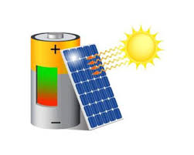
Join the Storage Co-op!
Already have solar on your home or business,
and want to install storage?
Join Maryland’s first ever storage co-op!
Notes:
Main Messages:
Storage is new to us too but we’re taking our solar co-op experience and model and applying it here to help homeowners figure it out together

Slide 31
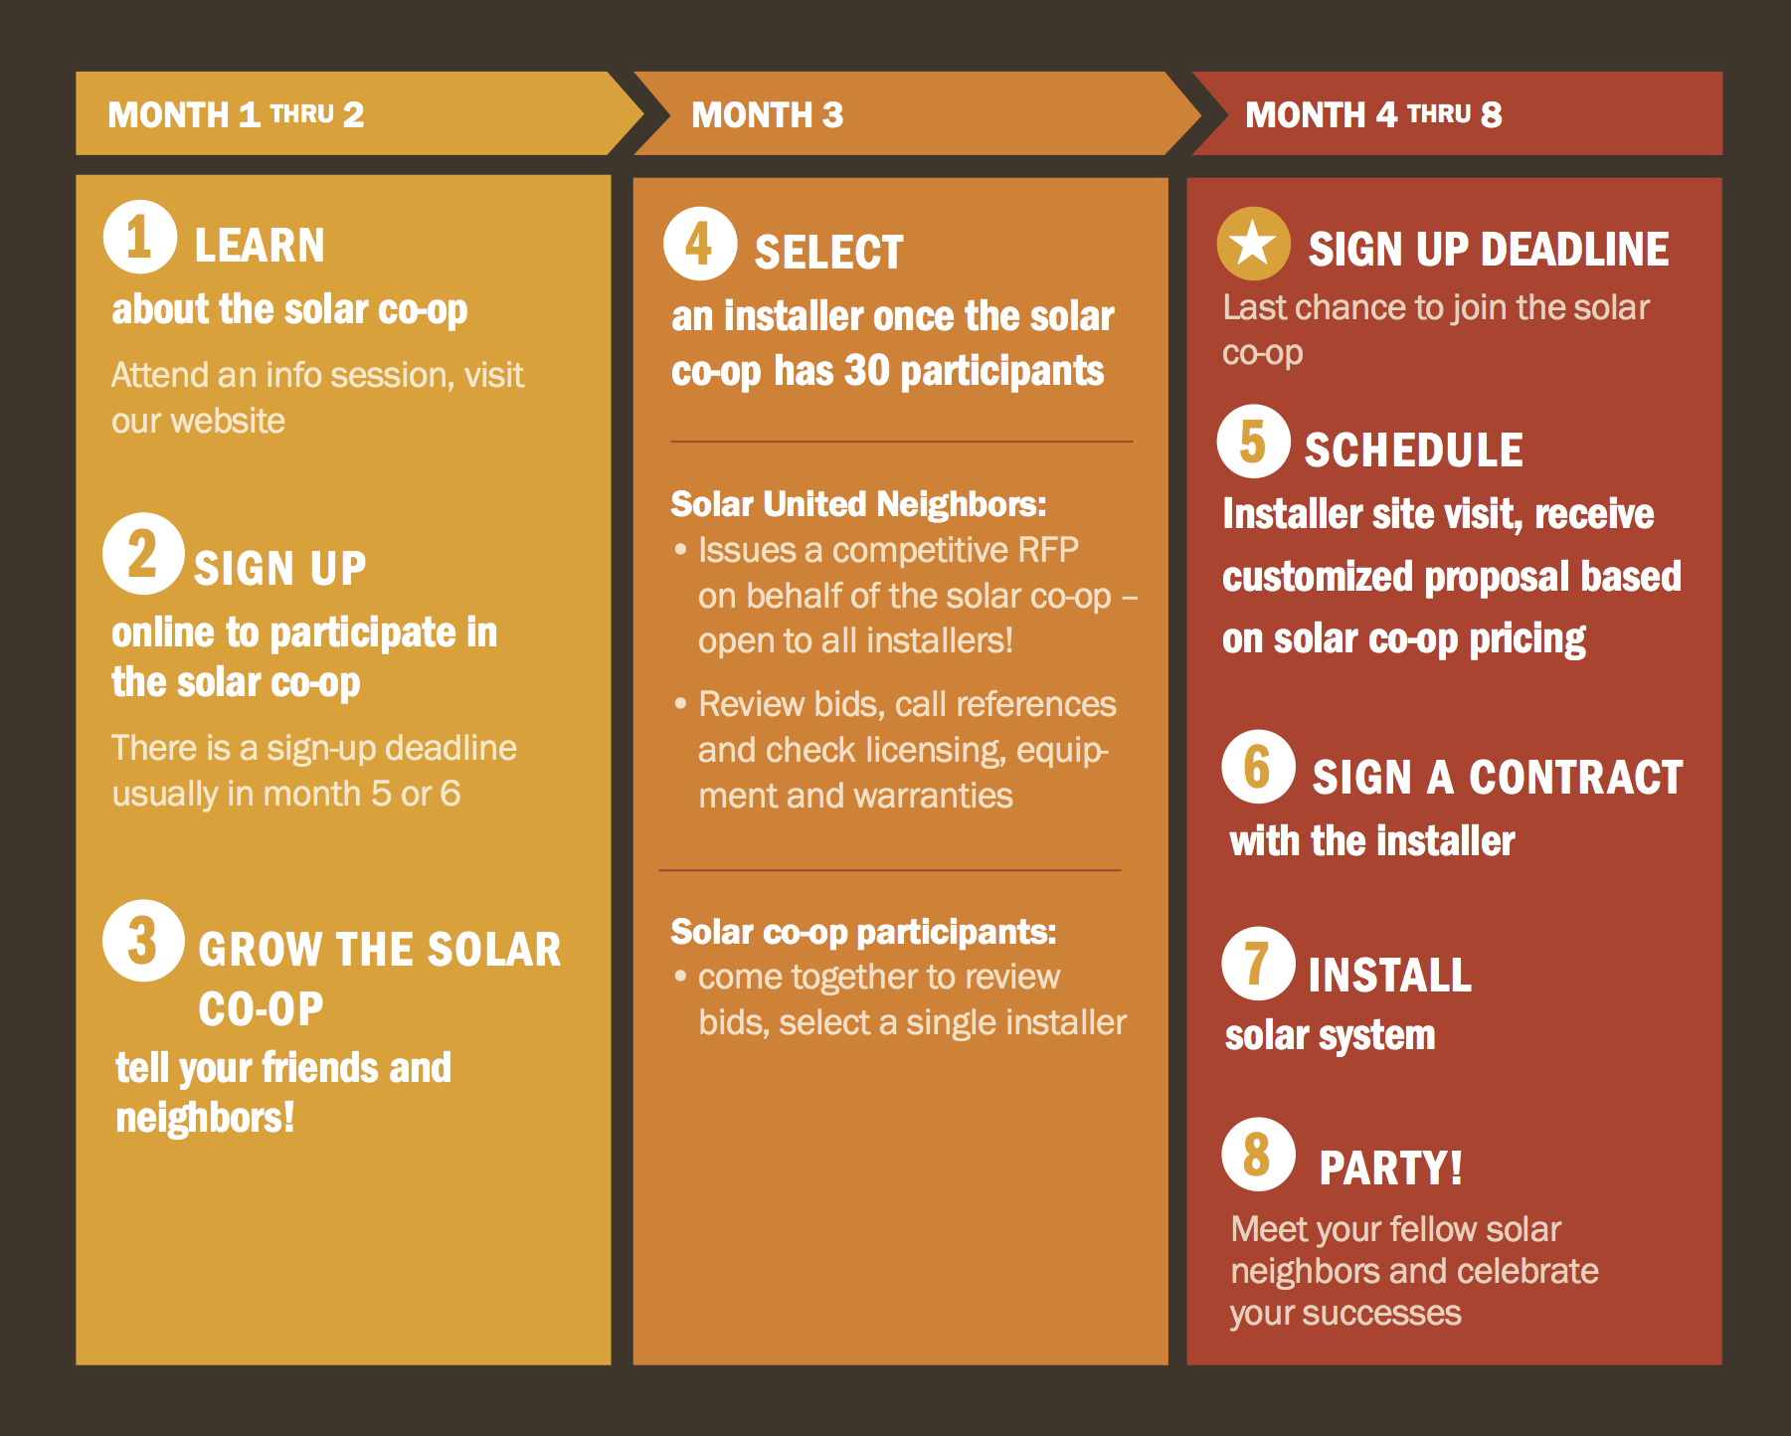
Part 2: How Solar Co-ops Work

Slide 32
Storage Co-op Specifics
Who can participate?
Existing solar PV owners (residential or commercial)
Those interested in storage for backup power during grid outages
Any solar owner in Maryland
This is a pilot
Why participate?
Learn about different storage products and opportunities
Select a battery installer as a group
Technical support of Solar United Neighbors of Maryland
Assistance in reviewing proposals and applying for the state tax credit
Notes:
Main Messages:
We’re simplifying the process by only working with existing solar homeowners so we can focus on storage
This is a pilot, we’re game for figuring this out with you because we don’t have all the answers

Slide 33
Storage Co-op Specifics
Timeline
February - Maryland Storage Tax credit application opens
February - Group opens for sign-ups
March/April - Release Request for Proposals to area installers
April - Group selects installer
May to Fall - Participants sign contracts and complete installations

Slide 34
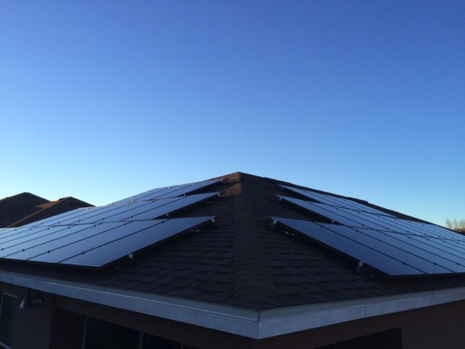
What’s next?
Join the Storage Co-op
www.solarunitedneighbors.org/mdstorage
Join the listerv
Like us on Facebook! (/SolarUnitedNeighborsofMaryland/)
mdteam@solarunitedneighbors.org
Notes:
A copy of the presentation slides and a recording of this will be made available on the storage co-op page above

Slide 35
Thank You!

