Slide 1
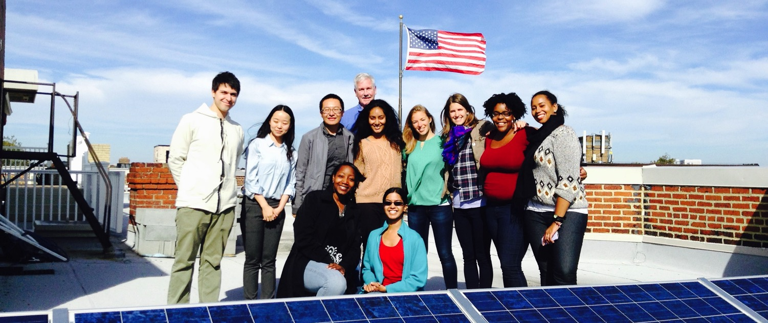
Solar Info Session

Slide 2
Overview
Who we are
How we got started

Slide 3
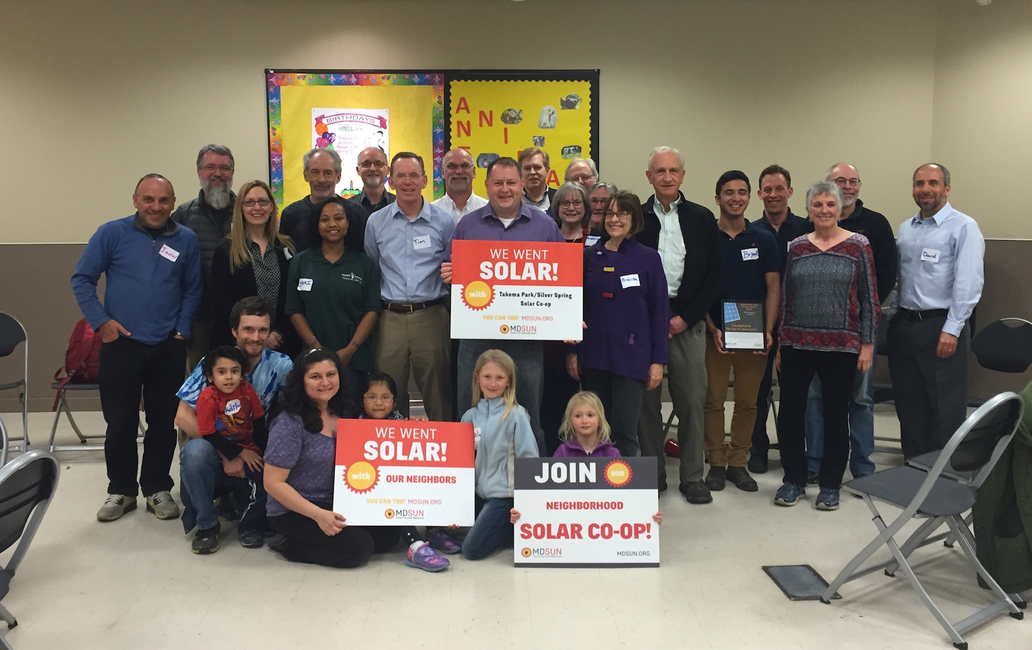
Who we are
We are a network of people taking control of our energy by installing solar and generating our own electricity.

Slide 4
Helping communities go solar

Slide 5
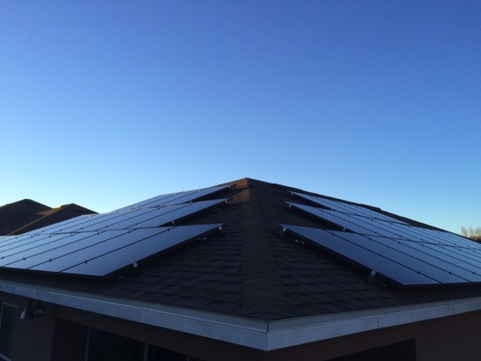
How we help you go solar
Co-op/group purchase
Individual Support
50 – 100 neighbors
Group decision process
6-8 month process
Bulk negotiation for best pricing
Sign individual contract
Help reviewing up to 3 proposals
Negotiate your own deal
Can be faster timeline
Ongoing advice & assistance (post install)
$85 annual membership

Slide 6
Presentation in three parts:
Solar technology
How solar co-ops work
Solar economics

Slide 7
Part 1: Solar technology

Slide 8
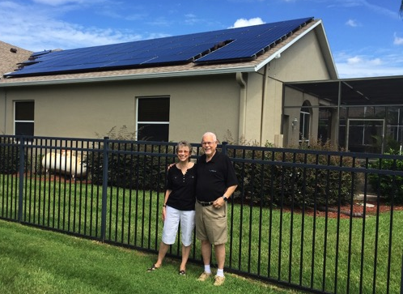
Part 1: Solar technology
How does a solar panel work?
Solar photovoltaic (PV)
Converts solar energy to electricity

Slide 9
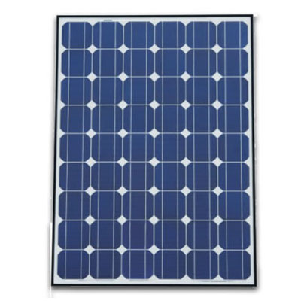
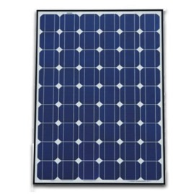
Part 1: Solar technology
System components
Panels
Cell
Solar Array
Panel / Module

Slide 10
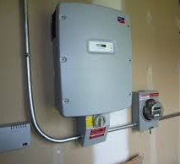
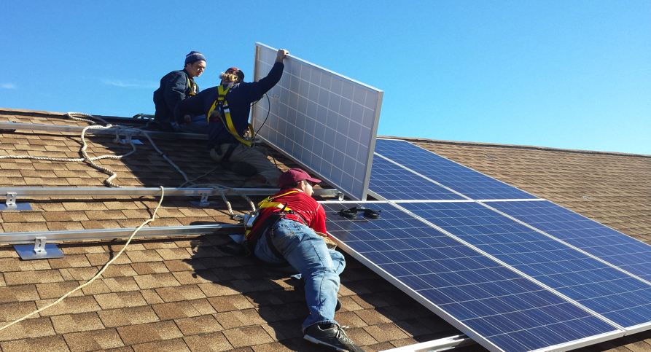
Part 1: Solar technology
System components
Inverter(s)
Racking system
Inverter
Racking system

Slide 11
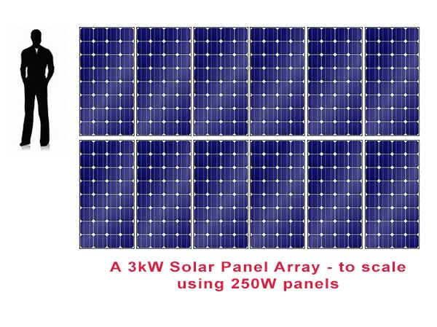
Part 1: Solar technology
Terminology
Kilowatts (kW)
Kilowatt-hours (kWh)
System measured in kW
Electricity production in kWh
Most homeowners install between 2 kW – 12 kW

Slide 12
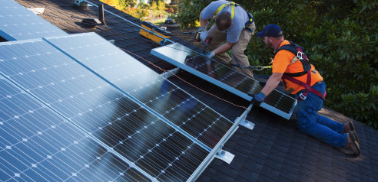
Part 1: Solar technology
How does solar connect to my roof?
Installation
Taken from www.huffingtonpost.com

Slide 13
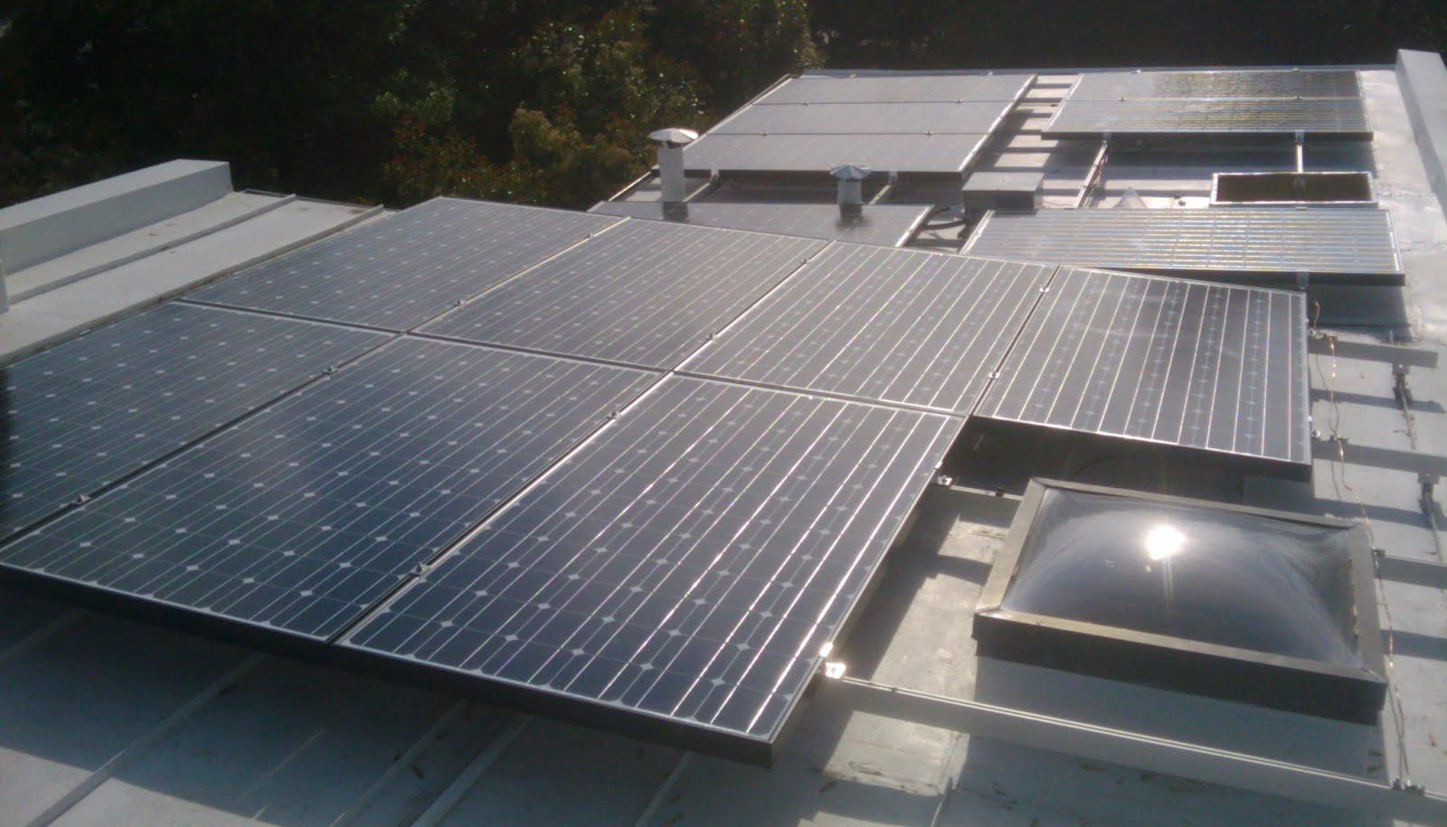
Part 1: Solar technology

Slide 14
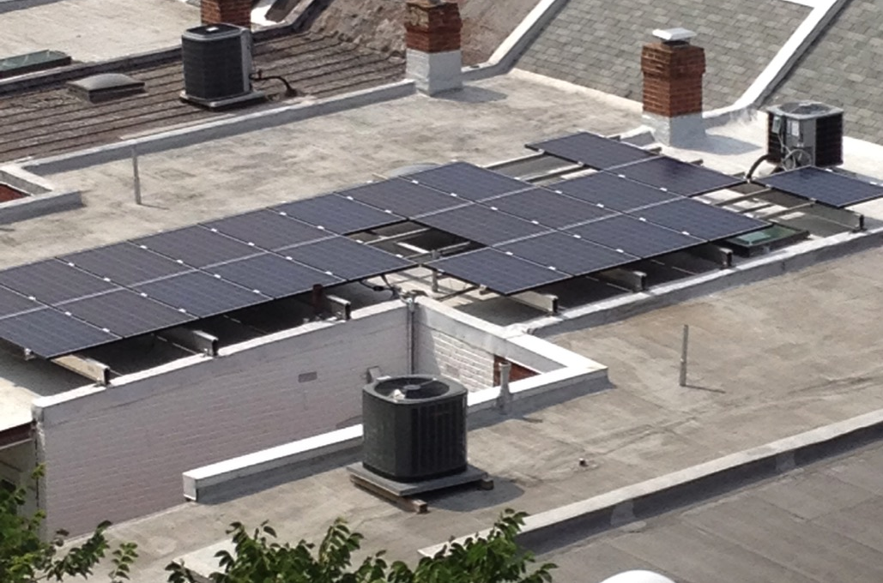
Part 1: Solar technology
Flat Roof Installation Example

Slide 15
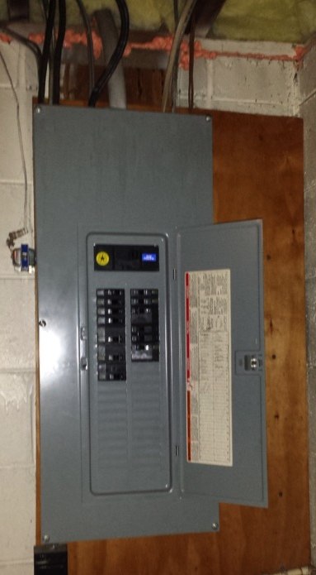
Solar Co-op Information Session
Part 1: Solar technology
How does it connect to my electrical panel?
Simple connection
Most home electric systems don’t need upgrades before solar

Slide 16
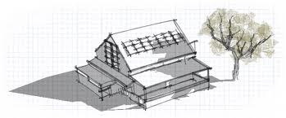
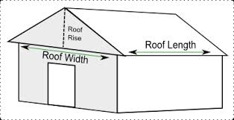
Part 1: Solar technology
What makes a good site for solar?
No shading
Roof faces southerly direction
Enough space to mount panels

Slide 17
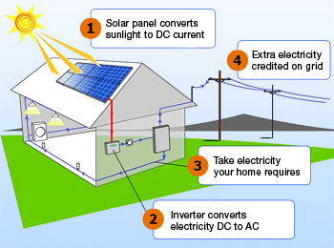
Part 1: Solar technology
How a solar PV system works (grid-tied)
Via wattpatrol.com

Slide 18
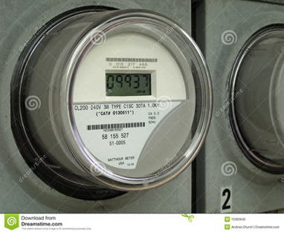
Part 1: Solar technology
What is Net Metering?
Allows flow of electricity to AND from customer
When generating is more than using, extra electricity flows back through meter
You get a credited on your power bill for that production
Monthly electric bill:
[Amount electricity used] – [Amount electricity produced]
Utilities required by law to let you net meter

Slide 19
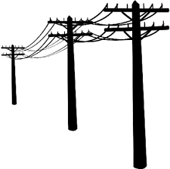
Part 1: Solar technology
What happens when the power goes out?
When grid is down, solar shuts off
Safety mechanism
Need batteries if want power during outages
source: www.pixgood.com

Slide 20
Part 1: Energy Storage for Homeowners
The two main values of storage
Backup
Power for you
Save money or get paid to help the Grid
Notes:
Main messages:
Backup is what you can get now and there are different technologies that provide that.
Backup power does not make you any money if you are a residential homeowner. It will also make your solar array a little less efficient due to energy needed to keep batteries topped off.
Some storage technologies are resources that are flexible in how they can be used and their value may change if the rules of the grid change
Narrative:
Energy storage can do many things from providing backup power to supporting the expansion of renewable energy on the grid. However, it’s very important for you to understand that right now in {STATE}, the only thing that energy storage like batteries can do for you is to provide backup power and it will not make you any money. In fact, if you have solar it will actually reduce the economic impact of your solar for you because some of that solar energy will be used to top off your batteries and keep them ready for use instead of powering other things in your home or generating kilowatt-hour credits for you.

Slide 21
Part 1: Energy Storage for Homeowners
Energy Storage for Homeowners
You might want storage if…
Frequent utility outages
Critical loads at home (ex. well pumps, medical equipment)
Emergency/disaster preparedness
Two ways it may benefit you
Notes:
Main messages:
These are the kind of things that might make you think about backup power
There are different chemistries. Lead acid’s been around for a while. Lithium ion is newer. There are trade offs to each but more detail than we can go into here.
(If you want more information than we’re discussing in these slides check out our webinar online)
Narrative:
Not everyone needs energy storage for backup power. Most people who are interested are in places where utility service is sometimes unreliable. They might be considering a generator or have a generator and want to replace it or augment it. If you have reliable utility power that rarely if ever goes out then battery backup power is probably not right for you unless you are motivated by disaster preparedness or if you have sensitive and life-saving medical equipment that most always remained powered.

Slide 22
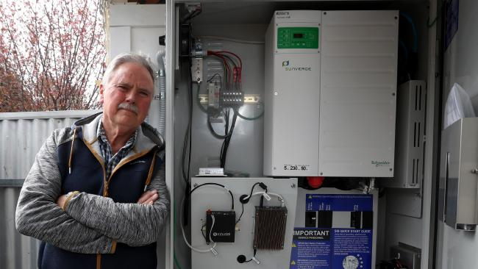
Part 1: Energy Storage for Homeowners
Energy Storage for Homeowners
6 kWh Battery Bank
Fully re-charged by solar (5.6 kW) daily
NOTE: No solar = 1 day only
What will run when the power is out:
refrigerator; small microwave
Some lights; Some outlets
cable modem
What they chose not to power:
stove; dryer; electric water heater;
The Johnsons lose power from the utility several times of year.
Each time the power is out for the entire day.
Notes:
Main messages:
It’s important to limit your expectations on how much your energy storage can cover while the power is out
What you power depends on your budget and the space you have for batteries
Your installer will help you figure out the right solution for you
Narrative:
Energy storage in the home is right now all about backup power. That means when the power from the utility goes out the energy storage will kick on and run part or all of your home until the utility power returns. How much of your home can run on batteries? That depends on how much you want to spend. It’s very common for homeowners to over-expect how much they can run on their energy storage system. Because energy storage like batteries is still expensive you’re probably going to only power the really important stuff while the grid power is out. Here’s an example of the kinds of things someone might typically power in an emergency power outage.

Slide 23
Part 1: Energy Storage for Homeowners
Energy Storage for Homeowners
Example Upfront Costs (small system)
$9,000 : 6 kWh of storage
(lithium ion battery & installation)
+
$15,500 : 5.6 kW solar array
(optional)
Two ways it may benefit you
Notes:
Main messages:
Battery system life depends on technology but is between 5 and 10 years
These are example costs!!! The actual will differ by location, technology, & desired loads to run.
These costs are before tax credits
With solar = 30% federal is applicable. Without solar it likely is not
Any state credits available?
Narrative:
The costs here are purely for example purposes. They are based on a small-sized Lithium Ion battery backup system and a solar array you might see on a small residential home. Lead acid storage options may also work and be cheaper but also may have a shorter life span depending on usage patterns. There are a wide variety of storage options, manufacturers, technologies, and configurations that can affect this price. At the end of the day you and your solar installer will work together to determine what you want to power in the event of an grid outage, how long you want to power it, and what you can fit into your budget. Other factors that affect the price include whether you can take the federal tax credit for solar for your energy storage system and whether there are state or local incentives available.

Slide 24
Part 1: Solar technology
Frequently asked questions
Warranties?
Homeowner’s insurance?
Maintenance?
How long do systems last?
Will HOA allow solar on my home?
What if I’m in a historic district?

Slide 25
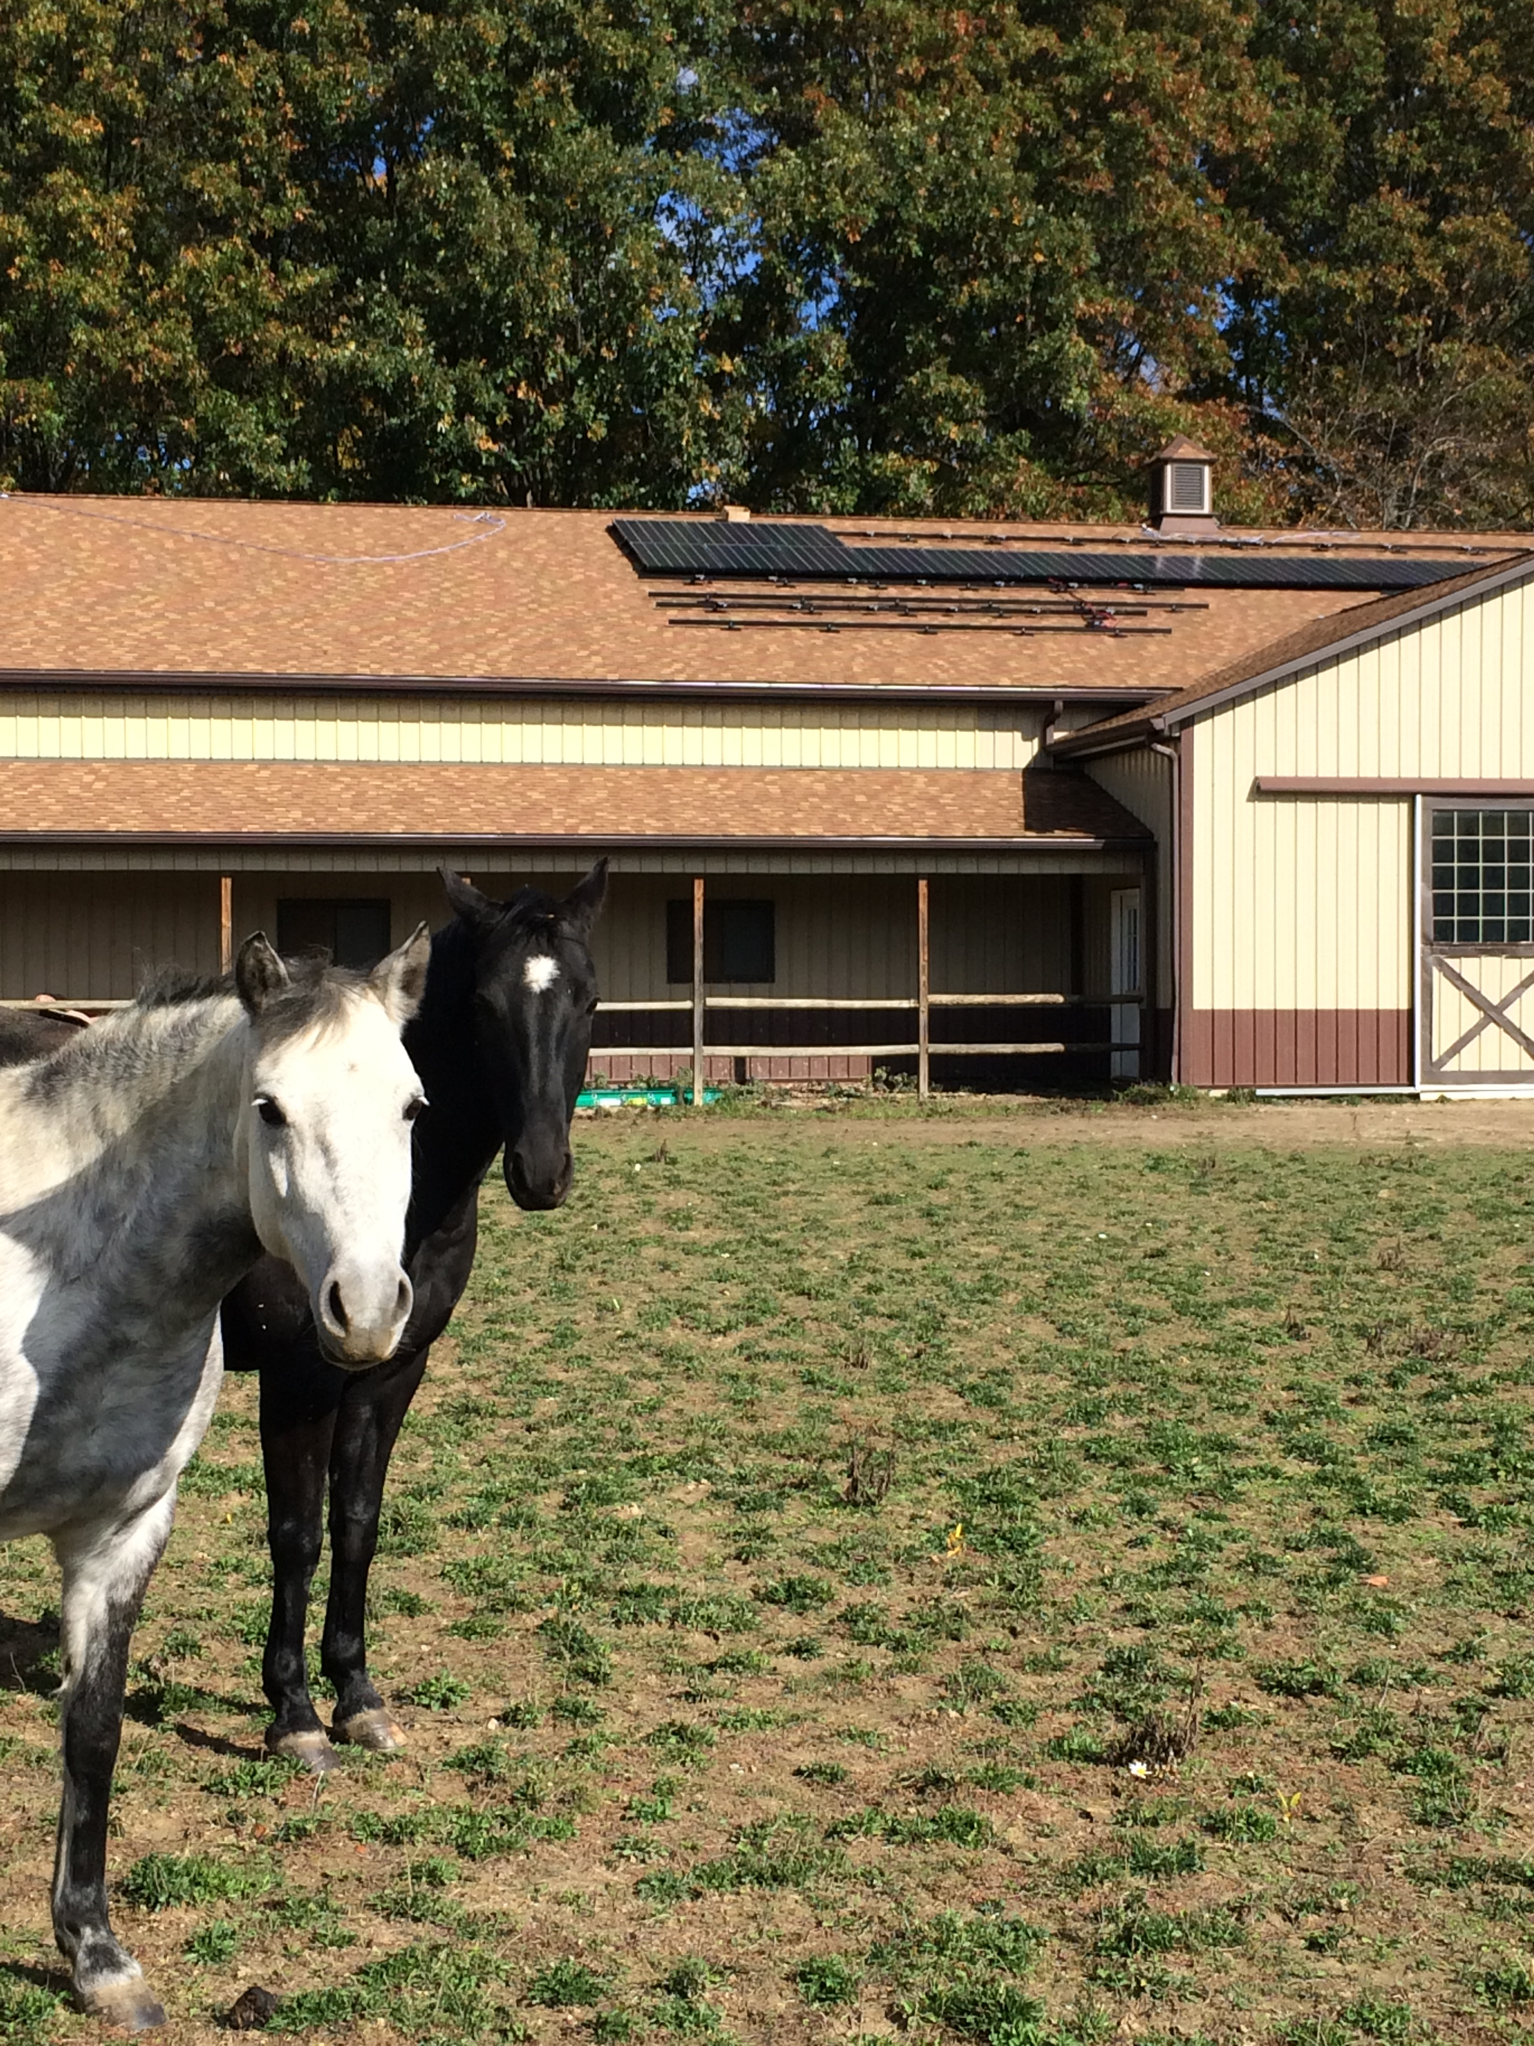
Part 2: How solar co-ops work
Peggi Ignagni’s install in Oberlin.

Slide 26
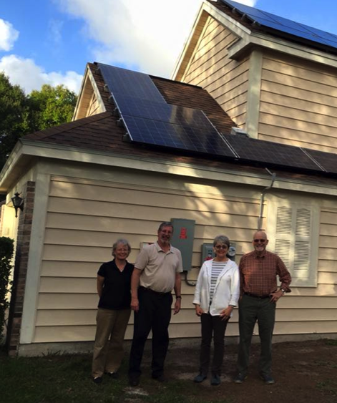
Part 2: Co-op process
Benefits of co-ops
Save on cost of system (10-20%)
Get support of the group through the process
Connect with fellow solar enthusiasts
Become part of a growing solar movement

Slide 27
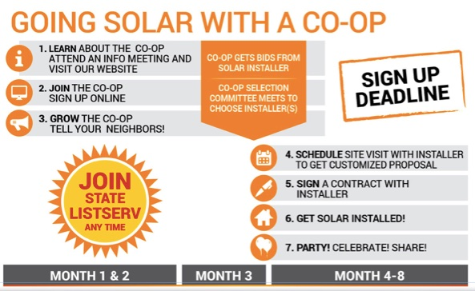
Solar Co-op Information Session
Part 2: Co-op process
Notes:
Emphasize participants direct involvement & collaborative decision making/selection
Online sign-up process is non-binding but essential to build group size
Roof assessment process
to protect homeowners
avoid wasting people’s time
Yes / No / Maybe response
Satellite imagery sometimes out of date
20 to 30 signups w/ good roofs
Each RFP reflects interest of the group collectively
Selection process
Committee of volunteers
Group stays open after selection
Proposal & installation phase
Bi-lateral contracts between homeowner & installer
We’re an interested 3rd party that follows along to make sure things go smoothly
If you sign a contract we get $500 from installer
Contract sign to completed system time. Set expectations for your area and key milestones
Party! & connecting to larger network via listserv, newsletter, etc.

Slide 28
Part 2: Co-op process
Who picks the installer? – Co-op members
When someone joins a co-op, they select specific installer criteria from some or all of the following:
Offer the best price
Use higher quality equipment
Have more experience
Offer stronger warranties
Are a local company
Other - Please describe

Slide 29
Part 3: Solar economics

Slide 30
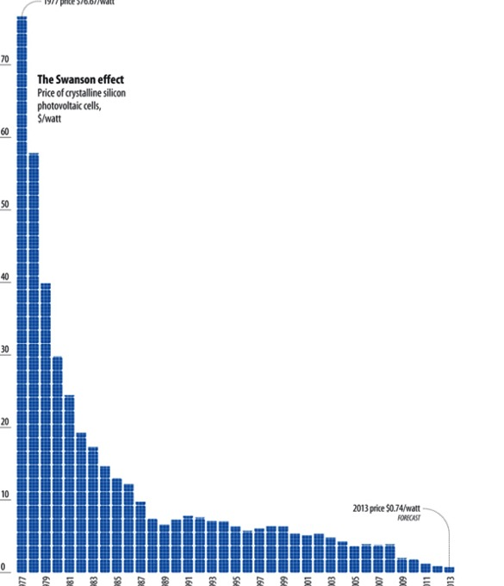
Part 3: Solar economics
Solar in increasingly affordable
Costs have come down 90% since the 1970s
Solar is no longer a specialty, expensive or boutique project for a homeowner
But, can still be daunting to tackle
1970’s Today

Slide 31
Solar Co-op Information Session
Part 3: Solar economics
Electricity costs example over 20 years
Monthly purchase of solar kWh
One time purchase of solar array
$
$
years
years

Slide 32
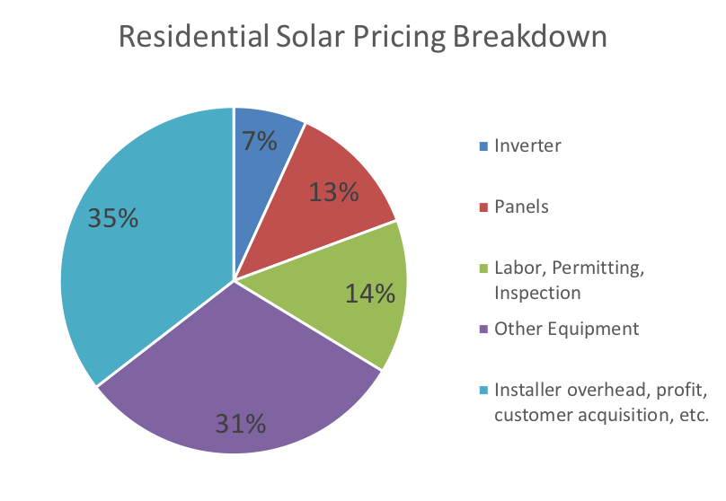
Part 3: Solar economics
Solar Panel Tariff
30% tariff on imported solar panels
Only about 10-15 cents/watt (estimated)
Average 7kW system = $1,050 -- $735 after tax credit
Tariff drops down over next four years
2018 – 30%
2019 – 25%
2020 – 20%
2021 – 15%
Source: NREL
Notes:
The relief will include a tariff of 30 percent in the first year, 25 percent in the second year, 20 percent in the third year, and 15 percent in the fourth year. Additionally, the first 2.5 gigawatts of imported solar cells will be exempt from the safeguard tariff in each of those four years. Last year there were roughly 12 gigawatts installed of solar, so 2.5 gigawatts would be about 20% assuming all panels were imported (which is not true).

Slide 33
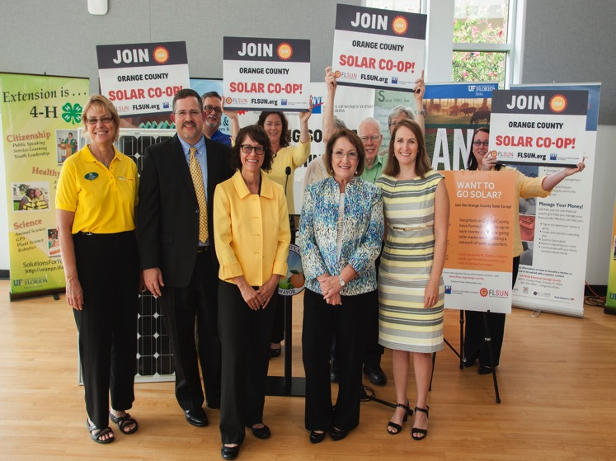
What’s next?
What’s next?
Join the co-op
Join the listserv
Tell your friends and neighbors

Slide 34
Sign-up for the listserv
An invaluable resource for participants!

Slide 35
Thank You!

