Slide 1
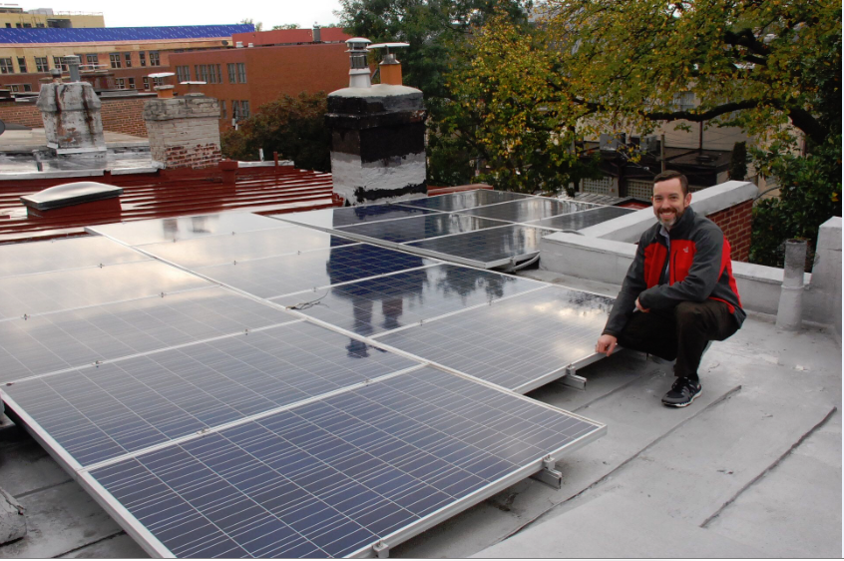
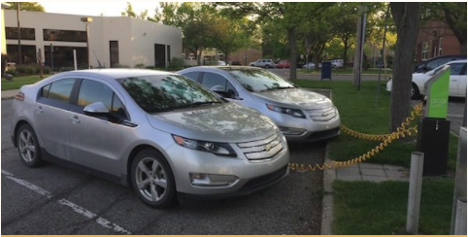
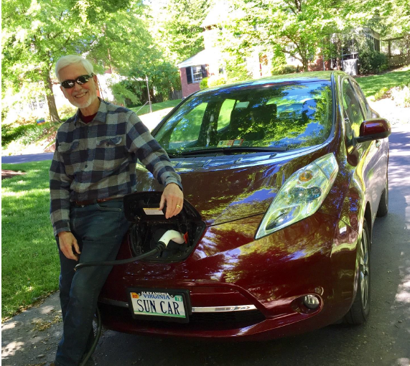
Electric Vehicles Brownbag
Notes:
This was designed for the Maryland program. The majority of the slides are applicable broadly but there’s also some state-specific content during the presentation and at the end

Slide 2
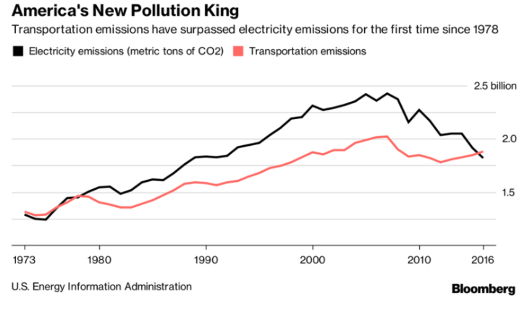
Why electrifying transportation is necessary

Slide 3
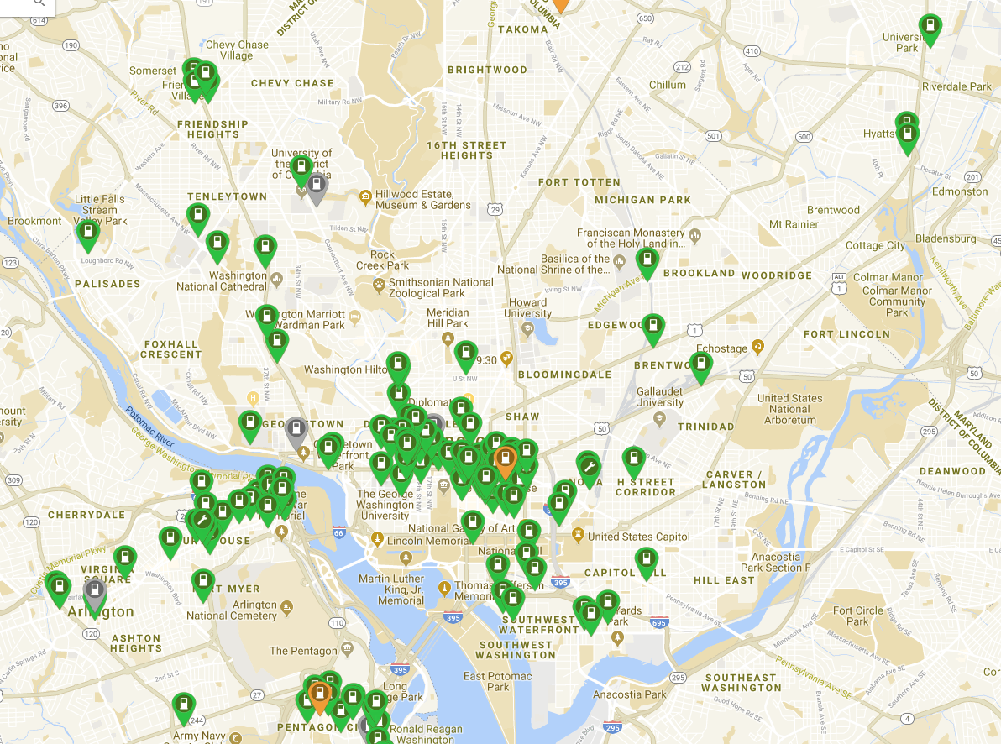
EVs in DC
Roughly 80 “public” chargers now
EV growth
Future charging needs

Slide 4
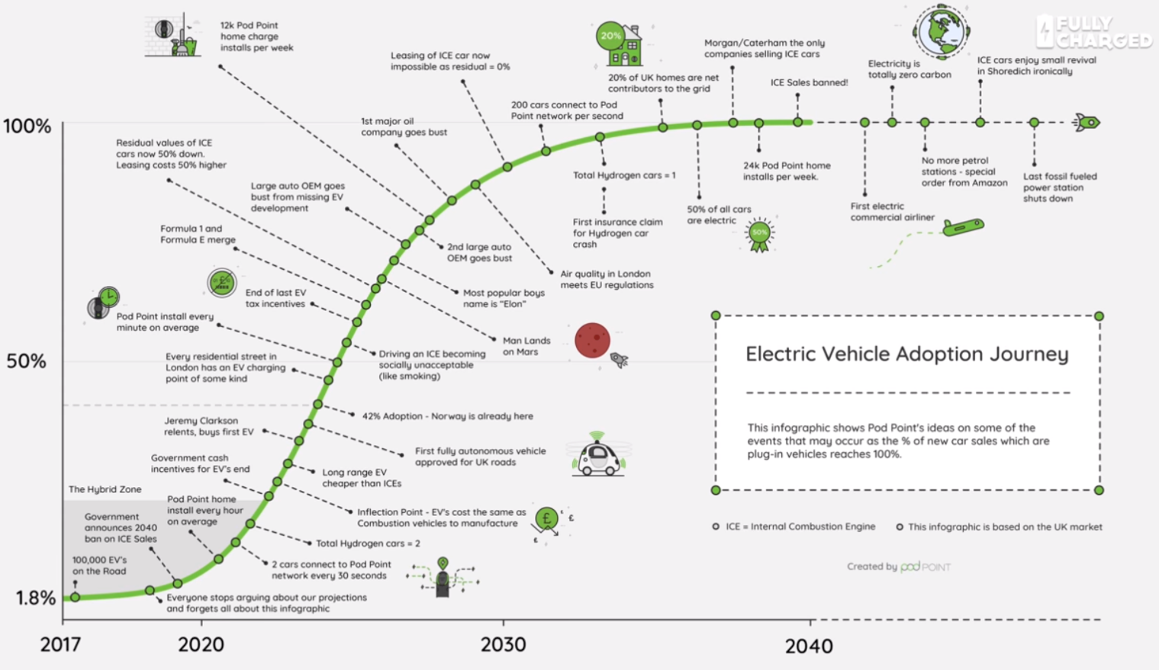
The future of transportation electrification is exciting!
EVs
Buses
AVs
Ridesharing
Peak Oil?

Slide 5
What is Solar United Neighbors doing and how can you get involved?
D.C. Policy
Pepco EV Pilot Program
City Charger Pilot (DDOT)
Arlington PV+EV Bulk Purchase

Slide 6
Discussion, Questions, Comments?
Are you interested in owning an EV?
Where do you think we need public charging?
What’s the right transportation mix?
What should the city government be doing?
What is the private sector’s role?
What if we set a zero emissions goal by 2040?

