Slide 1

DECARBONIZATION &
GRID MODERNIZATION
April 14, 2018, Solar Congress
Edward Yim, Energy Administration

Slide 2
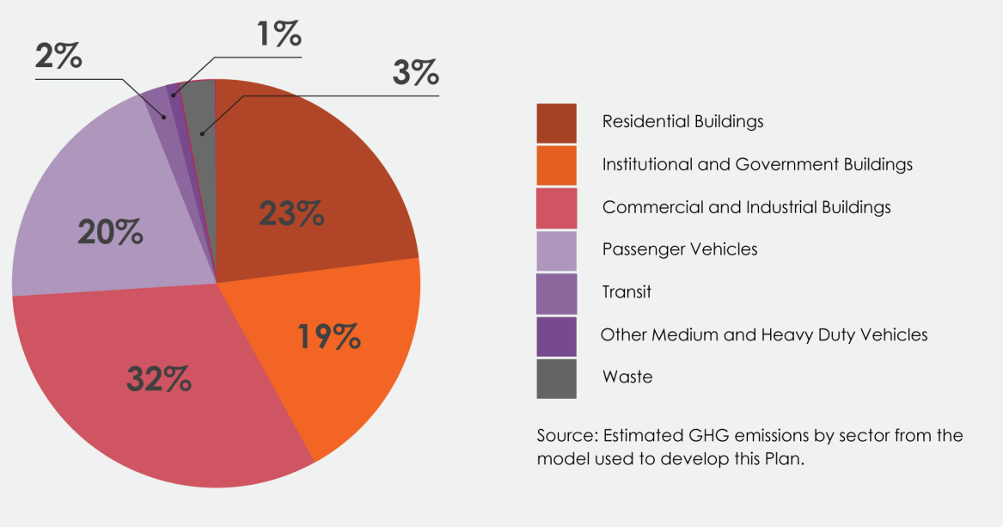
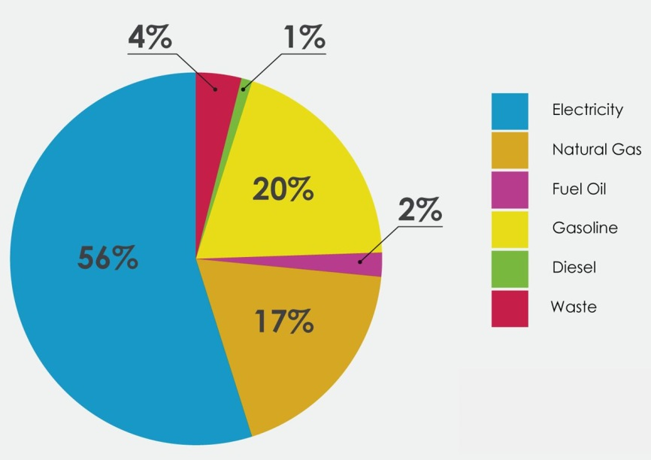

GHG MITIGATION APPROACH
2012-13 GHG Emissions By Sector And Fuel Type
Source: Greenhouse Gas Inventory

Slide 3

ENERGY: CLIMATE & INNOVATION
CLEAN
MITIGATION
RESILIENT
ADAPTATION
GOAL
MODERNIZATION
EFFICIENT &
INTERACTIVE

Slide 4

DRAFT CLEAN ENERGY DC 50% GHG CUTS
BUILDINGS
ENERGY
TRANSPORTATION
13.6%
18.6%
14.2%
9.5% from PJM fuel mix change

Slide 5
ESTIMATED GHG REDUCTIONS
Action Area | GHGs Reduced 2032 BAU | % GHGs Reduced 2032 BAU
Fuel Economy Std | 626,000 | 7.1%
New Construction | 408,000 | 4.6%
Existing Building | 797,000 | 9.0%
Government Buildings | 45,000 | 0.5%
Renewable Portfolio | 841,000 | 9.5%
RPS Local Solar Requirement | 164,000 | 1.9%
Standard Offer Service | 584,000 | 6.6%
Neighborhood-Scale Energy | 49,000 | 0.6%
Mode Share Change | 320,000 | 3.6%
EV Adoption | 32,000 | 0.9%
Bus Fleet Electrification | 230,000 | 2.6%
Total GHGs Avoided vs. 2032 BAU | 4,140,000 | 47.0%
Total GHGs Reduced vs. 2006 Baseline | 5,870,000 | 55.7%

Slide 6
DECARBONIZATION TOOLKIT
CLEAN
LOCAL
ENERGY
BUY CLEAN
POWER
EFFICIENT
BUILDINGS
CLEAN CARS
Notes:
What does an energy plan look like that maximizes DER? And what would be needed to do that?

Slide 7
DECARBONIZATION APPROACH
LOCALTION-SPECIFIC PLANNING
SUSTAINABLE DC
UN DDPP (US)
GRID MODERNIZATION
NEIGHBORHOOD-SCALE RENEWABLE ENERGY + NET ZERO DISTRICTS
DISTRIBUTED ENERGY RESOURCE (DER) POTENTIAL
ENERGY DEMAND PROFILE
EFFICIENCY +
CLEAN GRID +
FUEL SWITCH
UTILITY PLANNING USING DISTRIBUTED ENERGY
RESILIENT + INTERACTIVE +
NEW RULES
INTENTIONAL ISLANDING & BACKUP POWER
MICROGRIDS AND
DISTRICT ENERGY
INCENTIVE ALIGNMENT
Notes:
What does an energy plan look like that maximizes DER? And what would be needed to do that?

Slide 8
DECARBONIZATION ROADMAP
Energy Performance Standards: All Buildings
Increase Renewable Energy
in Standard Offer Service:
Residential Sector
Electric Vehicles and Buses
BUILDINGS
ENERGY
TRANSPORTATION
Net Zero Codes:
New Buildings
GHG Performance Standard: Commercial Sector
Bike, Walk, and Metro

Slide 9
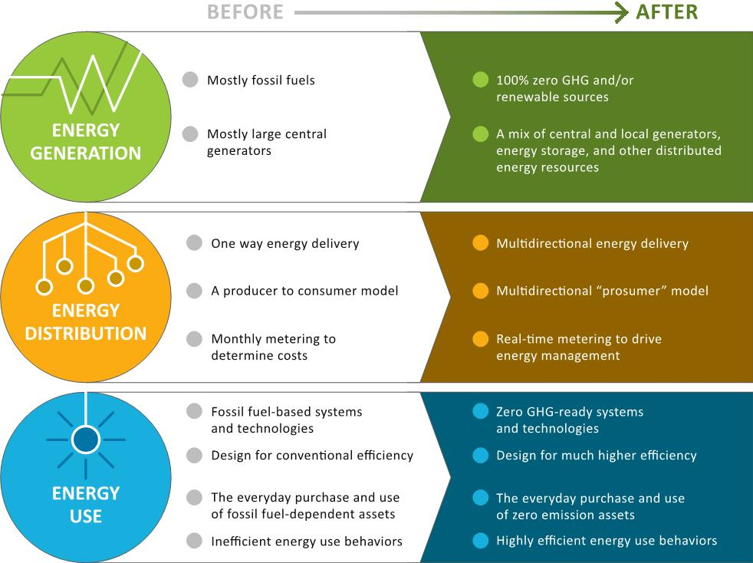
ENERGY SYSTEM TRANSFORMATION

Slide 10

DECARBONIZATION MEASURES
Amount of Natural Gas Replacement:
30 % of Base Load Assuming Highest Efficiency
Heat Pumps
Rooftop
Solar
Wastewater Thermal
Renewable
CHP
ENERGY
TRANSPORTATION
Biomethane
District
Energy

Slide 11
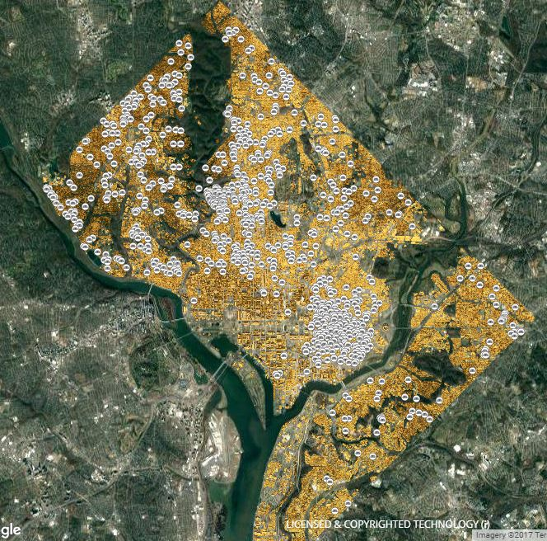
MAPPING ENERGY POTENTIAL

Slide 12
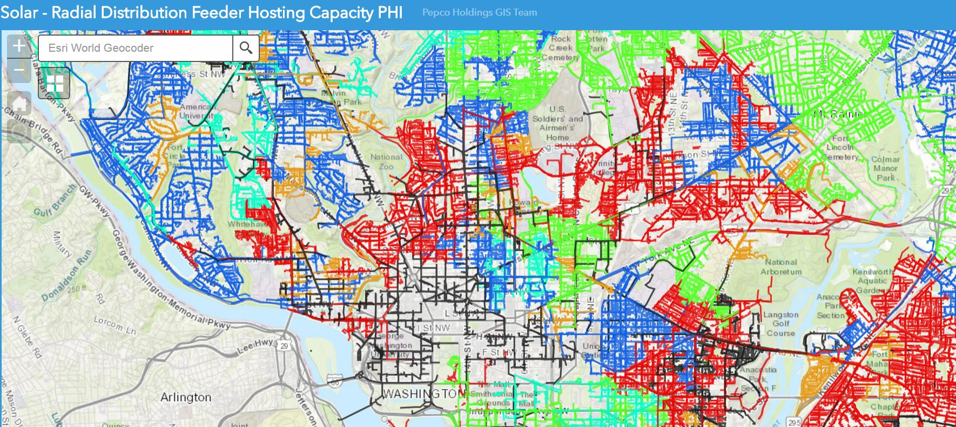
HOSTING CAPACITY ISSUES
Potential Solutions Using AMI, Advanced Inverters and
Battery Storage For Dynamic Feeder Load Management

Slide 13
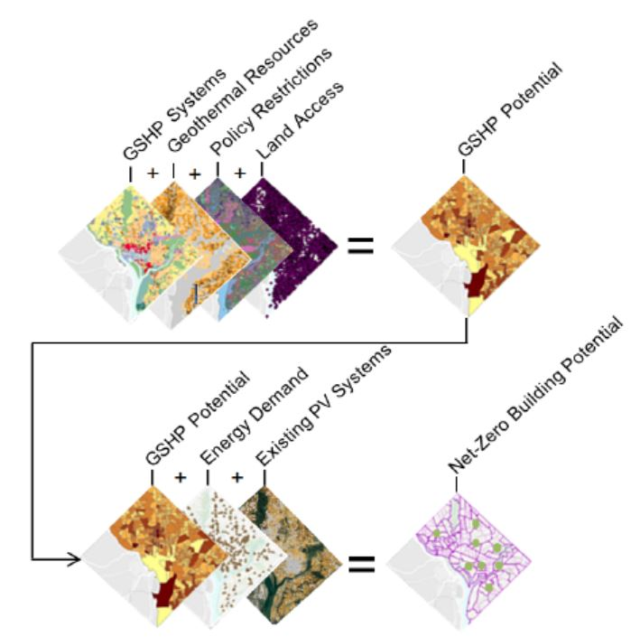
NET ZERO POTENTIAL ANALYSIS

Slide 14
MAPPING ENERGY POTENTIAL

Slide 15






NEIGHBORHOOD ENERGY & RESILIENCE

Slide 16
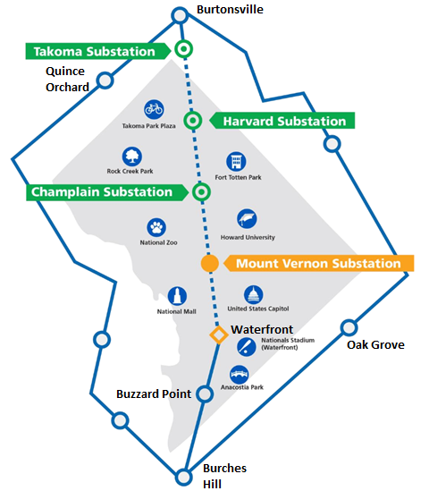

NON-WIRES ALTERNATIVE FOR CAPACITY
Per Pepco | Capital Grid | Mt. Vernon
Issue | May ‘17 | Jan-Feb ‘18
Stated Need | Reliability & Resilience | Load Growth
Project | 2 new transmission lines (‘22) & Rebuild Harvard substation (‘22) and Champlain substation (‘26) | 2 new transmission lines & new substation at Mt. Vernon
Cost | $414 M | Unstated
 | Harvard ($179M) Champlain ($122M) Lines ($113 M) | Mt. Vernon ($150M) Lines (Unknown)
Bill Impact | Commercial: Unstated Residential: ≈20-25% increase in distribution ($2-$4/mo) | Unstated
Alter-native | $705M (just for the two substations) | Unstated

Slide 17
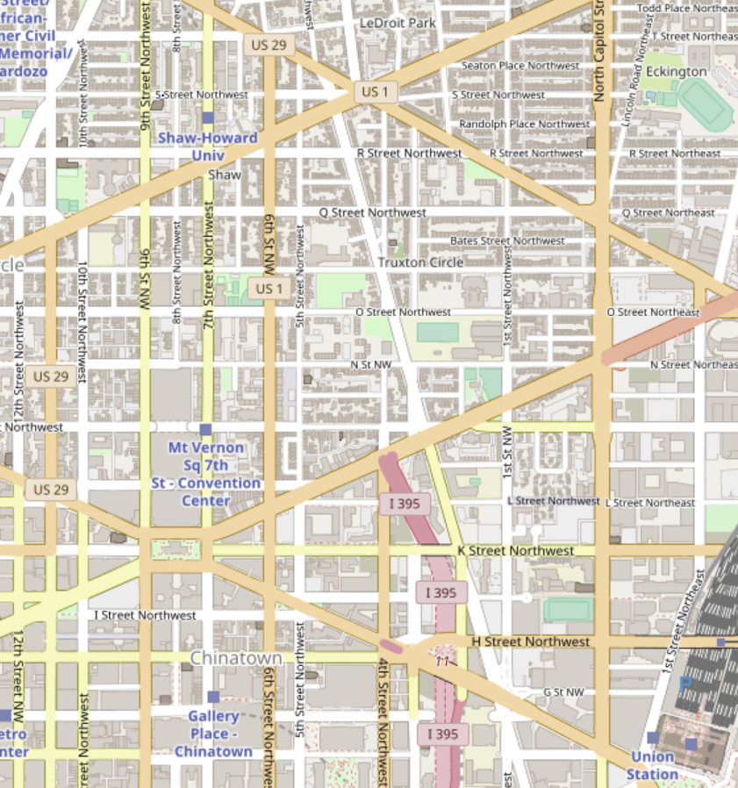
LOAD GROWTH AREA
Shaw, Mt. Vernon, NoMA. Capitol X
  9.4 million sq. ft. of new office
  600,000 sq. ft. of new retail
  6,200 residential units
  1,200 hotel rooms
Need for the Mt. Vernon substation:
  6.61M sq. ft. worth of load is projected to be located in the area served by 6 underground feeders (SW LVAC Network),
  a 3 x 4 block area, between Gallery Place and Capitol Crossings
  The increased load in the SW LVAC network is the justification Pepco cites for the need to build the Mt. Vernon substation
Northeast Sub #212
212 Radial System
SW LVAC
Network
SW LVAC feeders are served by the
Northeast #212 substation

Slide 18
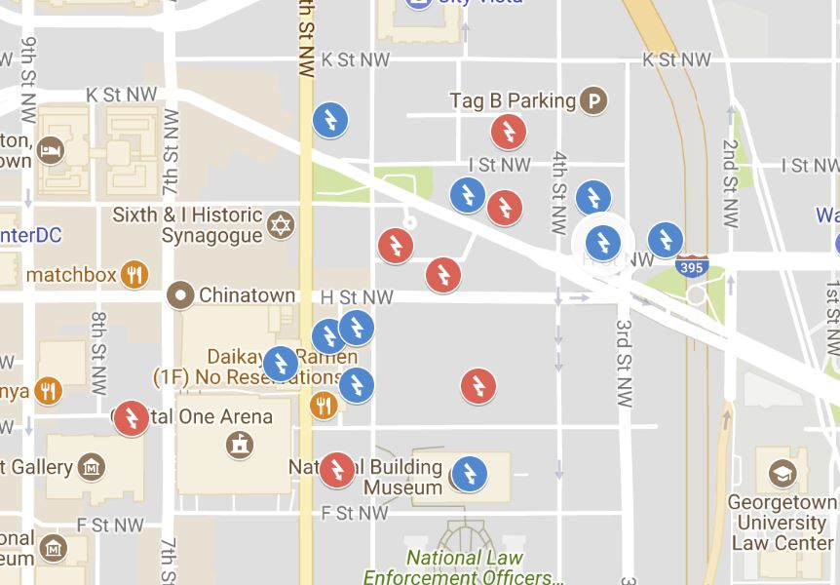
BUILDINGS THAT MATTER
Address | Size (sq. ft.) | peak hour load (kW)
441 G St. NW (GAO) | 1,935,500 | 6,342
425 Mass Ave NW | 605,405 | 1,902
Gallery Place | 590,688 | 2,228
600 5th St. NW | 423,710 | 1,388
450 Mass Ave. NW | 407,710 | 1,335
425 I St. NW | 399,371 | 1,309
700 Sixth St. NW | 306,459 | 971
455 Mass Ave. NW | 247,330 | 784
770 5th St. NW | 233,968 | 766
811 4th St. NW | 208,767 | 609
461 H St. NW | 197,648 | 1,325
401 F St. NW | 197,094 | 644
777 6th St. NW | 196,997 | 624
599 Mass Ave. NW | 172,236 | 428
500 H St., NW | 120,000 | 309
251 H St. NW | 93,877 | 298
301 Mass Ave. NW | 68,989 | 201
Total | 6,405,749 | 21,463
Adj. Total (loss, weather, PF) |  | ≈26,000

Slide 19
SOLUTIONS USING DER
Deferral year | 2022 | 2023 | 2024
Total MVA deferred | 2.2 | 7.6 | 13.4
Capacity reached at SW LVAC | 52.2 – 2.2 = 50 MVA | 57.6 – 7.6 = 50 MVA | 63.4 – 13.4 = 50 MVA
Length of deferral | 1 year | 2 years | Indefinite
Alternative measures | EE or DR | EE + DR | EE, DR, PV, Storage
Cost (EE: lifetime DR: annual) | $5.6M (EE) or $1.6 (DR) | $9.3M | $32.3M
Net benefit | $10.6M (EE) or $7.7M (DR) | $17.5M | $45.5M

Slide 20
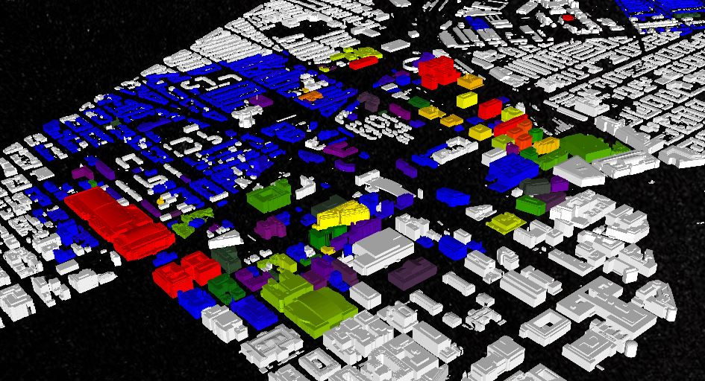
NEIGHBORHOOD ENERGY

Slide 21
Questions?

