Slide 1
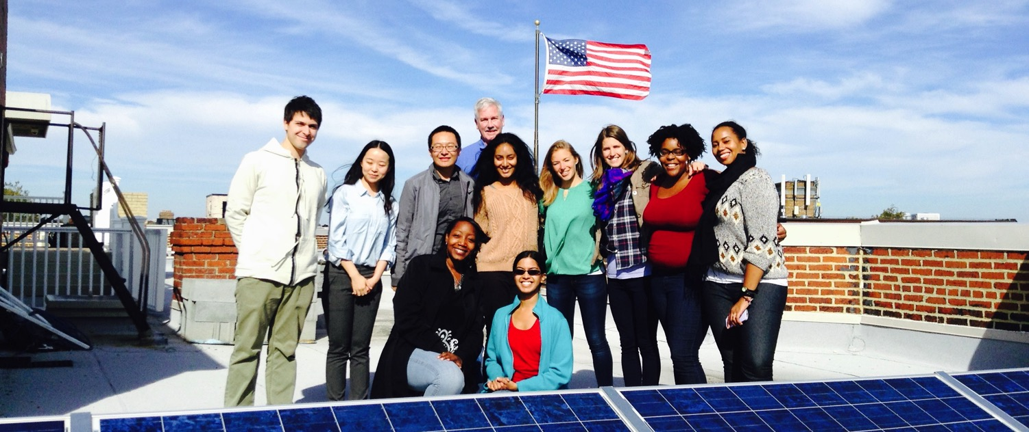
Solar information session

Slide 2
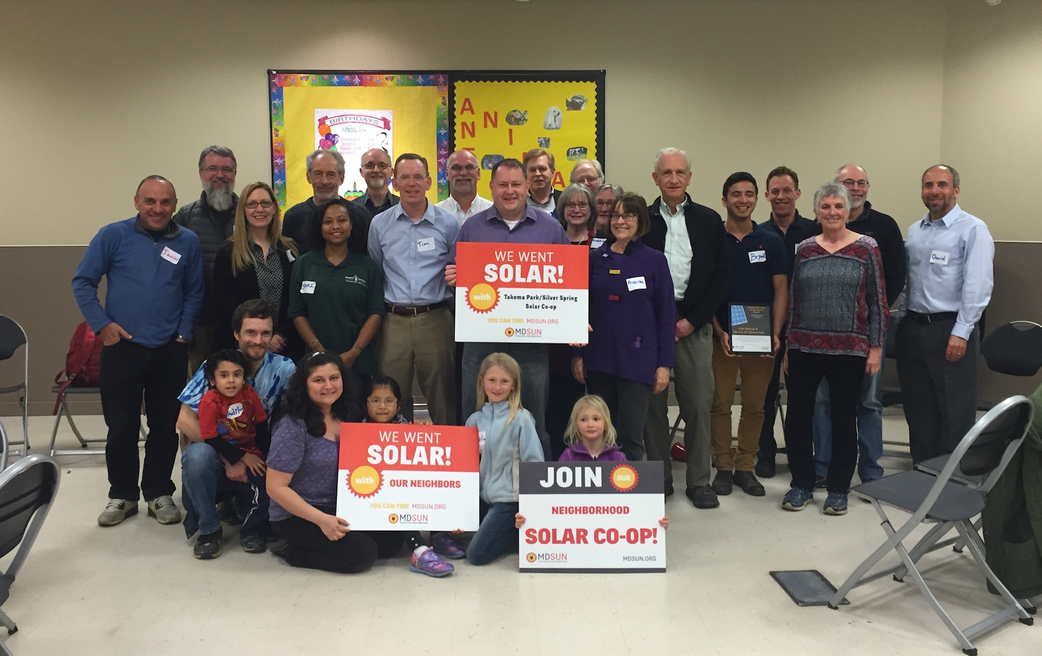
Who we are
We are a network of people taking control of our energy by installing solar and generating our own electricity.

Slide 3
How we got started
Started in 2007 and it wasn’t easy!

Slide 4
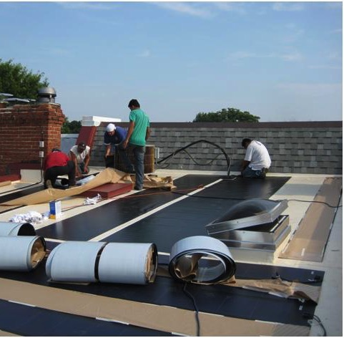
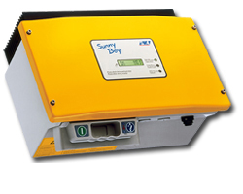
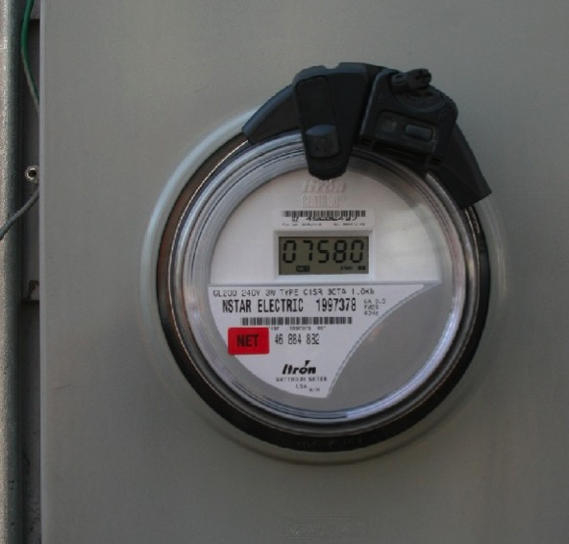
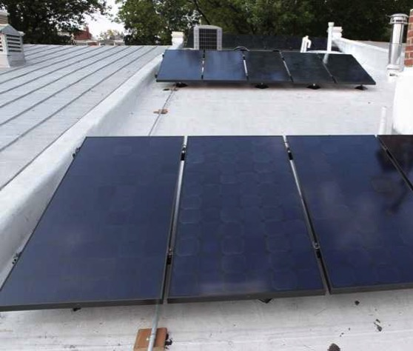
It was harder than we thought!
How we got started
Notes:
There were only two companies working in DC. They told us totally different things about how to install PV on our roof, and then there were the issues of Cost, equipment, taxes, regulations, rules, permits, meters, billing, historic association, SRECs, PSC

Slide 5
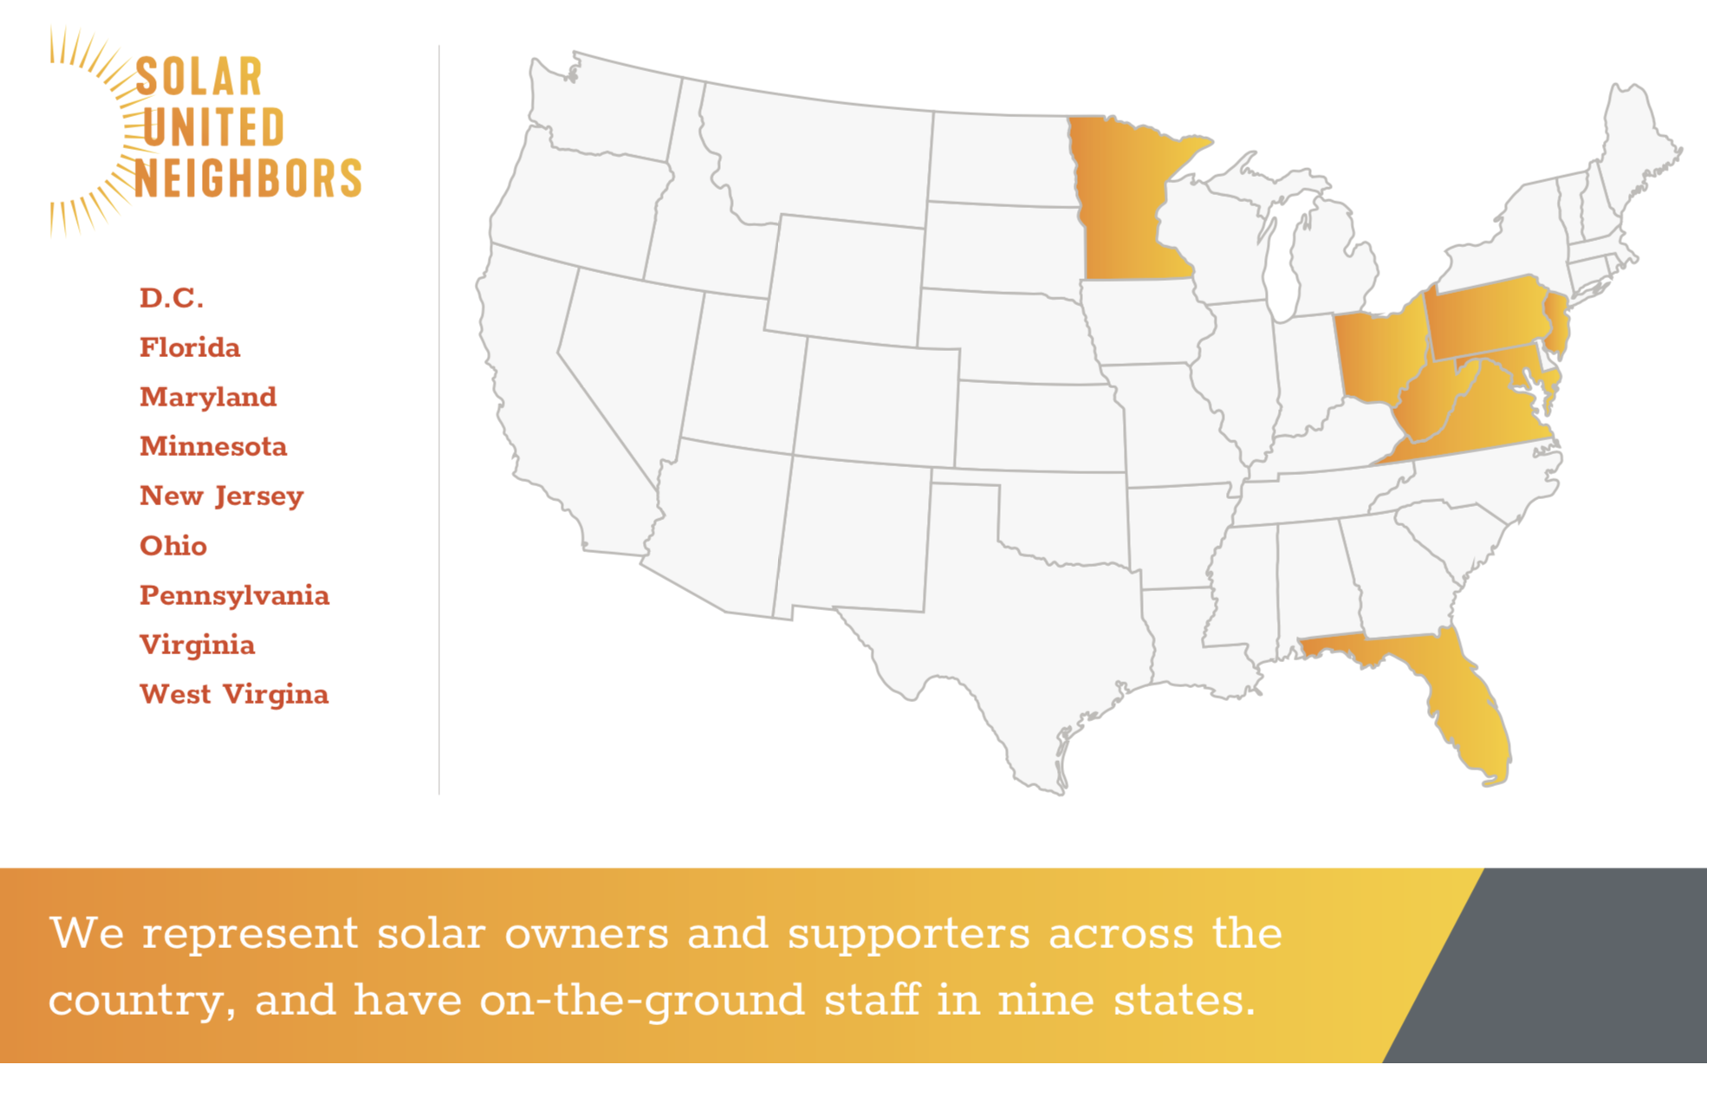
How we help you go solar

Slide 6
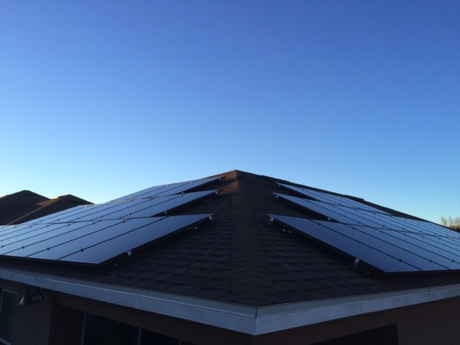
How we help you go solar
Solar co-op/bulk purchase
Individual Support
50 – 100 neighbors
Group decision process
6-8 month process
Bulk negotiation for best pricing
Sign individual contract
Free process
Help reviewing up to 3 proposals
Negotiate your own deal
Can be faster timeline
Ongoing advice & assistance (post install)
$85 annual membership

Slide 7
Presentation in three parts:
Solar technology
How solar co-ops work
Solar economics

Slide 8
Part 1: Solar technology

Slide 9
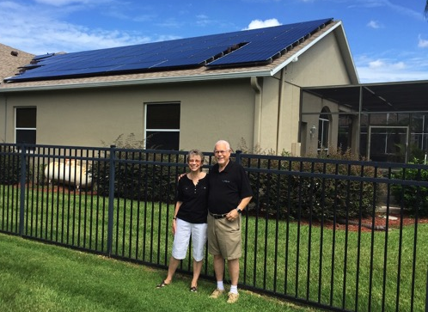
Part 1: Solar technology
How does a solar panel work?
Solar photovoltaic (PV)
Converts solar energy to electricity

Slide 10
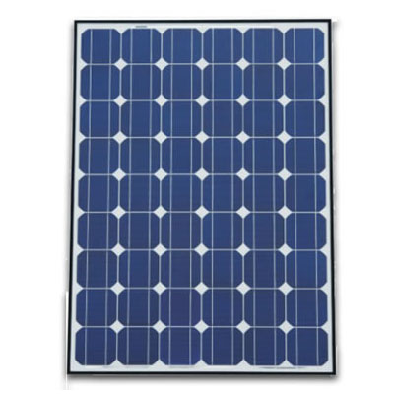
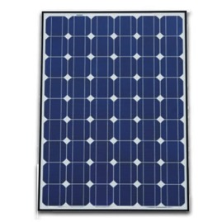
Part 1: Solar technology
System components: Panels
Cell
Panel / module
Solar array

Slide 11
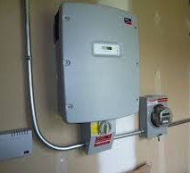
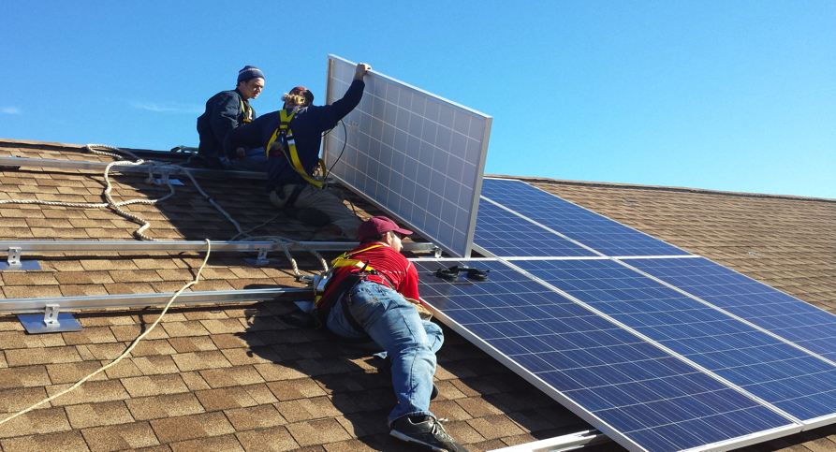
Part 1: Solar technology
System components:
Inverter & racking
Inverter
Racking system

Slide 12
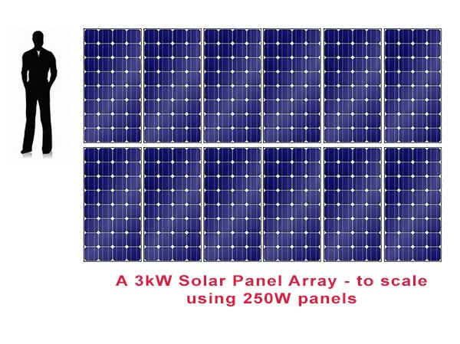
Part 1: Solar technology
Terminology: Kilowatts (kW) & kilowatt-hours (kWh)
System measured in kW
Electricity production in kWh
Most homeowners install between 2 kW – 12 kW

Slide 13
Part 1: Solar technology
How does solar connect to my roof?

Slide 14
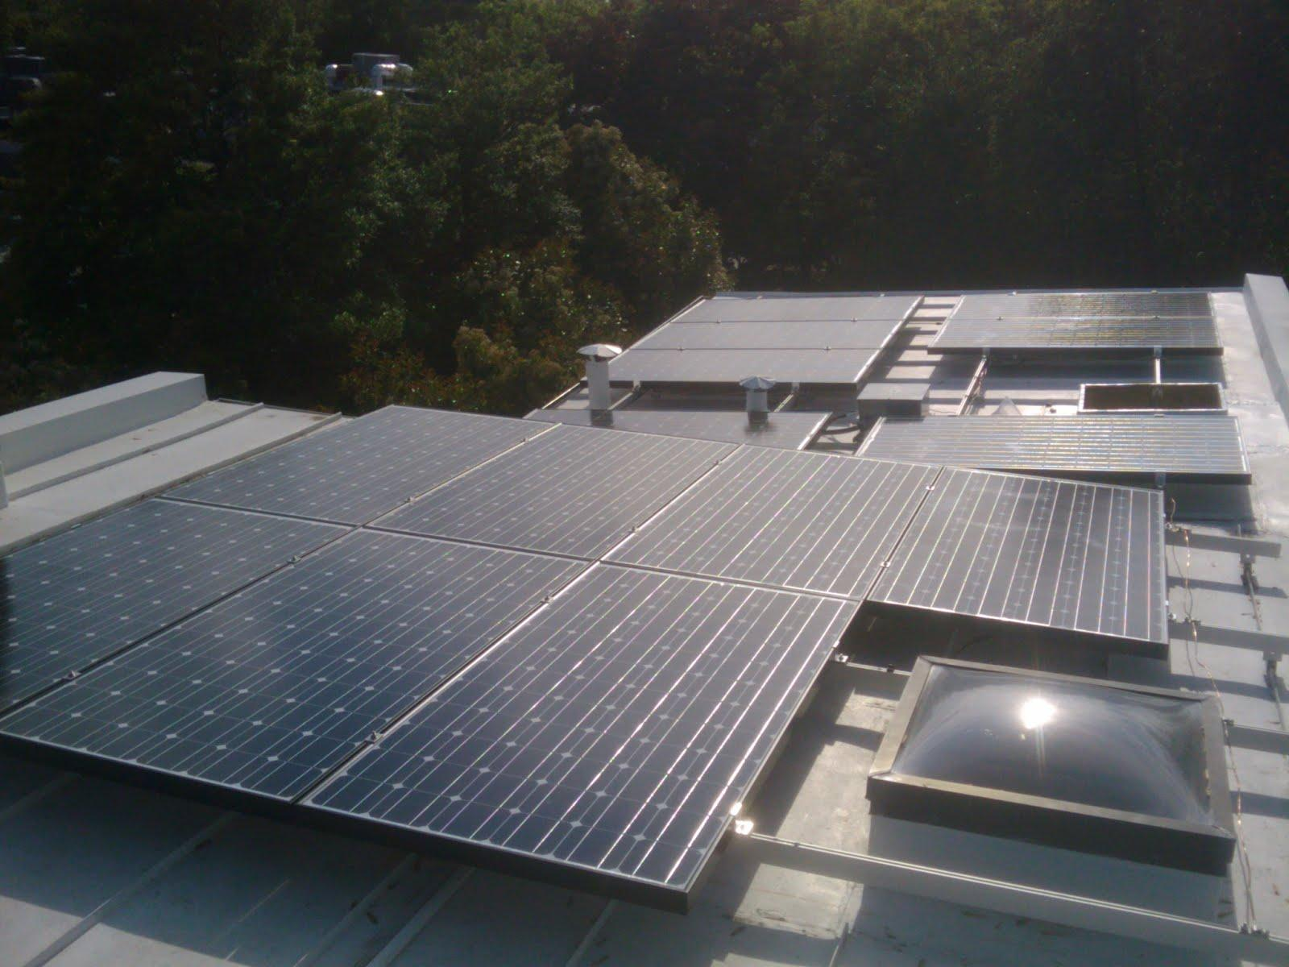
Part 1: Solar technology

Slide 15
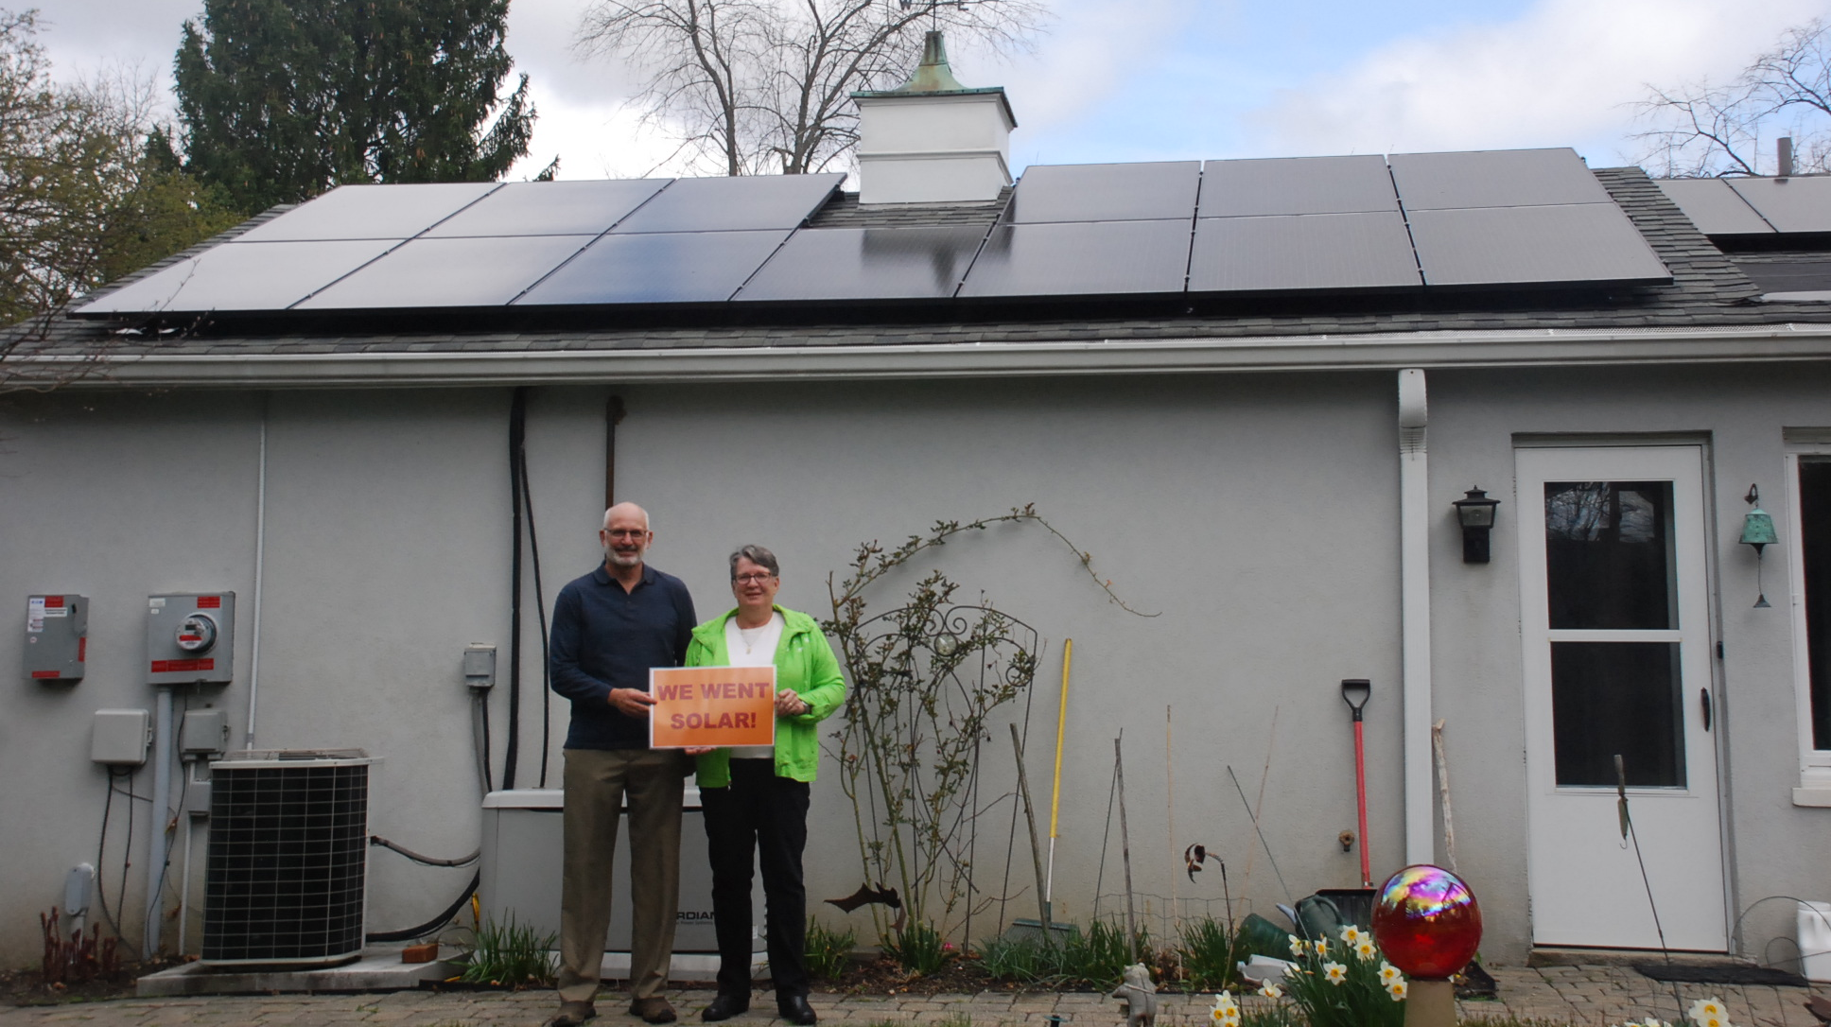
Part 1: Solar technology

Slide 16
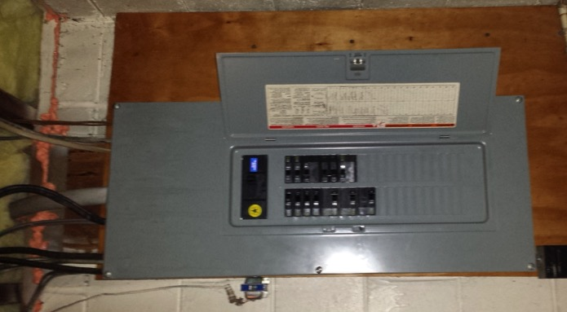
Part 1: Solar technology
How does it connect to my electrical panel?
Simple connection, most home electric systems don’t need upgrades before solar

Slide 17
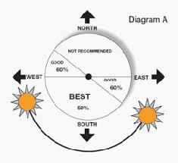
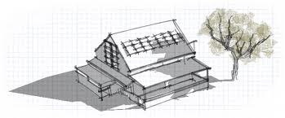
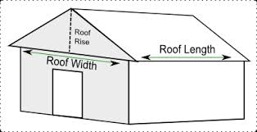
Part 1: Solar technology
What makes a site good for solar?
No shading
Roof faces southerly direction
Enough space to mount panels

Slide 18
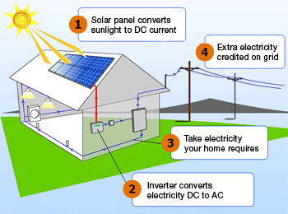
Part 1: Solar technology
How a solar PV system works (grid tied)
Via wattpatrol.com

Slide 19
Part 1: Solar technology
What is net metering?
Allows flow of electricity to AND from customer
When generation is more than use, extra electricity flows back through meter
You receive a credit on your power bill for that excess production

Slide 20
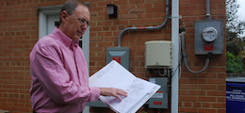
Part 1: Solar technology
Net metering, continued
Monthly electric bill =
[Amt electricity used] – [Amt electricity produced]
Minnesota law requires utilities to let you net meter

Slide 21
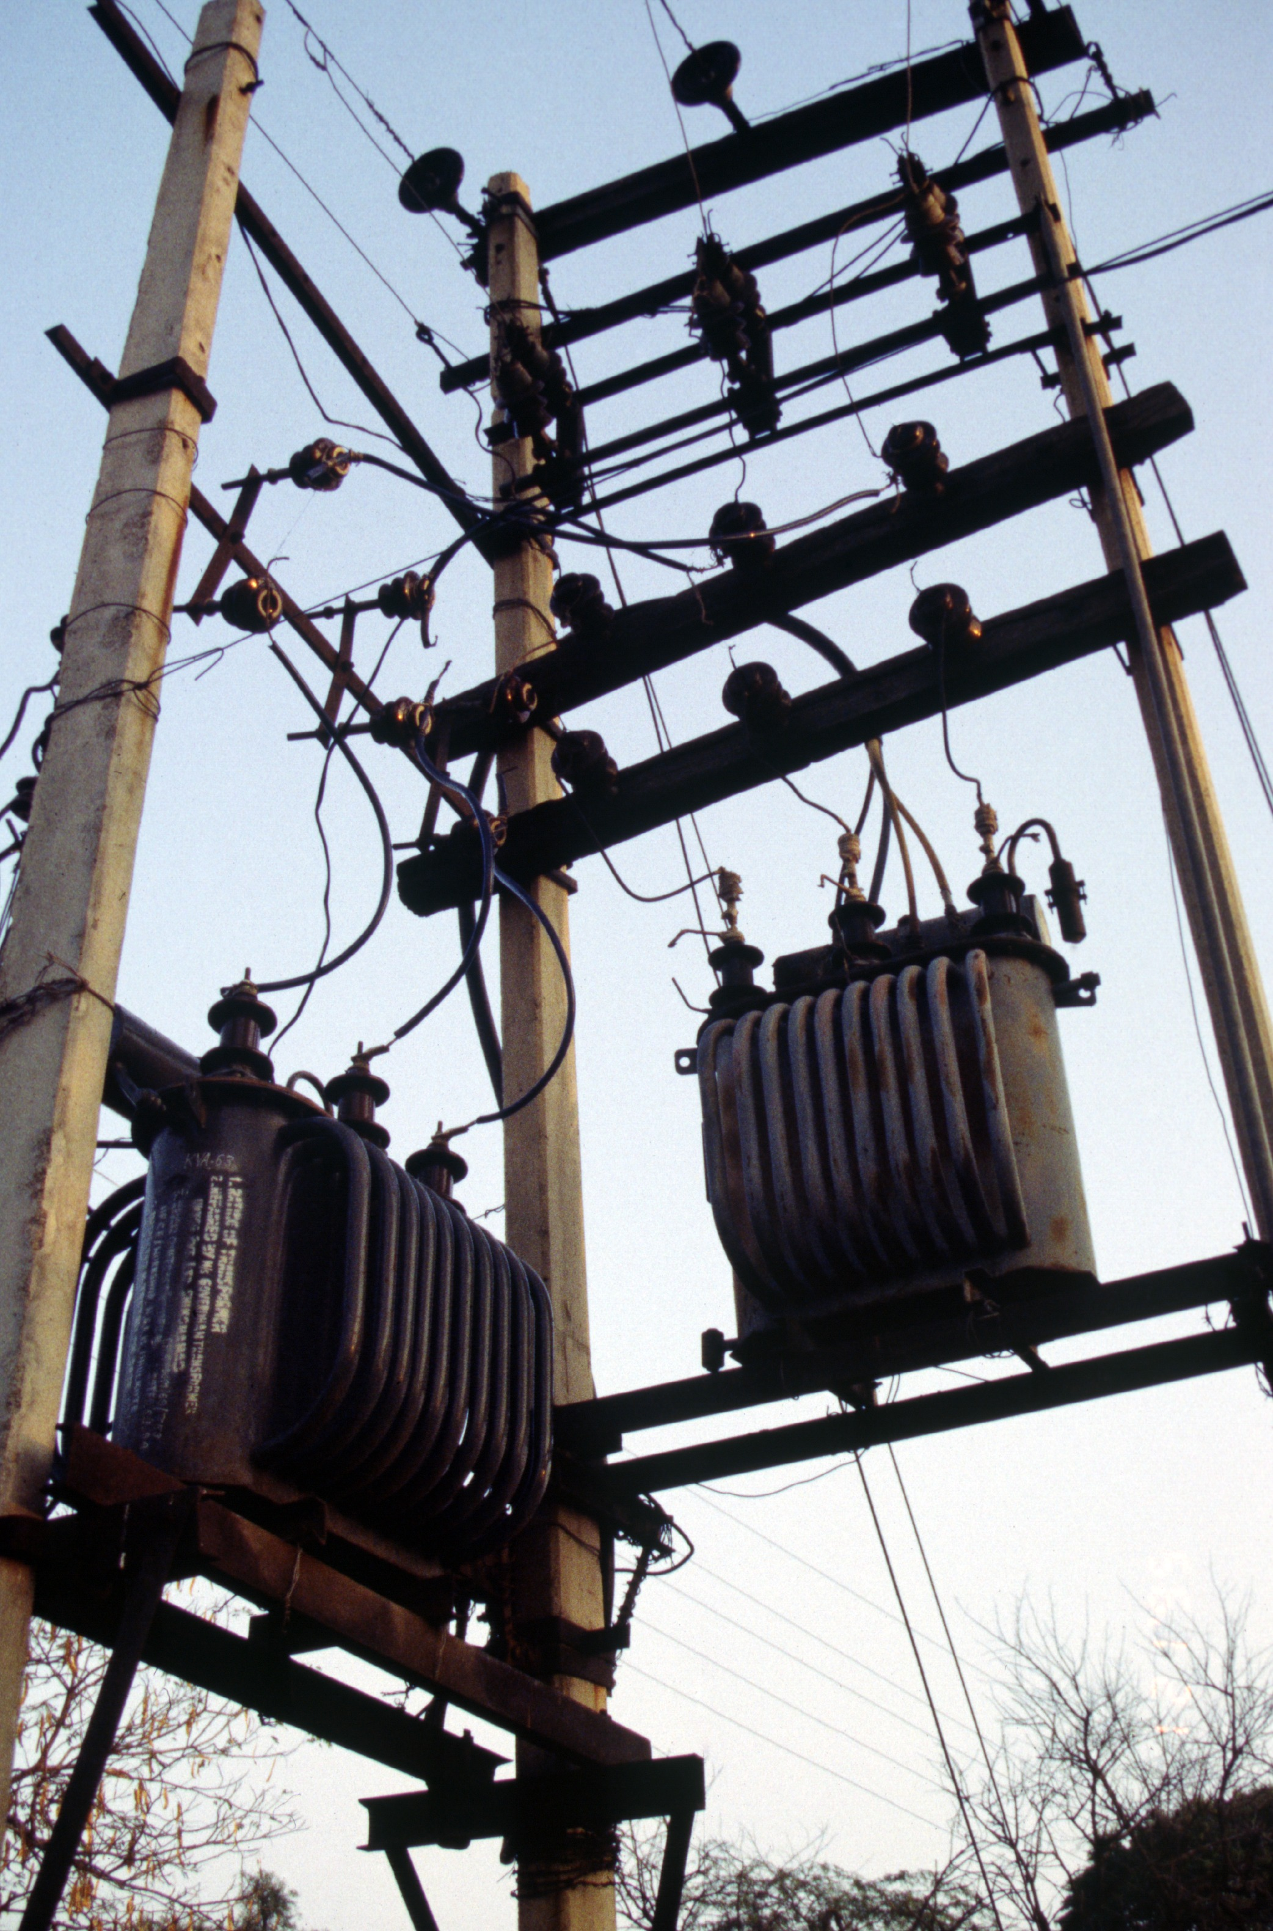
Part 1: Solar technology
What happens when the power goes out?
When grid is down, solar shuts off (safety mechanism)
Need batteries if you want power during outages

Slide 22
Part 1: Energy Storage for Homeowners
The two main values of storage
Backup
Power for you
Save money or get paid to help the Grid
Notes:
Main messages:
Backup is what you can get now and there are different technologies that provide that.
Backup power does not make you any money if you are a residential homeowner. It will also make your solar array a little less efficient due to energy needed to keep batteries topped off.
Some storage technologies are resources that are flexible in how they can be used and their value may change if the rules of the grid change
Narrative:
Energy storage can do many things from providing backup power to supporting the expansion of renewable energy on the grid. However, it’s very important for you to understand that right now in {STATE}, the only thing that energy storage like batteries can do for you is to provide backup power and it will not make you any money. In fact, if you have solar it will actually reduce the economic impact of your solar for you because some of that solar energy will be used to top off your batteries and keep them ready for use instead of powering other things in your home or generating kilowatt-hour credits for you.

Slide 23
Part 1: Energy Storage for Homeowners
Energy Storage for Homeowners
You might want storage if…
Frequent utility outages
Critical loads at home (ex. well pumps, medical equipment)
Emergency/disaster preparedness
Two ways it may benefit you
Notes:
Main messages:
These are the kind of things that might make you think about backup power
There are different chemistries. Lead acid’s been around for a while. Lithium ion is newer. There are trade offs to each but more detail than we can go into here.
(If you want more information than we’re discussing in these slides check out our webinar online)
Narrative:
Not everyone needs energy storage for backup power. Most people who are interested are in places where utility service is sometimes unreliable. They might be considering a generator or have a generator and want to replace it or augment it. If you have reliable utility power that rarely if ever goes out then battery backup power is probably not right for you unless you are motivated by disaster preparedness or if you have sensitive and life-saving medical equipment that most always remained powered.

Slide 24
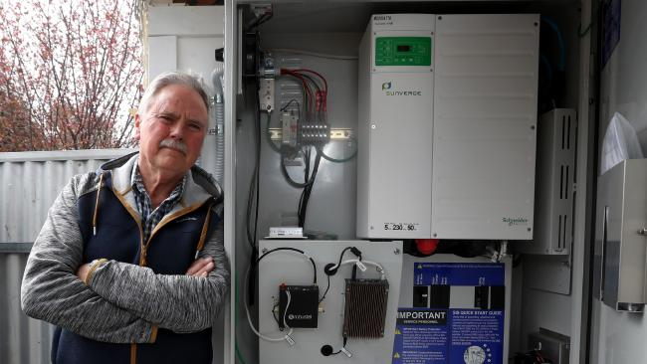
Part 1: Energy Storage for Homeowners
Energy Storage for Homeowners
6 kWh Battery Bank
Fully re-charged by solar (5.6 kW) daily
NOTE: No solar = 1 day only
What will run when the power is out:
refrigerator; small microwave
Some lights; Some outlets
cable modem
What they chose not to power:
stove; dryer; electric water heater;
The Johnsons lose power from the utility several times of year.
Each time the power is out for the entire day.
Notes:
Main messages:
It’s important to limit your expectations on how much your energy storage can cover while the power is out
What you power depends on your budget and the space you have for batteries
Your installer will help you figure out the right solution for you
Narrative:
Energy storage in the home is right now all about backup power. That means when the power from the utility goes out the energy storage will kick on and run part or all of your home until the utility power returns. How much of your home can run on batteries? That depends on how much you want to spend. It’s very common for homeowners to over-expect how much they can run on their energy storage system. Because energy storage like batteries is still expensive you’re probably going to only power the really important stuff while the grid power is out. Here’s an example of the kinds of things someone might typically power in an emergency power outage.

Slide 25
Part 1: Energy Storage for Homeowners
Energy Storage for Homeowners
Example Upfront Costs (small system)
$9,000 : 6 kWh of storage
(lithium ion battery & installation)
+
$21,000 : 5.6 kW solar array
(optional)
Two ways it may benefit you
Notes:
Main messages:
Battery system life depends on technology but is between 5 and 10 years
These are example costs!!! The actual will differ by location, technology, & desired loads to run.
These costs are before tax credits
With solar = 30% federal is applicable. Without solar it likely is not
Any state credits available?
Narrative:
The costs here are purely for example purposes. They are based on a small-sized Lithium Ion battery backup system and a solar array you might see on a small residential home. Lead acid storage options may also work and be cheaper but also may have a shorter life span depending on usage patterns. There are a wide variety of storage options, manufacturers, technologies, and configurations that can affect this price. At the end of the day you and your solar installer will work together to determine what you want to power in the event of an grid outage, how long you want to power it, and what you can fit into your budget. Other factors that affect the price include whether you can take the federal tax credit for solar for your energy storage system and whether there are state or local incentives available.

Slide 26
Part 1: Solar technology
Frequently asked questions
Warranties?
Homeowners’ insurance?
Maintenance?
How long do systems last?
Will HOA allow solar on my home?
What about snow cover?

Slide 27
Part 2: How solar co-ops work

Slide 28
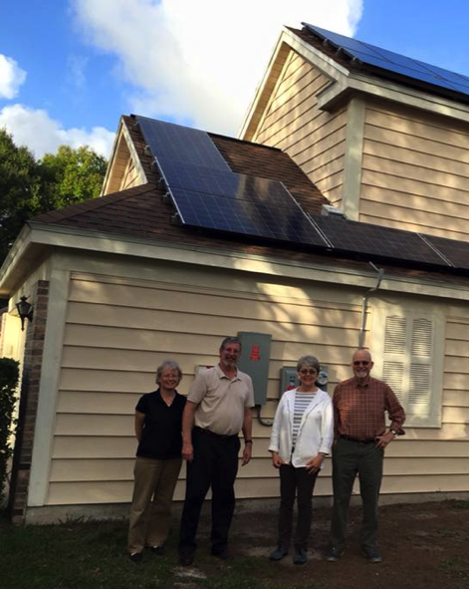
Part 2: How solar co-ops work
Solar co-op benefits
Get best value on installation and support throughout the process
Connect with fellow solar enthusiasts
Become part of the growing solar movement

Slide 29
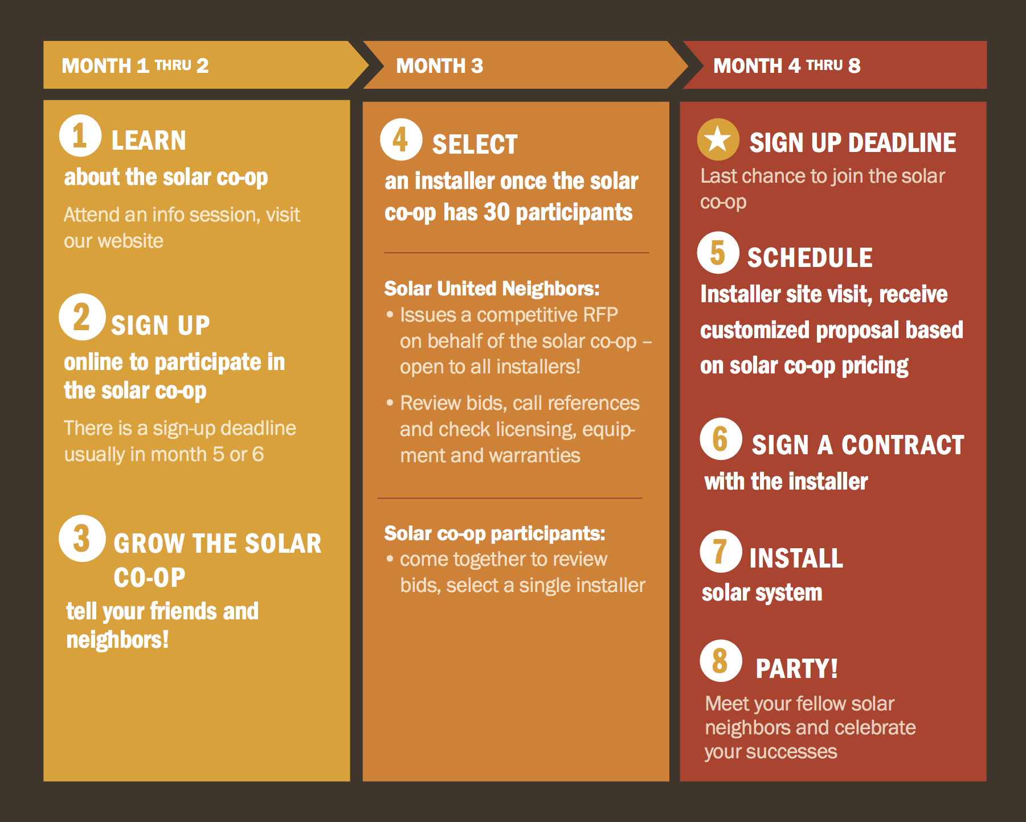
Part 2: How Solar Co-ops Work

Slide 30
Part 2: How solar co-ops work
Who picks the installer?
Solar co-op participants!
Solar co-op participants select specific installer criteria including:
Price
Equipment quality
Warranties
Local company

Slide 31
Part 3: Solar economics

Slide 32
Part 3: Solar economics
A few considerations
Solar is priced by the watt (not by panel)
$12,000 / 3,000 watts (i.e. 3 kW) = $4 / watt
Solar is long-term
No moving parts & 25 year lifespan
Average residential utility rate
10-12 year payback time
Rising energy prices
Increased value for your solar array

Slide 33
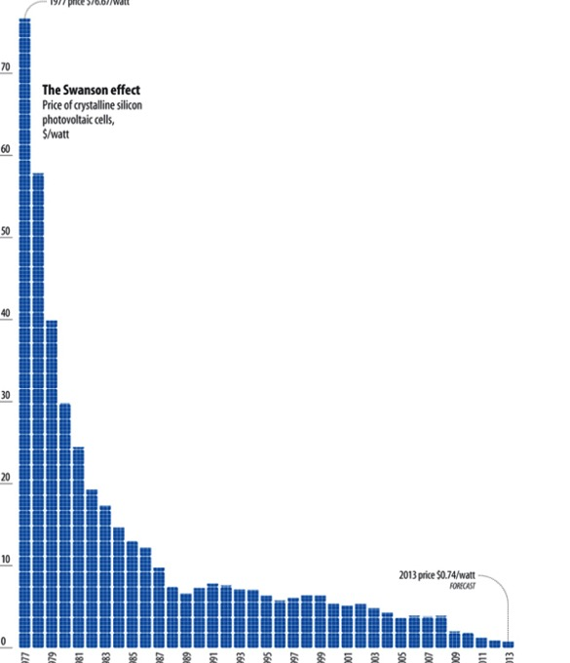
Part 3: Solar economics
Solar is increasingly affordable
Costs have dropped 90% since the 1970s
Solar is no longer a specialty or boutique project
But, can still be daunting to tackle
1970’s 2013

Slide 34
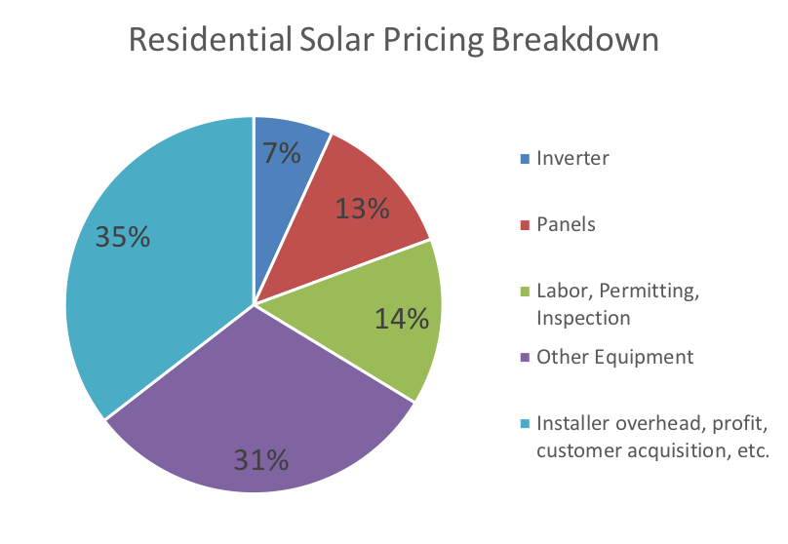
Part 3: Solar economics
Solar Panel Tariff
30% tariff on imported solar panels
Only about 10-15 cents/watt (estimated)
Average 7kW system = $1,050 -- $735 after tax credit
Tariff drops down over next four years
2018 – 30%
2019 – 25%
2020 – 20%
2021 – 15%
Source: NREL
Notes:
The relief will include a tariff of 30 percent in the first year, 25 percent in the second year, 20 percent in the third year, and 15 percent in the fourth year. Additionally, the first 2.5 gigawatts of imported solar cells will be exempt from the safeguard tariff in each of those four years. Last year there were roughly 12 gigawatts installed of solar, so 2.5 gigawatts would be about 20% assuming all panels were imported (which is not true).

Slide 35
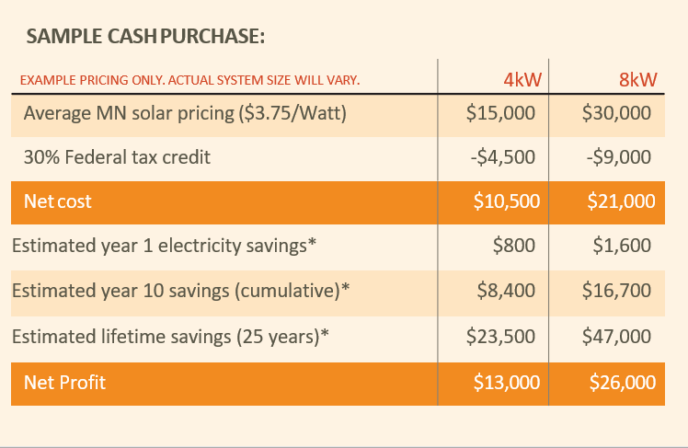
Part 3: Solar economics
* Assumes a 2% electricity price increase per year, 11.72 cents/kWh electricity rate, -.5% panel degradation per year, 1,242 yearly production per 1kW of solar, does not include solar renewable energy credits or additional incentives

Slide 36
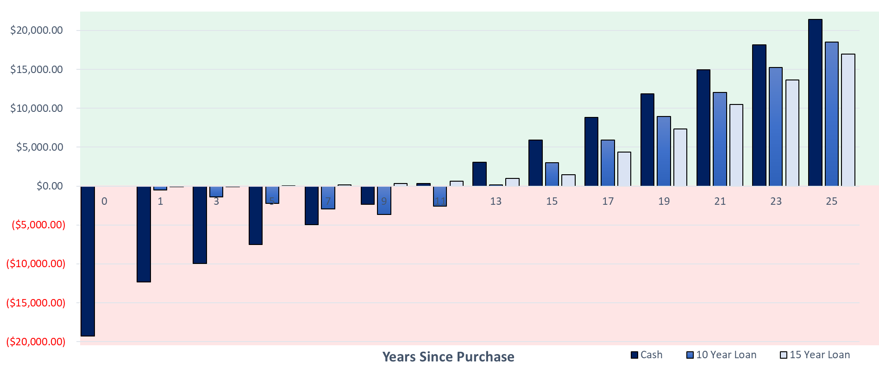
Cumulative Savings with Solar
Cost of solar system after 30% Tax Credit
30% Federal tax credit
Assumptions
SRECs not included, 2% energy increase per year, 7kW System Size, Base Price $2.75/W, 1336 yearly production of 1kW, $0.1243 starting electricity rate, -0.5% panel degradation per year, 4% Interest rate on loan, 70% of cost covered by loan , $0 Operations and Maintenance over system lifetime
Notes:
Photo copy – wont change with excel sheet

Slide 37
Part 3: Solar economics
Incentives: Solar*Rewards (Xcel Energy)
$0.08 / kWh x annual production = yearly check
e.g. 7 kW system → ~$650 check
10 years of payments
10 years = ~$6,500
In addition to net metering arrangement
Solar can be sized to 120% of annual usage
Must conduct energy audit
Xcel will own SRECs for 10 years

Slide 38
Part 3: Solar economics
Financing to own
Installers offer financing
Banks & credit unions offer loans & HELOCs
Center for Energy & Environment solar loan
Fix Up Loans (MHFA)
Third party ownership (rare in MN)
Leases
Power Purchase Agreements

Slide 39
What’s next?

Slide 40
What’s next?
Visit our website: www.solarunitedneighbors.org/Minnesota
Join the Minneapolis Solar Co-op:
www.solarunitedneighbors.org/minneapolis
Join the listserv
Spread the word!

Slide 41
Useful resource

Slide 42
Thank you!
Virginia Rutter
Solar United Neighbors of Minnesota
mnteam@solarunitedneighbors.org

Slide 43
Part 3: Solar economics
Incentives: Solar Rebate (Rochester Public Utilities)
$0.50 / watt, up to $5,000 total
e.g. 7 kW system → $3,500 rebate
Paid out as check
In addition to net metering arrangement
Must conduct energy audit & share with utility
Must conduct shading analysis
Utility keeps the SRECs for life of PV system

Slide 44
Part 3: Solar economics
Incentives: Solar Rebate (Dakota Electric)
$0.50 / watt, up to $4,000 total
e.g. 7 kW system → $3,500 rebate
Paid out in monthly bill credits
$0.08 / kWh x monthly production = bill credit
Up to 10 years of payments
In addition to net metering arrangement
Solar can be sized to 120% of annual usage
Customer keeps the SRECs

