Slide 1
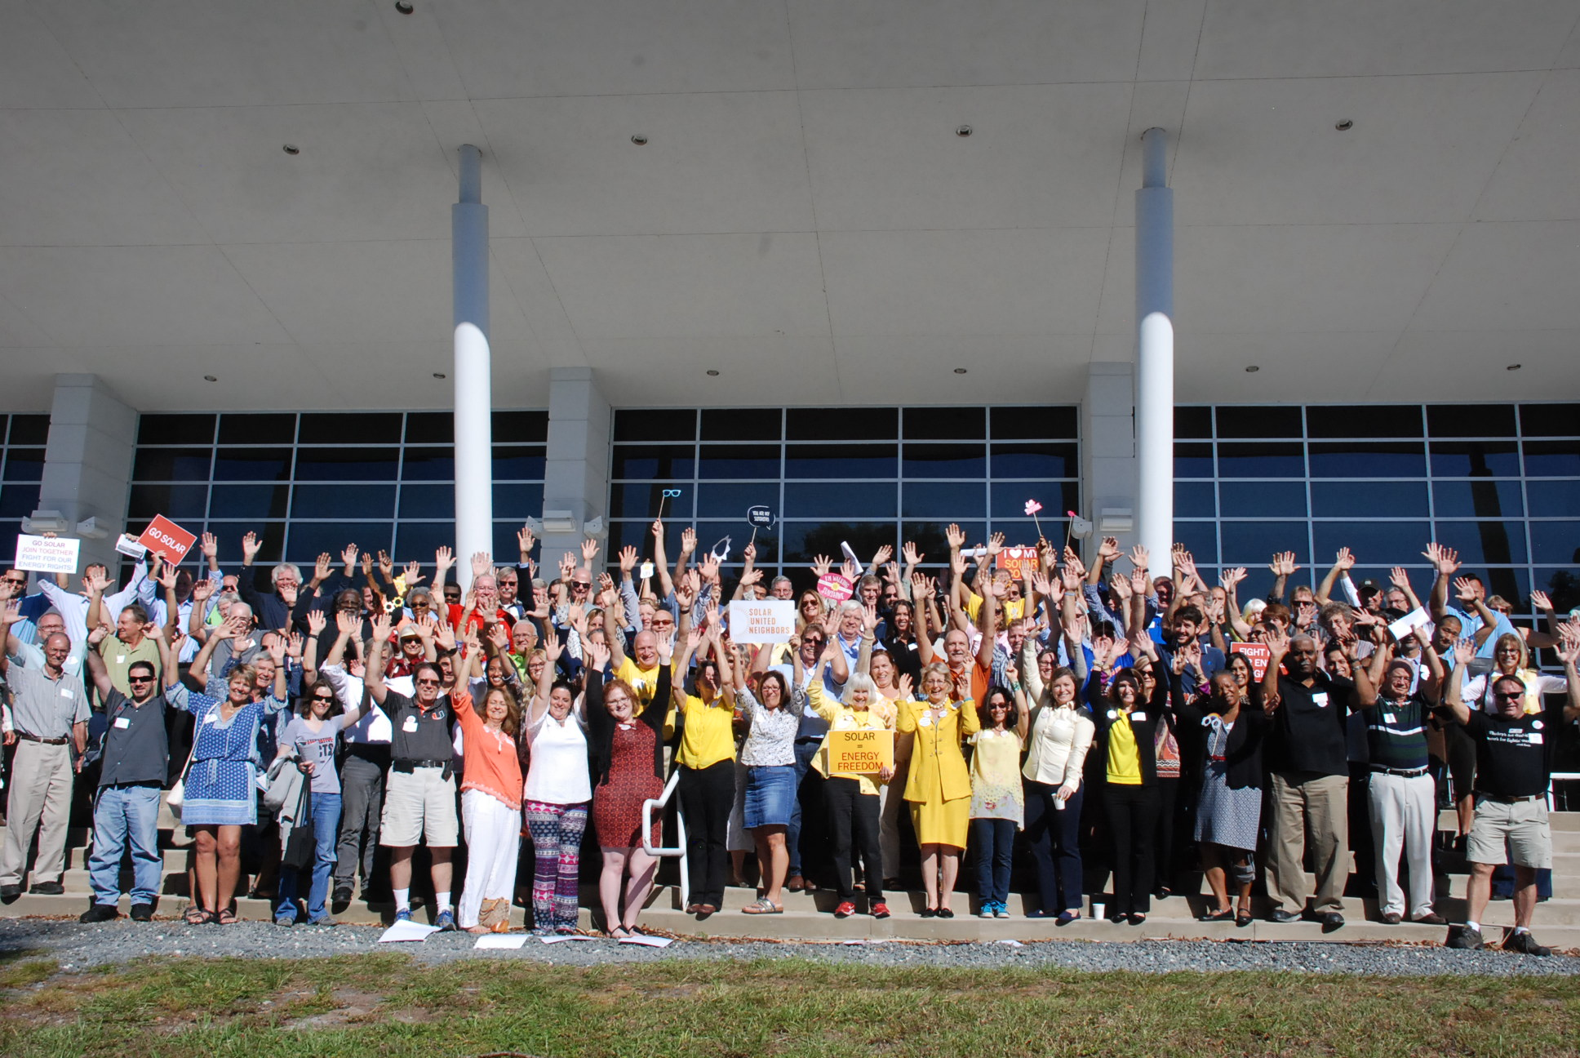
Solar Congress 2018

Slide 2
Overview
1. Who we are
2. How we got started
3. Thank You!
4. What’s to come

Slide 3
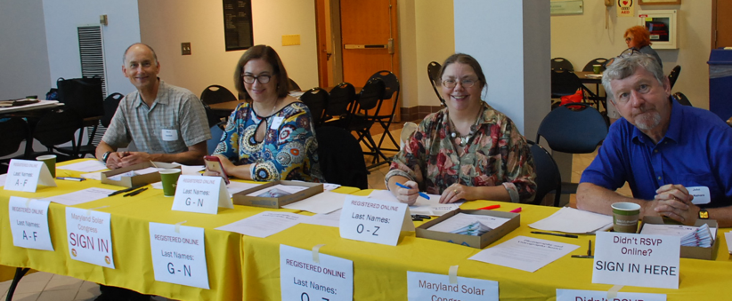
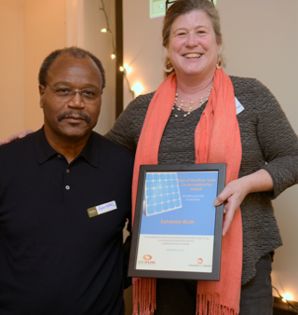
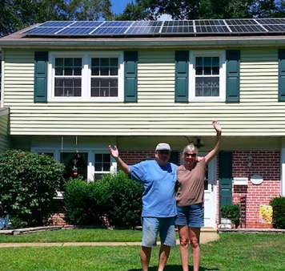
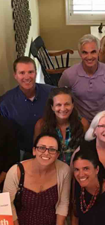
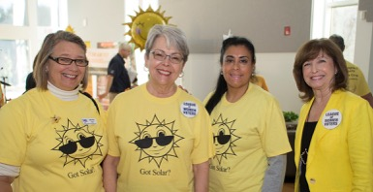
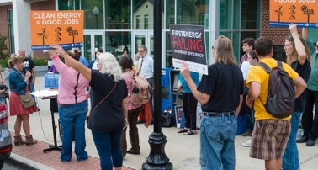
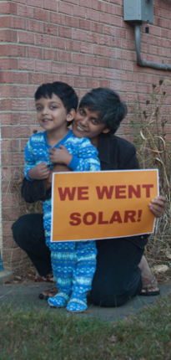
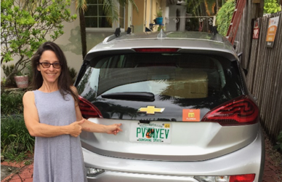
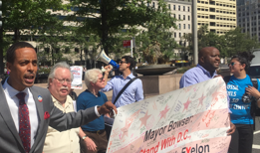
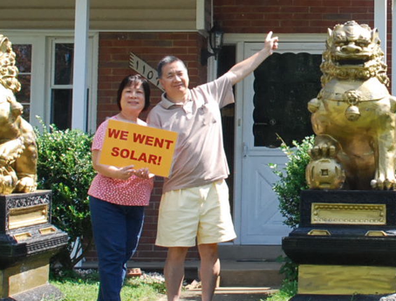
We’re a community of people building a new energy system with rooftop solar at the cornerstone. We help people go solar, join together, and fight for their energy rights.

Slide 4
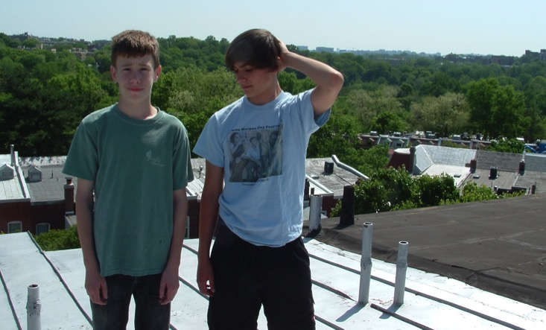
How we got started
Started in 2007 and it wasn’t easy!

Slide 5
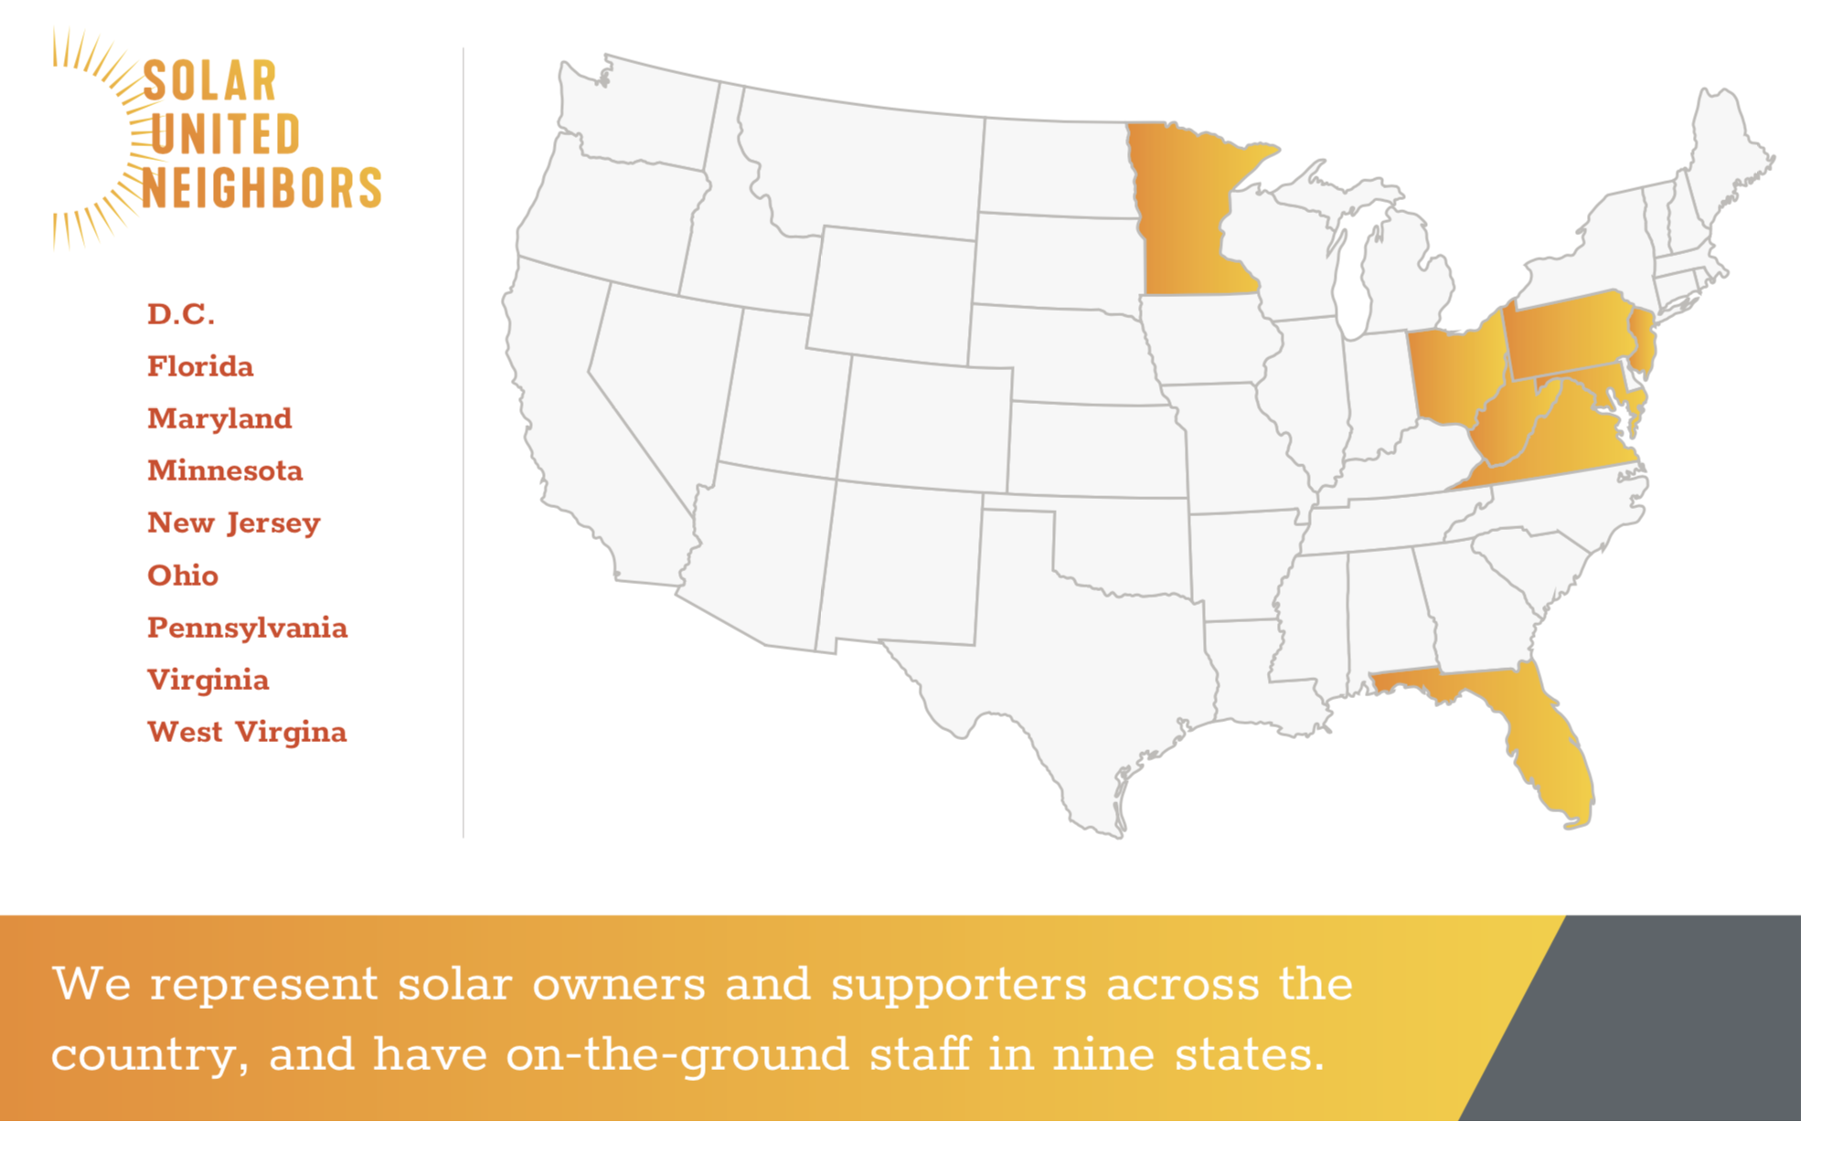
How we help you go solar
Notes:
Just hired someone in TX, CO and IN coming next year!

Slide 6
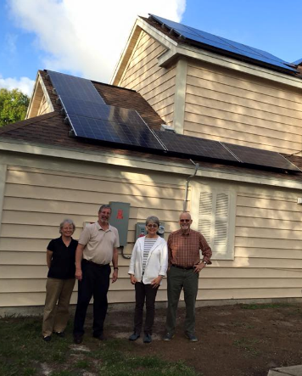
How we got started
Florida program started in 2015 when two volunteers heard about solar co-ops on the radio and wanted to bring them to Florida
Program launched officially in 2016 with major support from the League of Women Voters of Florida
Notes:
Mary Dipoye, of Orlando, heard about our nonprofit on NPR and knew she had to get this down to Florida! We had a couple pilot programs, then officially launched our Florida program in 2016.

Slide 7
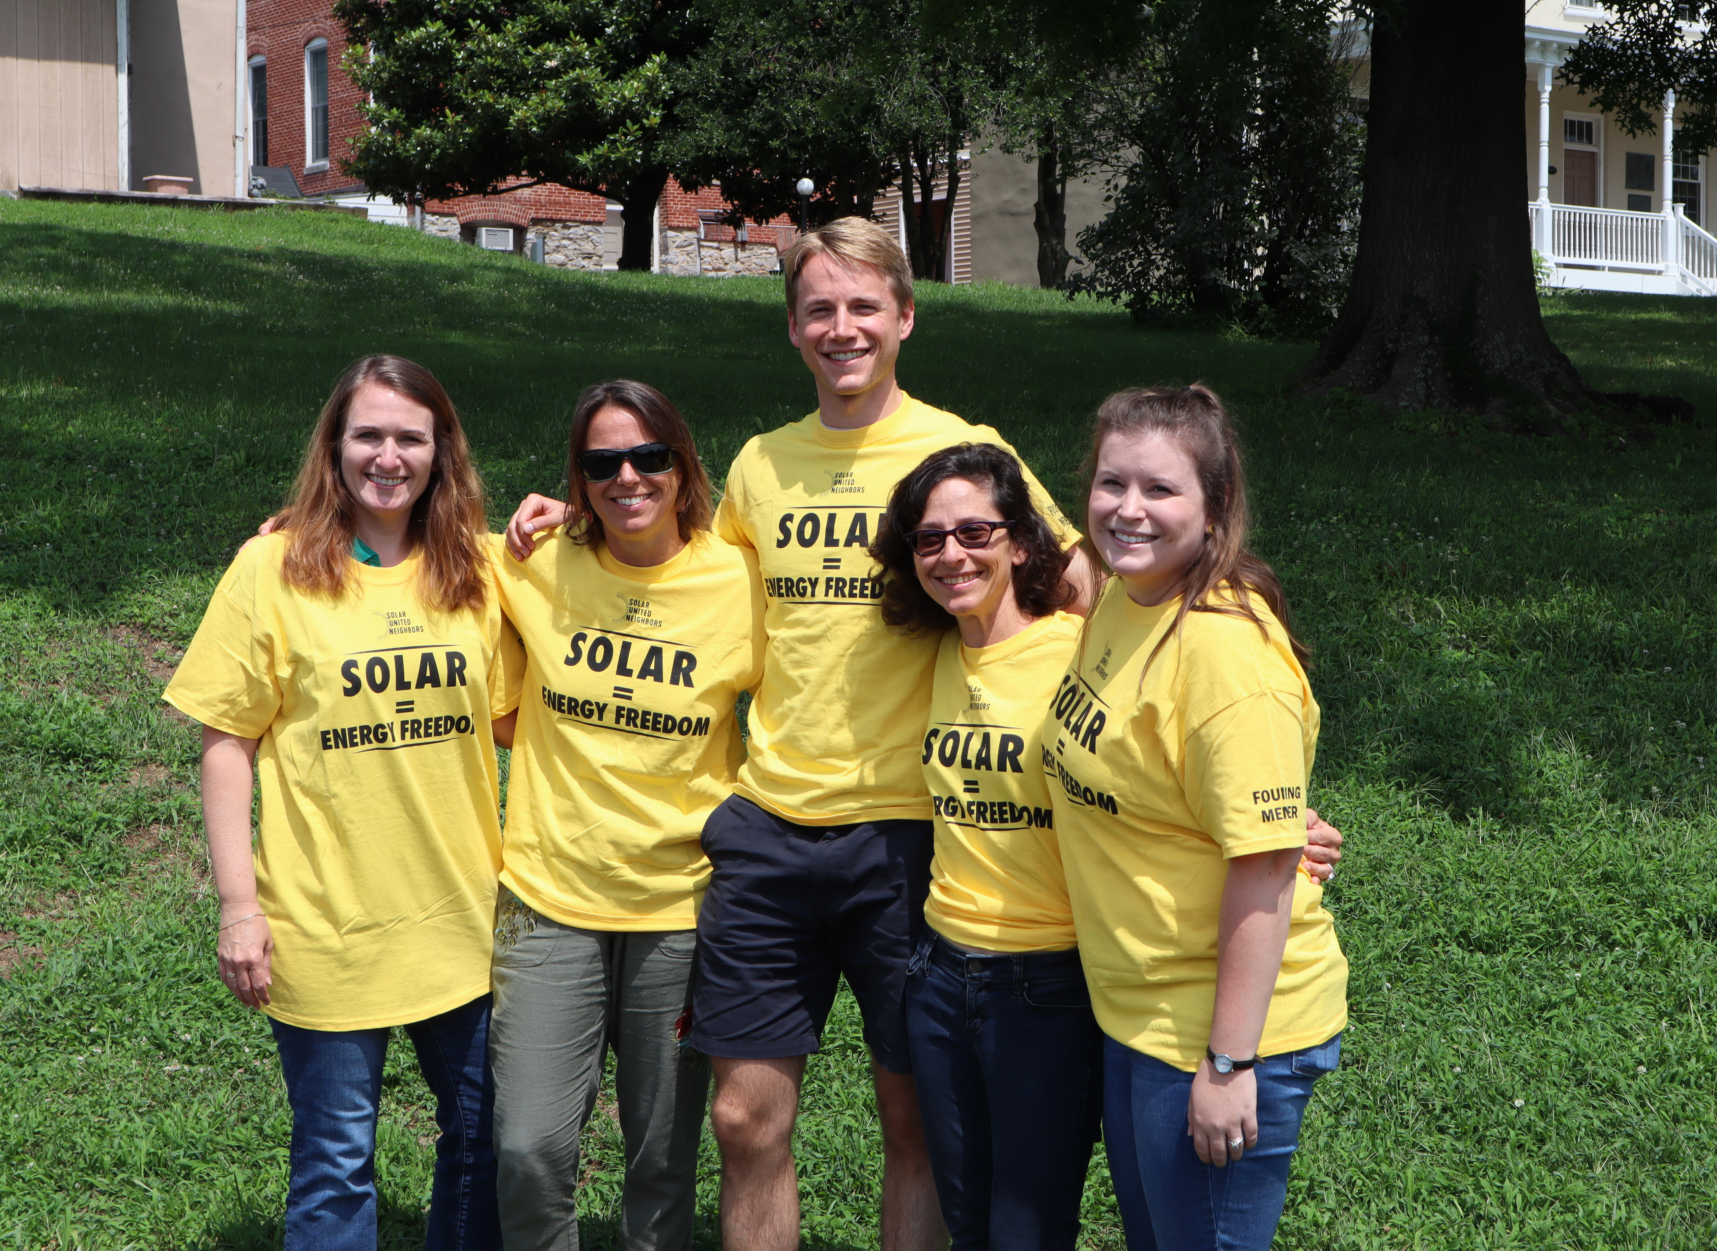
The Florida Team

Slide 8
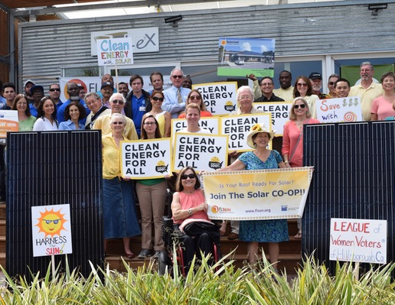
We help people go solar, join together, and fight for their energy rights
FLORIDA’s
impact is expanding solar in the Sunshine State!
40
Co-ops across the state—and growing
9,100+
Homeowners educated
11.5 MW
installed by our members
1,257
people gone solar with us
$24.6 M
invested in economy
438 M
lbs carbon offset
Notes:
This is our impact in a few short years!

Slide 9
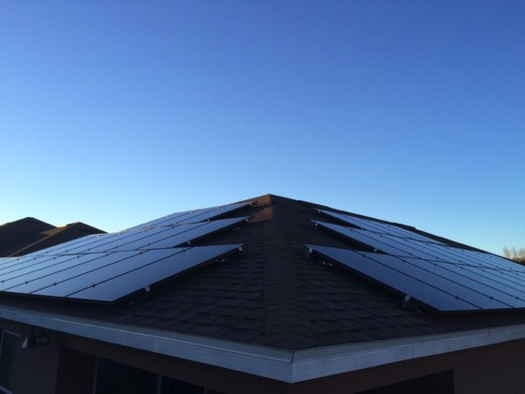
Orange County x5
St. Pete x4
Space Coast
Sarasota County x2
West Broward
Palm Beach County x2
Volusia County
St. Johns County
East Broward
Okaloosa-Walton
Citrus County
Alachua County x2
Seminole County
Miami-Dade County x6
North Pinellas County
Hillsborough County
Highlands County
Leon County
Upper Keys
Franklin-Bay
Manatee County
Polk County

Slide 10
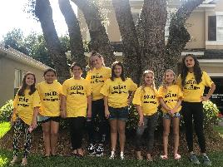
Deeper Engagement: Youth, business, partnerships
Partnership with ASES to organize National Solar Tour
National voting competition to crown America’s favorite craft solar brewery
Scouting patch program for Girl Scouts across the country
National directory of solar-powered businesses
Notes:
We are working to create meaningful engagement with different communities to spread the word about clean energy

Slide 11
We couldn’t do it without you!

Slide 12
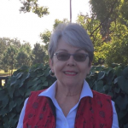
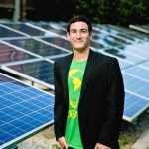
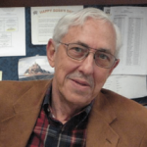
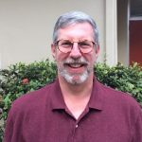
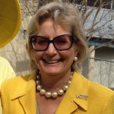
Mary Dipboye
Chris Castro
Dr. Rick Garrity
Michael Cohen
Deirdre Macnab
Notes:
Our Advisory Board!

Slide 13
Our Statewide Partners

Slide 14
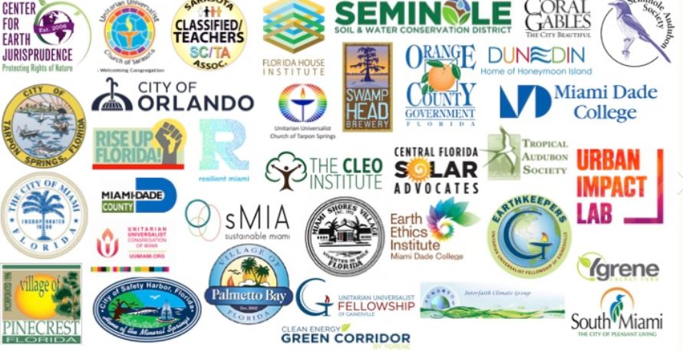
Local Partners - Thank You!

Slide 15
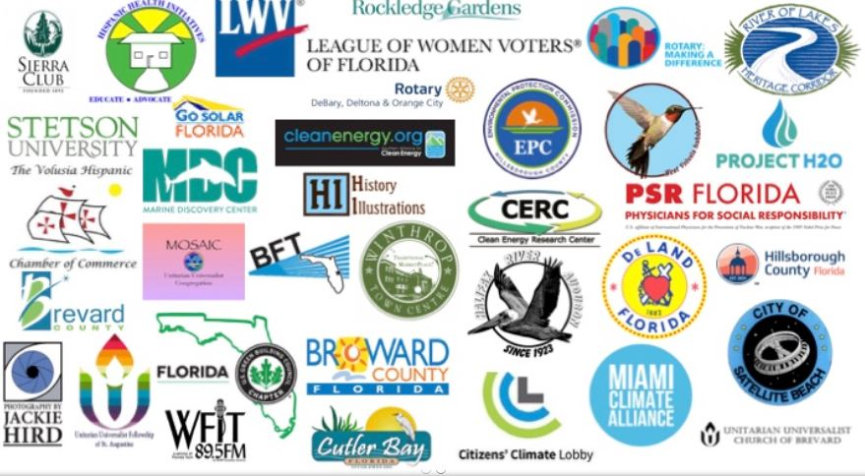
Local Partners - Thank You!

Slide 16
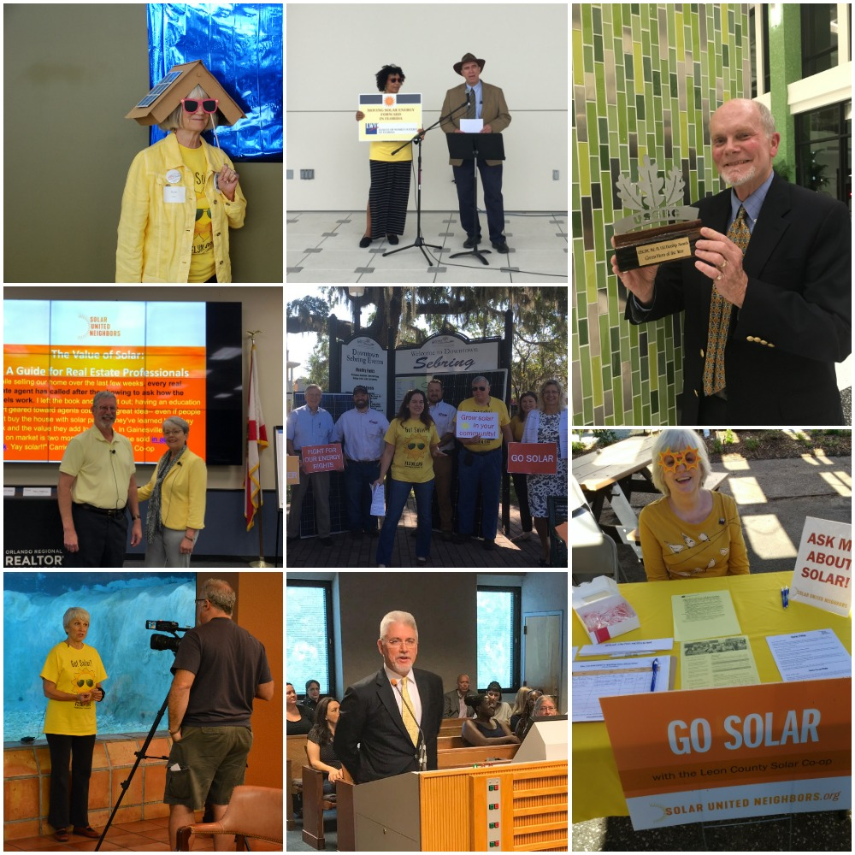
Our Volunteers!

Slide 17
What’s Next?
2019 Co-ops
Membership
Coming Soon
Seminole County, Collier County, Broward County, Escambia County, Hillsborough County, Miami-Dade County and many more…
Individual help outside of the co-op model
Can be faster timeline
Ongoing advice & assistance (post install)
Organizational membership now offered
$85 annual membership

Slide 18
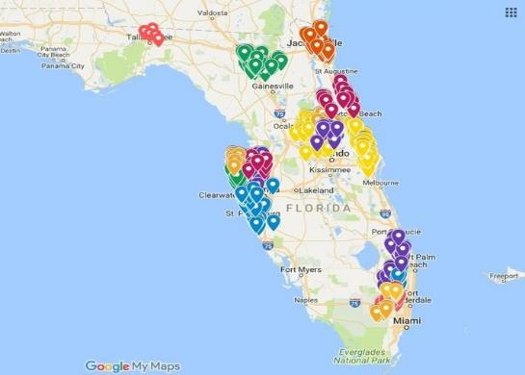
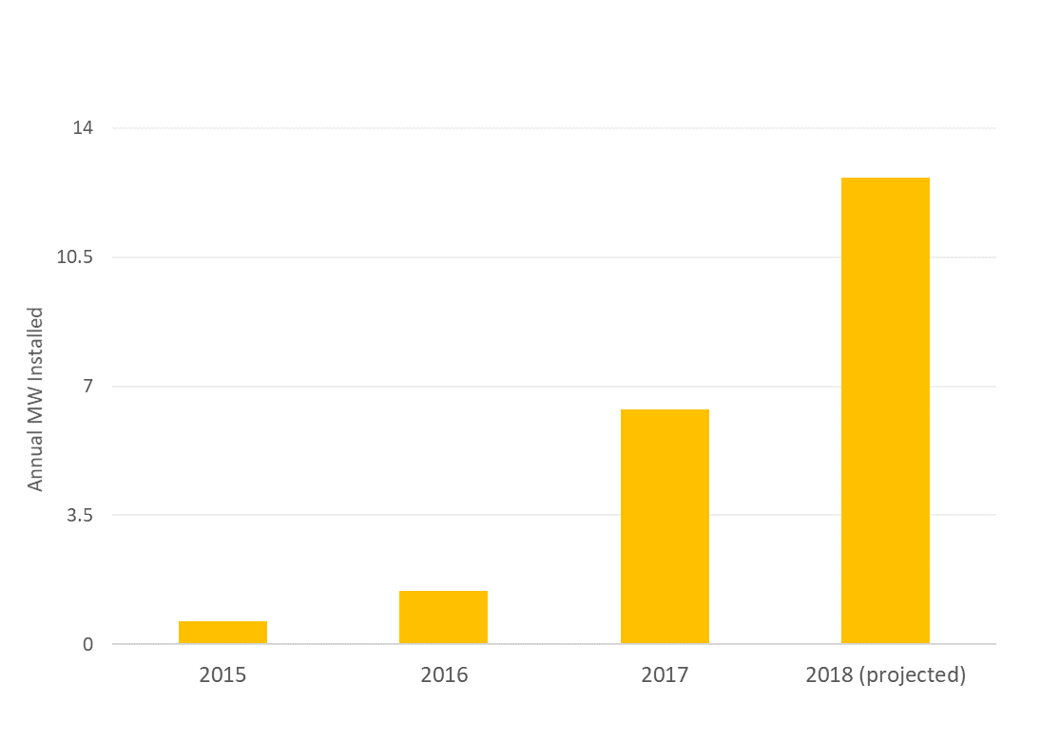
Advocacy: When we organize locally, we win
Jacksonville: Protect net metering and expand storage access
→ Accelerating the market
Statewide:
2016 ballot amendments
St. Pete: 100% clean energy commitment
Co-ops were 9.4% of all new installs
South Miami: Solar construction requirement
Miami-Dade: Permitting barriers
Co-ops were 3.5% of all new installs
→ Improving local & state policy
2 volunteer-led co-ops
Notes:
In Florida we are driving policy and the market

Slide 19
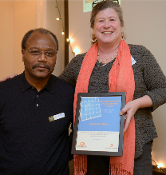
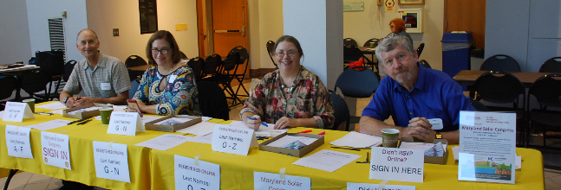
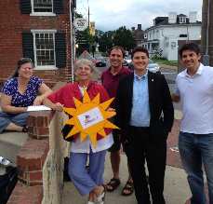
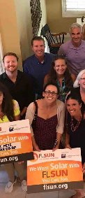
We’re building an army of
solar advocates.
Join us.

Slide 20
Thank you!
Angela DeMonbreun
Solar United Neighbors of Florida

