Slide 1
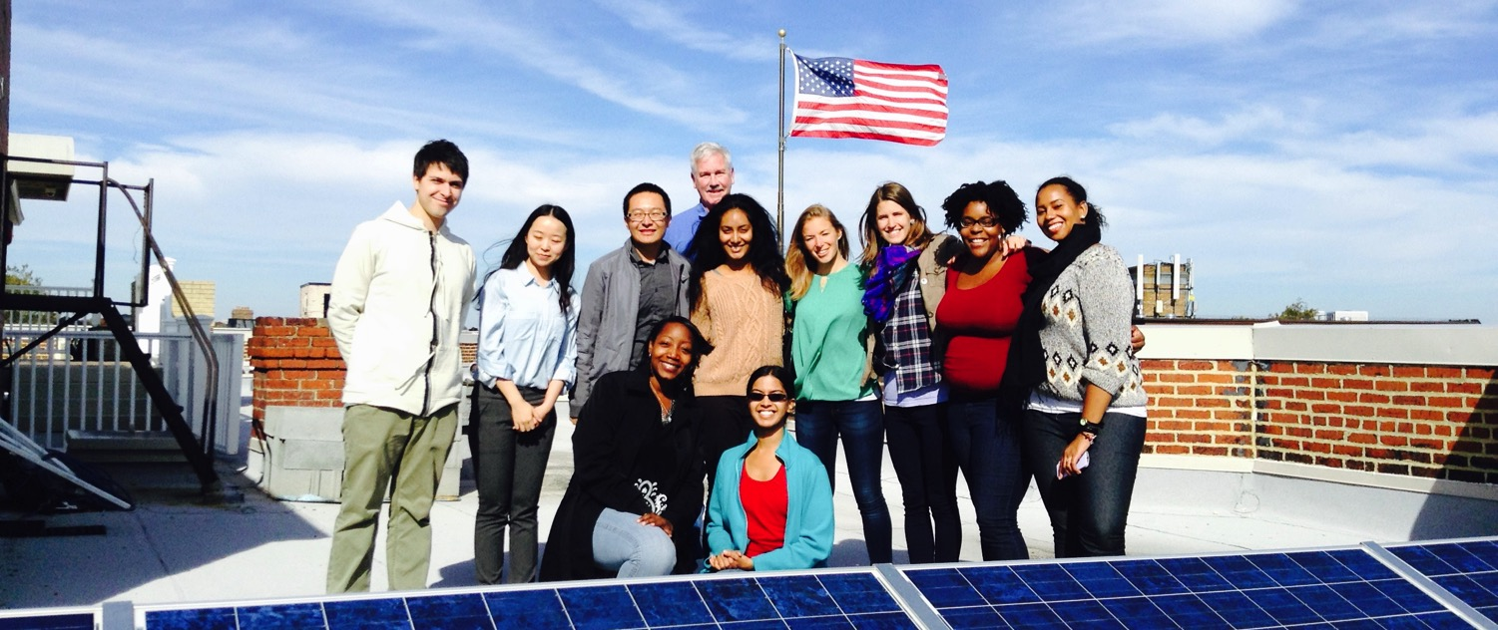
Solar 101

Slide 2
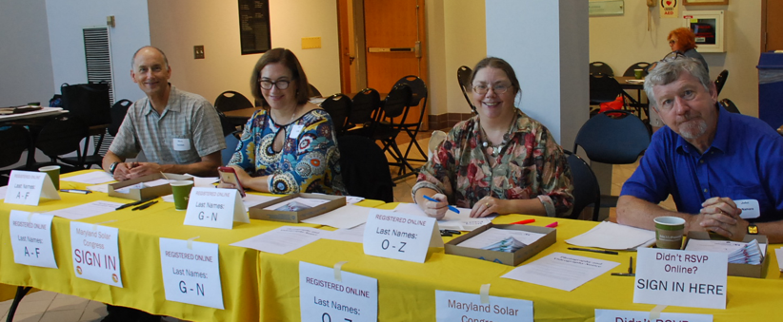
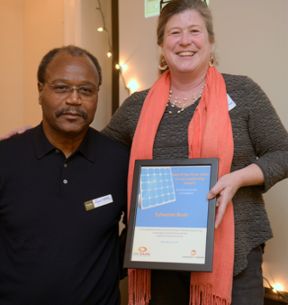
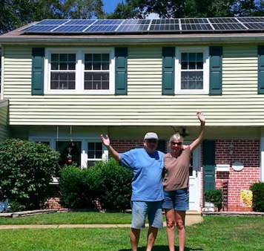
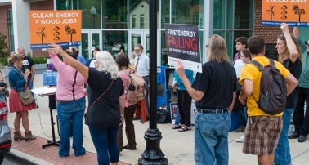
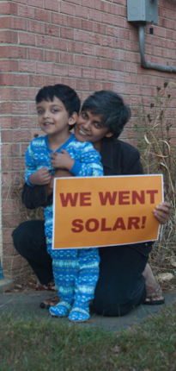
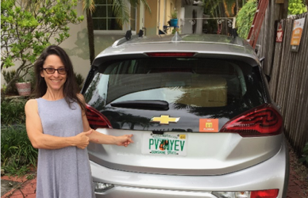
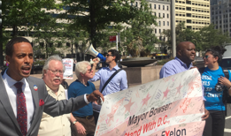
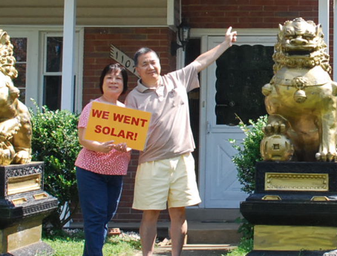
We’re a community of people building a new energy system with rooftop solar at the cornerstone. We help people go solar, join together, and fight for their energy rights.

Slide 3
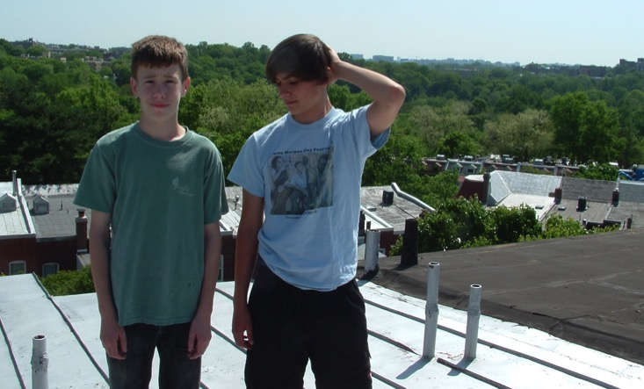
How we got started
Started in 2007 and it wasn’t easy!
Notes:
Walter and Diego
50 neighbors
Also passed legislation to make it easier to go solar

Slide 4
Helping communities go solar
Notes:
In original co-op in mt. pleasant, 50 homes went solar. We’ve since expanded to 9 states, with PA being the newest

Slide 5
Presentation in three parts:
Solar technology
How solar co-ops work
Solar economics

Slide 6
Part 1: Solar technology

Slide 7
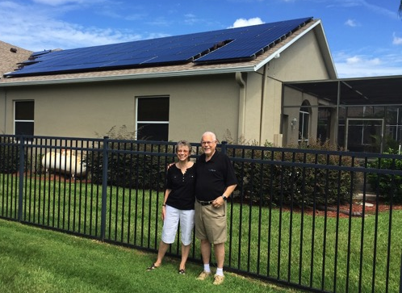
Part 1: Solar Technology
How does a solar panel work?
Solar photovoltaic (PV)
Converts solar energy to electricity

Slide 8
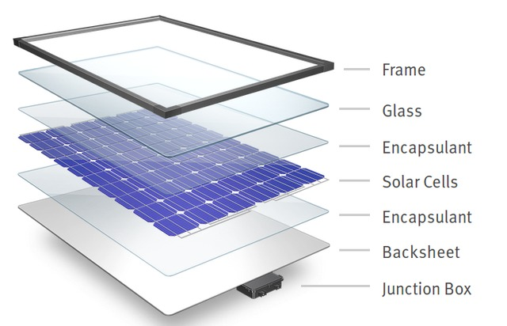
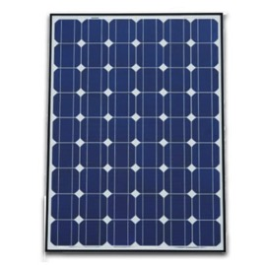
Part 1: Solar technology
System components
Panels
Solar Array
Panel / Module
Image Source: DuPont

Slide 9
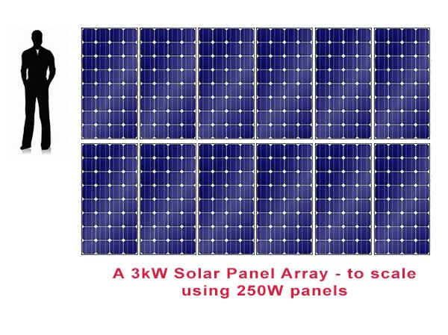
Part 1: Solar technology
Terminology: Kilowatts (kW) & kilowatt-hours (kWh)
System measured in kW
Electricity production in kWh
Most homeowners install between 2 kW – 12 kW
Notes:
Kilowatt – size of the system, like potential horsepower in an engine
Kilowatt hours – electricity produce over time, this is what you see on your bill

Slide 10
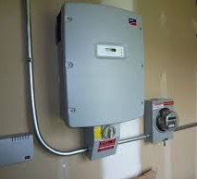
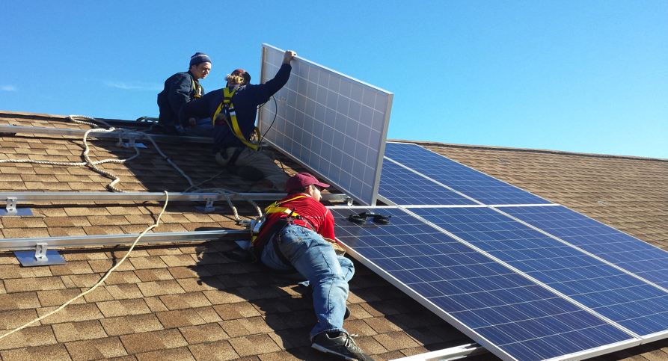
Part 1: Solar Technology
System components:
Inverter & Racking
Inverter
Racking system

Slide 11
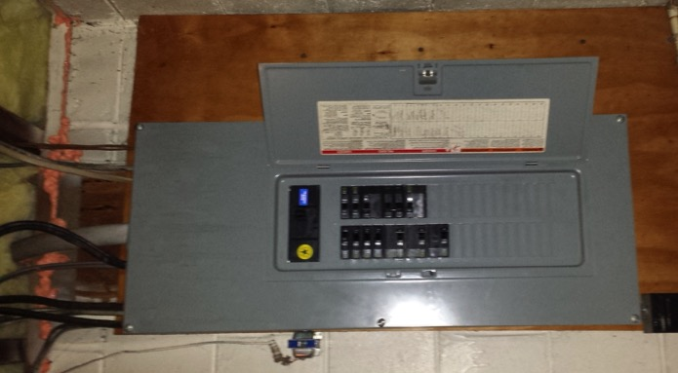
Part 1: Solar Technology
How does it connect to my electrical panel?
Simple connection, most home electric systems don’t need upgrades before solar

Slide 12
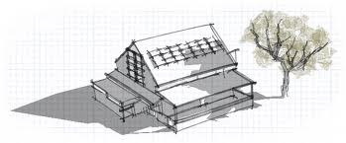
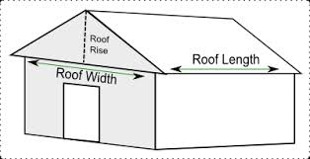
Part 1: Solar technology
What makes a good site for solar?
No shading
Roof faces southerly direction
Enough space to mount panels

Slide 13
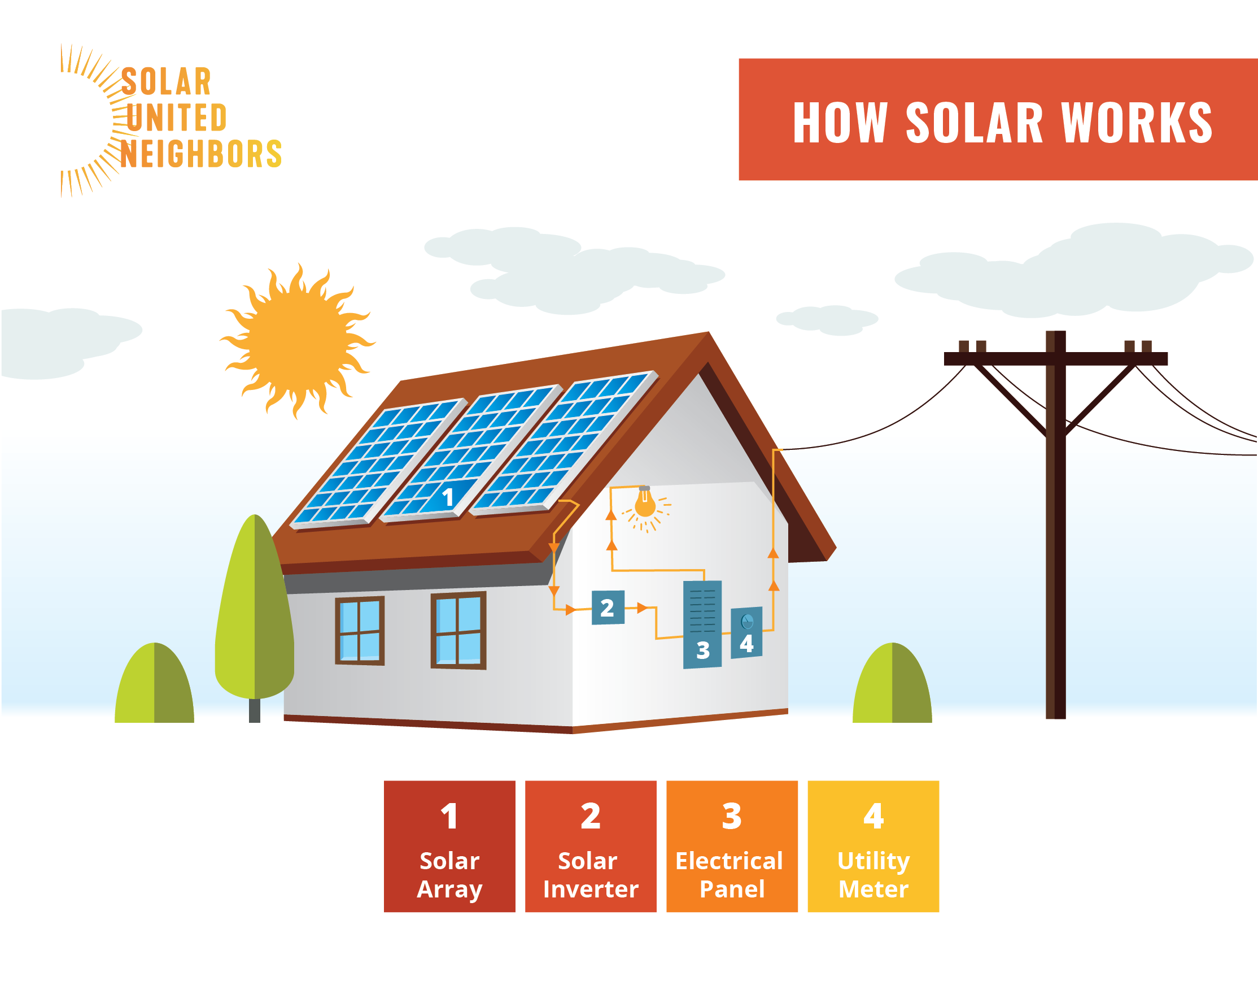
Part 1: Solar technology

Slide 14
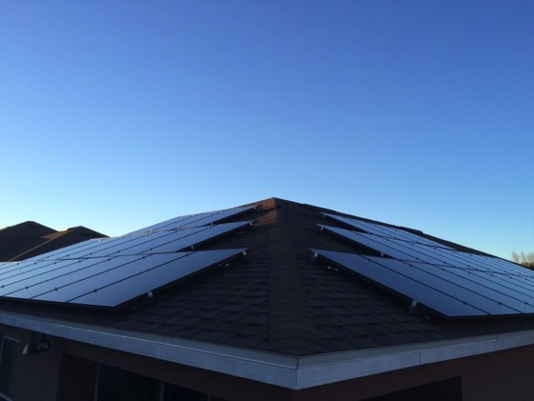
Part 1: Solar technology
What is net metering?
Allows flow of electricity to AND from customer
When generation is more than use, extra electricity flows back through meter
You receive a credit on your power bill for that excess production
Notes:
PA: our net metering policy is great, but it only applies to Investor Owned Utilities (Duquesne, West Penn, Penelec, etc), not rural electric co-ops. Many rural electric co-ops adopt the same or very similar net metering policy, but not all do, and they don't have to. They can reach out to me if they want help figuring our their REC or municipal utility's policy
120%
Give example over course of a day. Panels are cranking out power, and if it’s a really sunny day in June and you’re not using a lot of power, you produce excess power that flows out through your meter (spin it backwards) and then is used at your neighbors. At night you’re going to pull in electricity from the grid. At end of month, the total amount of what you use, minus what you produced, and that’s the netted amount. ** credit on bill, not a check. So don’t want to credit

Slide 15
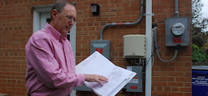
Part 1: Solar technology
Net metering, continued
Monthly electric bill:
[Amount electricity used] – [Amount electricity produced]
Utilities required by law to let you net meter

Slide 16
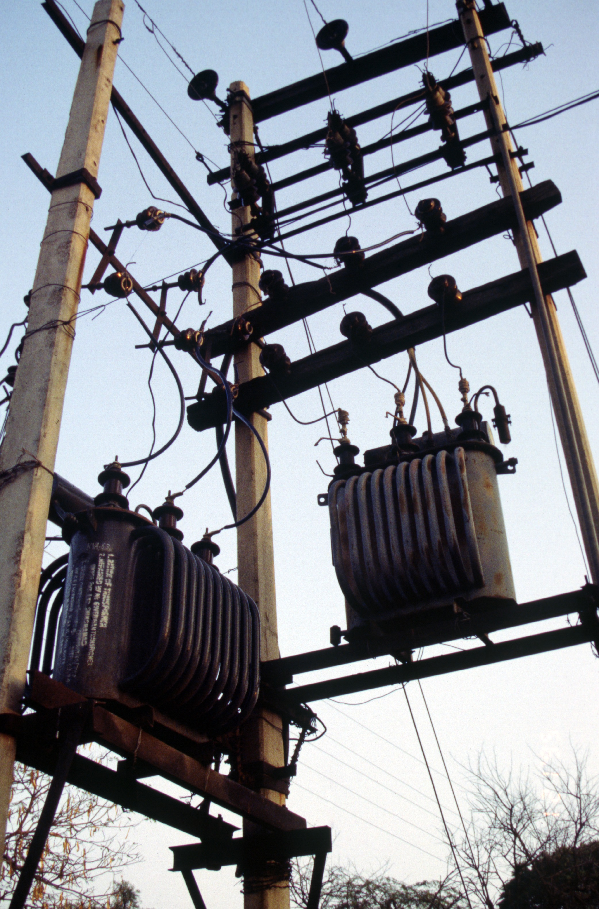
Part 1: Solar Technology
What happens when the power goes out?
When grid is down, solar shuts off (safety mechanism)
Need batteries if you want you want power during outages

Slide 17
Part 1: Solar Technology
Frequently asked questions
Warranties?
Homeowners’ insurance?
Maintenance?
How long do systems last?
Will HOA allow solar on my home?
What if I’m In a historic district?
Notes:
Manufacturer Warranty – Panel: 10-12 years, sometimes longer
Manufacturer Warranty – Central Inverter: 10-15 years
Manufacturer Warranty – Microinverter: 25 years
Production Warranty – Panels: 25 years/80%
Labor Warranty: 10 years

Slide 18
Part 2: How solar co-ops work

Slide 19
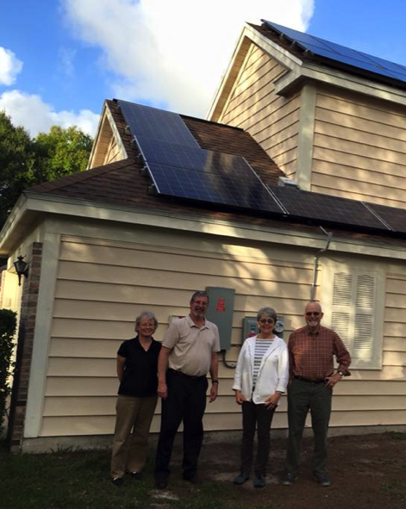
Part 2: How Solar Co-ops Work
Solar co-op benefits
Get a better deal on solar
Get unbiased support from Solar United Neighbors
Become part of the growing solar movement

Slide 20
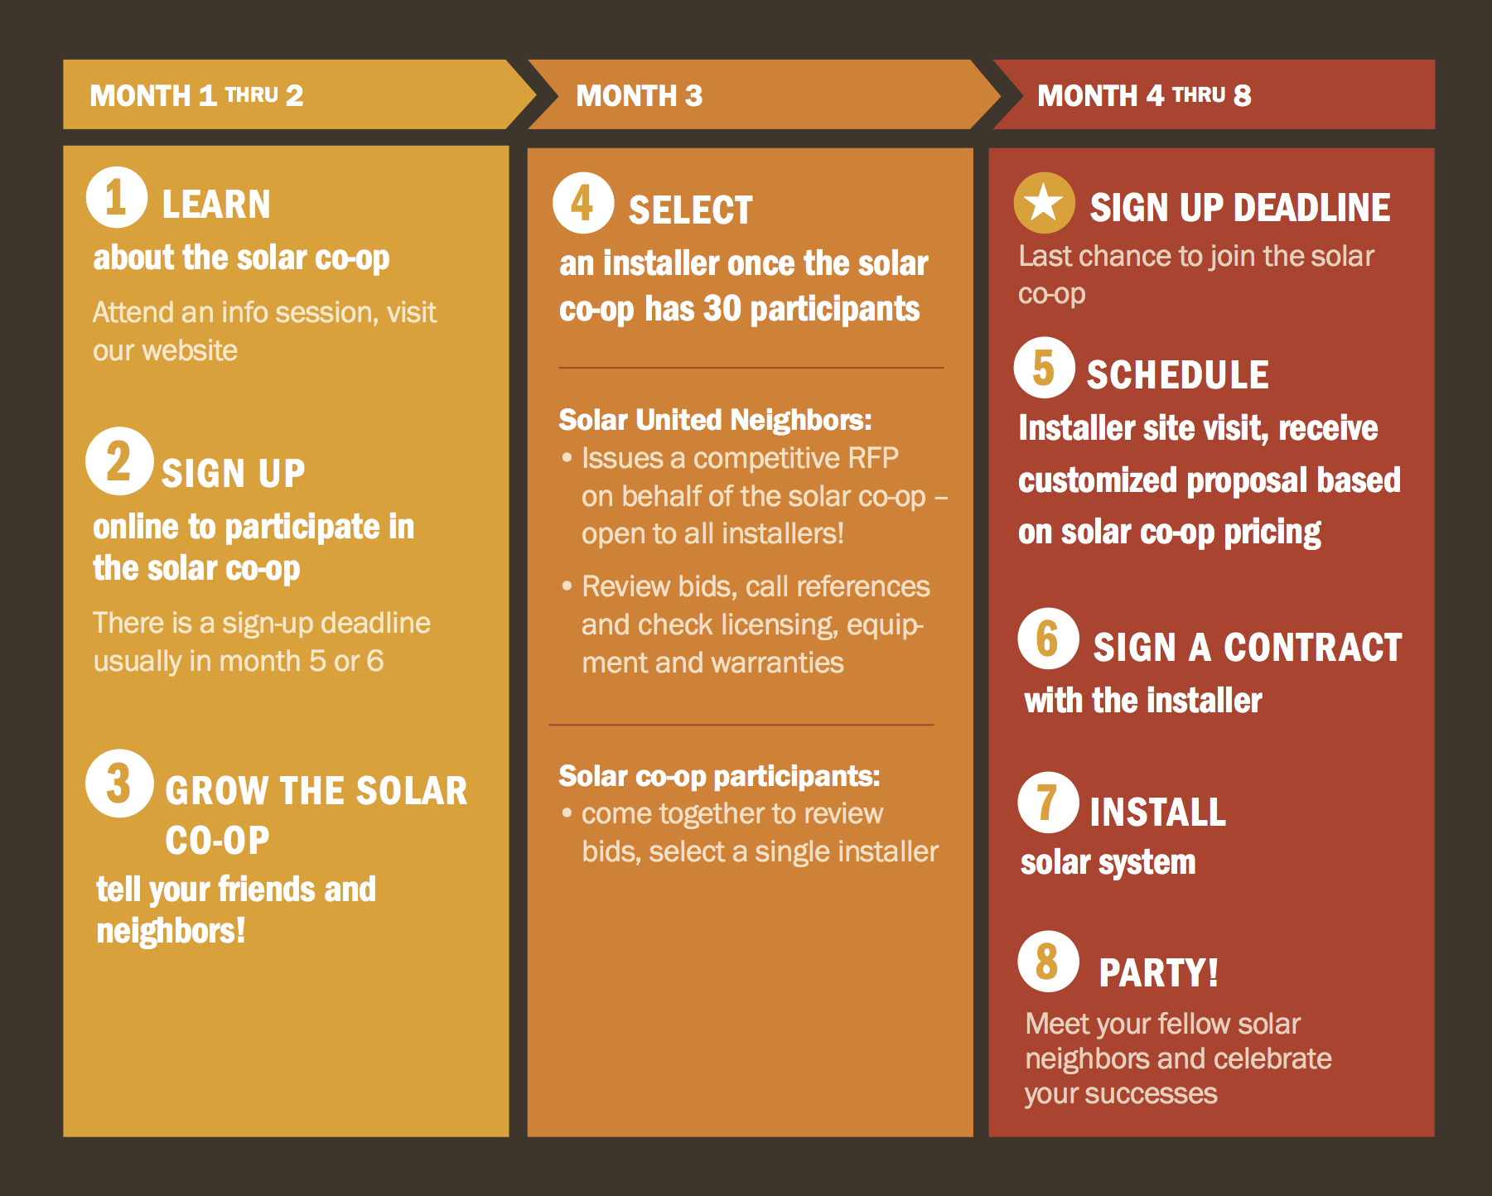
Part 2: How Solar Co-ops Work

Slide 21
Part 3: Solar economics

Slide 22
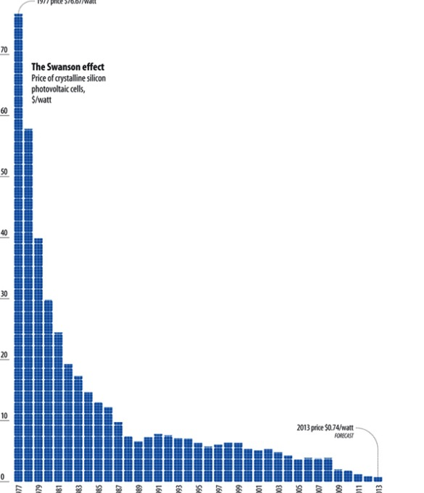
Part 3: Solar economics
Solar in increasingly affordable
Costs have come down 90% since the 1970s
Solar is no longer a specialty, expensive or boutique project for a homeowner
But, can still be daunting to tackle
1970’s Today

Slide 23
Part 3: Solar economics
$/W
Assumptions: 5.7 kW system size, adjusted for inflation, national data.
Citation: Fu, Ran, David Feldman, and Robert Margolis. 2017. “U.S. Solar Photovoltaic System Cost Benchmark Q1 2017.” NREL/TP-6A20-68925. Golden, CO: National Renewable Energy Laboratory (NREL). https://www.nrel.gov/docs/fy17osti/68925.pdf.

Slide 24
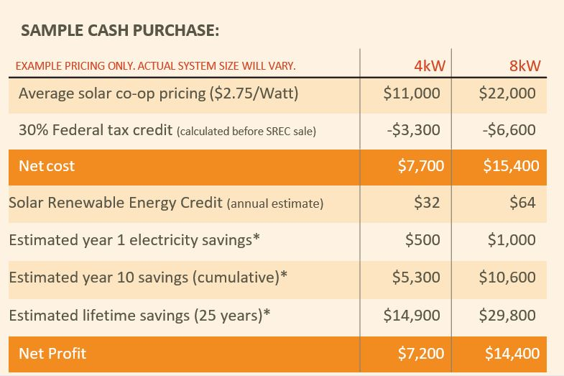
Part 3: Solar economics
Notes:
Talk about financing
~18% alternative energy resources by compliance year 2020-2021
our SRECs suck right now because our solar carve out is unambitious. But they are slowly getting better, and if we change the right policies, they may be very valuable during the life of a solar system.

Slide 25
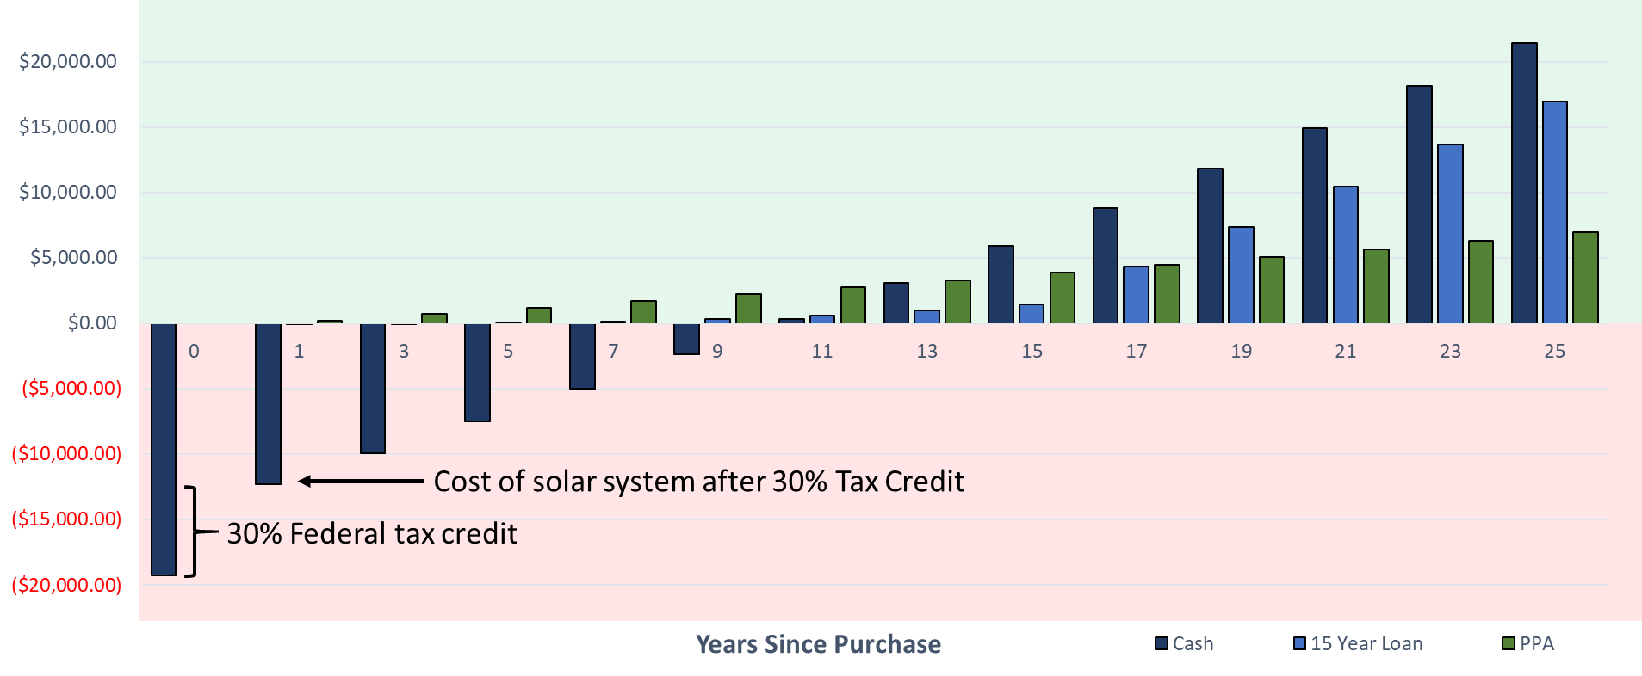
Cumulative Savings with Solar
Assumptions
SRECs not included, 2% energy increase per year, 7kW System Size, Base Price $2.75/W, 1336 yearly production of 1kW, $0.1243 starting electricity rate, -0.5% panel degradation per year, 4% Interest rate on loan, 70% of cost covered by loan , $0 Operations and Maintenance over system lifetime, Pay 80% of normal electricity cost with PPA
Notes:
Photo copies – wont change with excel sheet

Slide 26
Pittsburgh Home Rehabilitation Program: 0% Home Improvement Loan
This loan can be used to help you go solar and see immediate savings on your electric bill!
Loan Terms:
Up to $25,000 for single unit home
Up to $35,000 for two unit home
0% interest over 20 year payback term
For City of Pittsburgh residents only!
PHRP INCOME LIMITS:
Household Size | Maximum Income
1 Person | $40,700
2 Person | $46,500
3 Person | $52,300
4 Person | $58,100
5 Person | $62,750
6 Person | $67,400
Estimated 25 Year Cumulative Savings:
4kW: $6,500
7kW: $11,000
30% ITC not included in savings calculation!
4kW (30% of upfront cost): $3,300
7kW (30% of upfront cost): $5,775
Assumptions
Base Price: $2.75/W
Electricity Cost: $0.12/kWh (very conservative estimate for Duquesne territory)
Yearly increase in electricity cost: 2%
Yearly production of 1kW of solar: 1,217 kWh
30% ITC not incorporated into these calculations
Loan terms: up to $25,000 loaned, 0% interest over 20 years
4kW Solar: $11,000 loaned for solar installation at $2.75/W
7kW Solar: $19,250 loaned for solar installation at $2.75/W
Estimated Monthly Savings calculated by finding difference between amount owed for loan term and amount saved in electricity offset
0.5% yearly panel degradation
If you meet income requirements call the banking partner (Dollar Bank) at: 412-261-7502 OR the URA at 412-255-6573 and ask for a PHRP Loan Application.
Notes:
45 seconds
-warn people that it takes a year to complete this

Slide 27
Part 3: Solar economics
Financing
Loans
Standard loans
Solar loans & bridge loans
HELOC
Third party ownership
Leases
Power Purchase Agreements

Slide 28
What’s Next?
Join our ListServ:
www.solarunitedneighbors.org/join-our-active-listservs/
Like our Facebook Group:
www.facebook.com/groups/SolarUnitedNeighborsofPennsylvania/
Join a Solar Co-op:
Open for Sign Ups:
Indiana County Solar Co-op
Crawford-Mercer Solar Co-op
Launching this Year:
Allegheny County Solar Co-op
Beaver-Butler Solar Co-op
Monongahela River Solar Co-op
Notes:
Notes: ways to continue to engage with us.

Slide 29
Thank you!
Andrea Hylant
Solar United Neighbors of Pennsylvania
Notes:
Next session will start at 11:40 - in this room (the auditorium) I will be hosting the solar homeowner panel Q&A with five solar homeowners from PA. Downstairs, in the gymnasium, our Pennsylvania program director, Henry McKay, will be hosting a crash course in Pennsylvania Solar Policy

