Slide 1
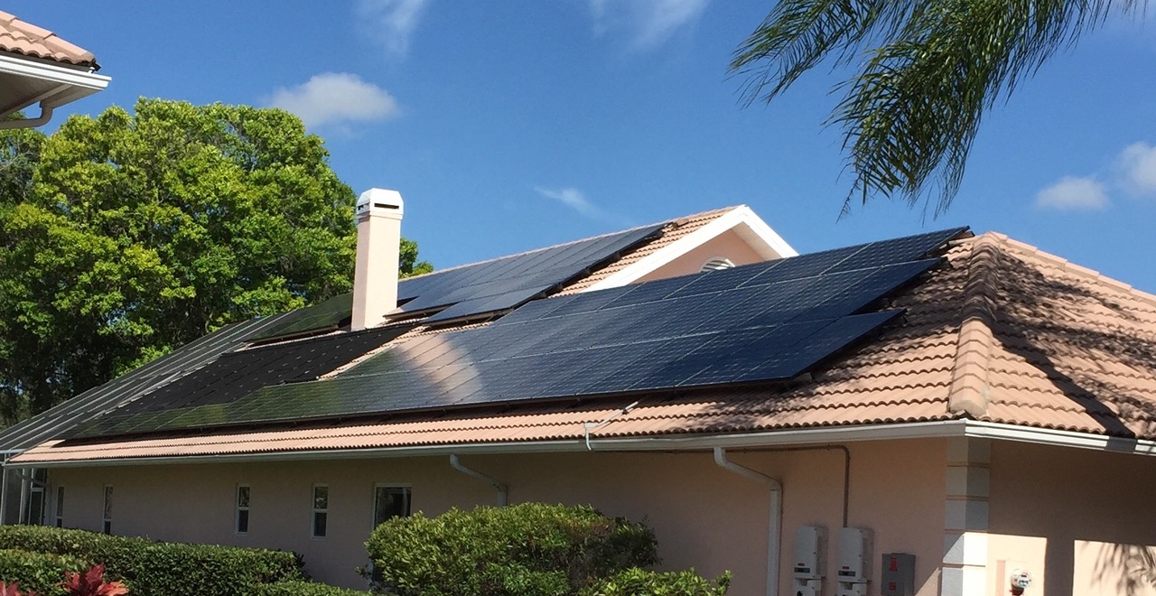
Solar And Storage
Notes:
Speaking Notes: 15 seconds
In this session we will be talking about batter backup storage systems and how they interact with solar panels

Slide 2
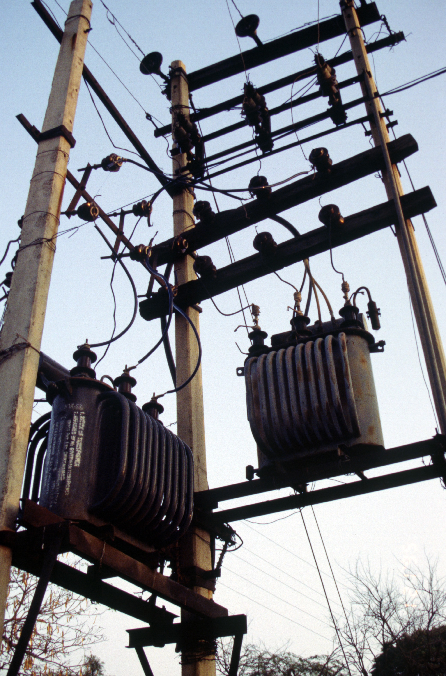
Safety first
What happens when the power goes out?
When grid is down, solar shuts off (safety mechanism)
Need batteries or special inverters if you want you want power during outages.
Notes:
Speaking notes: 30 seconds – setting the stage in the next three slides for the rest of the presentation
Basic overview of what happens to solar system when there is a grid outage.
Solar system will automatically shut off when the grid is down (prevent backfeeding so that workers on the line do not get electrocuted by a live wire that shouldn’t have electrical current running through it)
If you want your system to generate power during a power outage you either need special inverters or battery backup

Slide 3
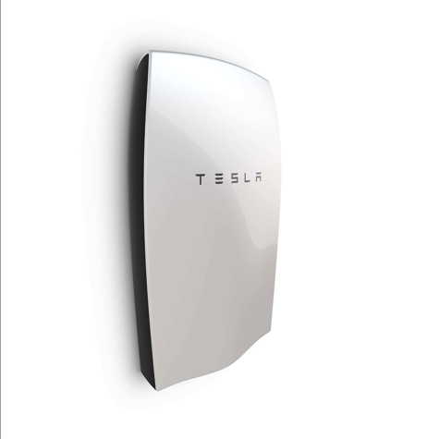
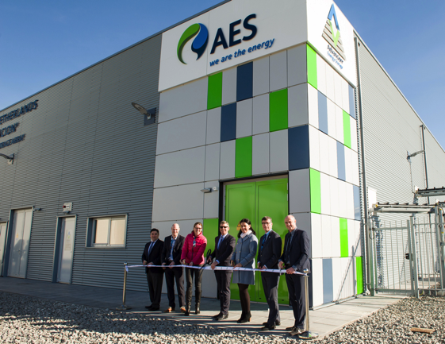
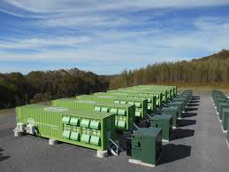
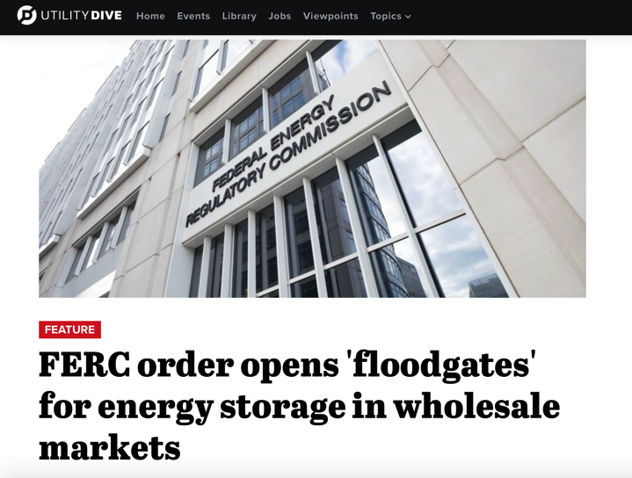
Storage has been getting a lot of press lately…
… what does it mean for you?
Notes:
Target time: 1 minute
Main Message:
Storage is in the news and we are working to dig through all of the reports in order to provide the audience practical info about storage (the fundamentals)

Slide 4
Energy Storage for Homeowners
You might want storage if…
Frequent utility outages
Critical loads at home (ex. well pumps, medical equipment)
Emergency/disaster preparedness
Notes:
Main messages:
These are the kind of things that might make you think about backup power
There are different chemistries. Lead acid’s been around for a while. Lithium ion is newer. There are trade offs to each but more detail than we can go into here.
(If you want more information than we’re discussing in these slides check out our webinar online)
Narrative:
Not everyone needs energy storage for backup power. Most people who are interested are in places where utility service is sometimes unreliable. They might be considering a generator or have a generator and want to replace it or augment it. If you have reliable utility power that rarely if ever goes out then battery backup power is probably not right for you unless you are motivated by disaster preparedness or if you have sensitive and life-saving medical equipment that most always remained powered.

Slide 5
Presentation in three parts:
Technology
Economics
Our work

Slide 6
Part 1: Technology

Slide 7
Two things to consider
Backup
Power for you
Save money or get paid to help the Grid
Notes:
Target time: 1 minute
Main messages:
Backup is what you can get now and there are different technologies that provide that.
Backup power does not make you any money. It will also make your solar array a little less efficient due to energy needed to keep batteries topped off.
Some storage technologies are resources that are flexible in how they can be used and their value may change if the rules of the grid change
Narrative:
Energy storage can do many things from providing backup power to supporting the expansion of renewable energy on the grid. However, it’s very important for you to understand that right now in {STATE}, the only thing that energy storage like batteries can do for you is to provide backup power and it will not make you any money. In fact, if you have solar it will actually reduce the economic impact of your solar for you because some of that solar energy will be used to top off your batteries and keep them ready for use instead of powering other things in your home or generating kilowatt-hour credits for you.

Slide 8
Batteries similar to generator
Source: alarmcentralsecurity.com
Source: Sonnen
Notes:
Target Time: 1-2 minutes
Main messages:
Currently in the states we work in, It’s a replacement for a generator, something to be used instead
Batteries are cleaner and can run with sun as the fuel.
Fossil-fuel powered backup generators can also be an economic source of backup power.
We’re talking about battery backup for grid-tied homes and not about homes that do not have utility electricity service (“Off Grid”)
“Off Grid” systems are similar but include other considerations we don’t cover here
NOTE: “Off Grid” has to be designed to have your full electric load run completely (day in and day out) on a combination of solar, batteries, generators, and possibly other sources like wind and hydro

Slide 9
Energy Vs Power
How is storage sized?
Energy vs Power
Energy
Amount of work the battery can do over time
Measured in kWh
Power
Maximum work it can do at any given time
Measured in kW
eg: a 13.5kWh battery can have a 7kW peak capacity inverter.
Your storage system will be custom for you:
How much energy do you consume?
What do you need to power during an outage?
Available space for storage?
Source: SimpliPhi
Notes:
Main Messages:
Your installer will help you size your system appropriately based on what you want or need to power when the grid is out and your budget
Systems are measured in how much energy they can hold (kWh) and how much power they can put out at one time (kW)
Your installer will help you size your system appropriately but we’ll give an example of an average system later
NOTES:
Example to clarify difference between energy and power. Only use this if someone asks and there’s time to provide during the presentation
Running a 100 Watt light for 25 minutes and running a 1500 Watt microwave for one minute use the same amount of energy (25 Watt-hours)
But the microwave needs 1500 Watts of power all at once and the light bulb only needs 100 Watts at any given moment
If your battery could only produce 1500 watts of power at once you couldn’t run the light bulb and the microwave at the same time

Slide 10
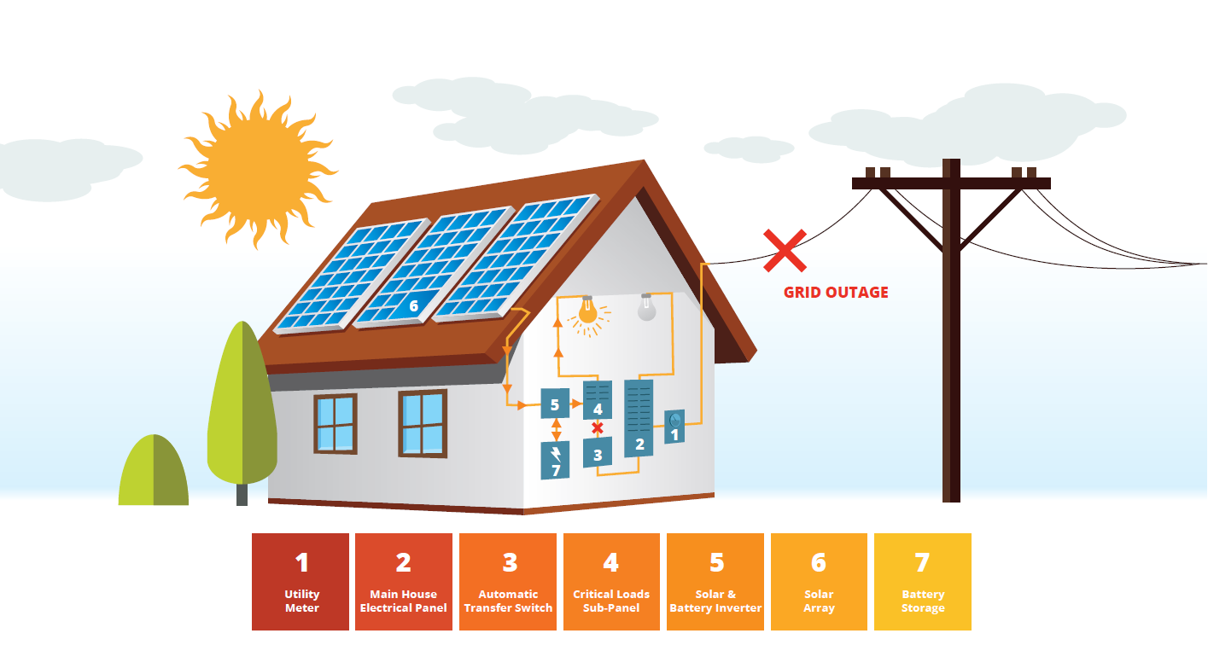
What can batteries power?
Critical home loads
Storage during a utility outage
Seamless backup power
Typically only power critical loads
Matched to battery size/amount
“Critical loads sub-panel”
Notes:
Target time: 2-3 minutes
Main messages:
When the power goes out the batteries kick in seamlessly
It’s uneconomical for people to power their entire home on batteries right now so you will likely need to choose what to run in an outage
A “backed up or critical loads” sub-panel is installed and circuits you want to power in your home during the outage are put there
When the grid goes out the battery backup system disconnects that sub-panel from the grid and powers it until the grid comes back up
Audience engagement:
What would you back up if you had a storage system?

Slide 11
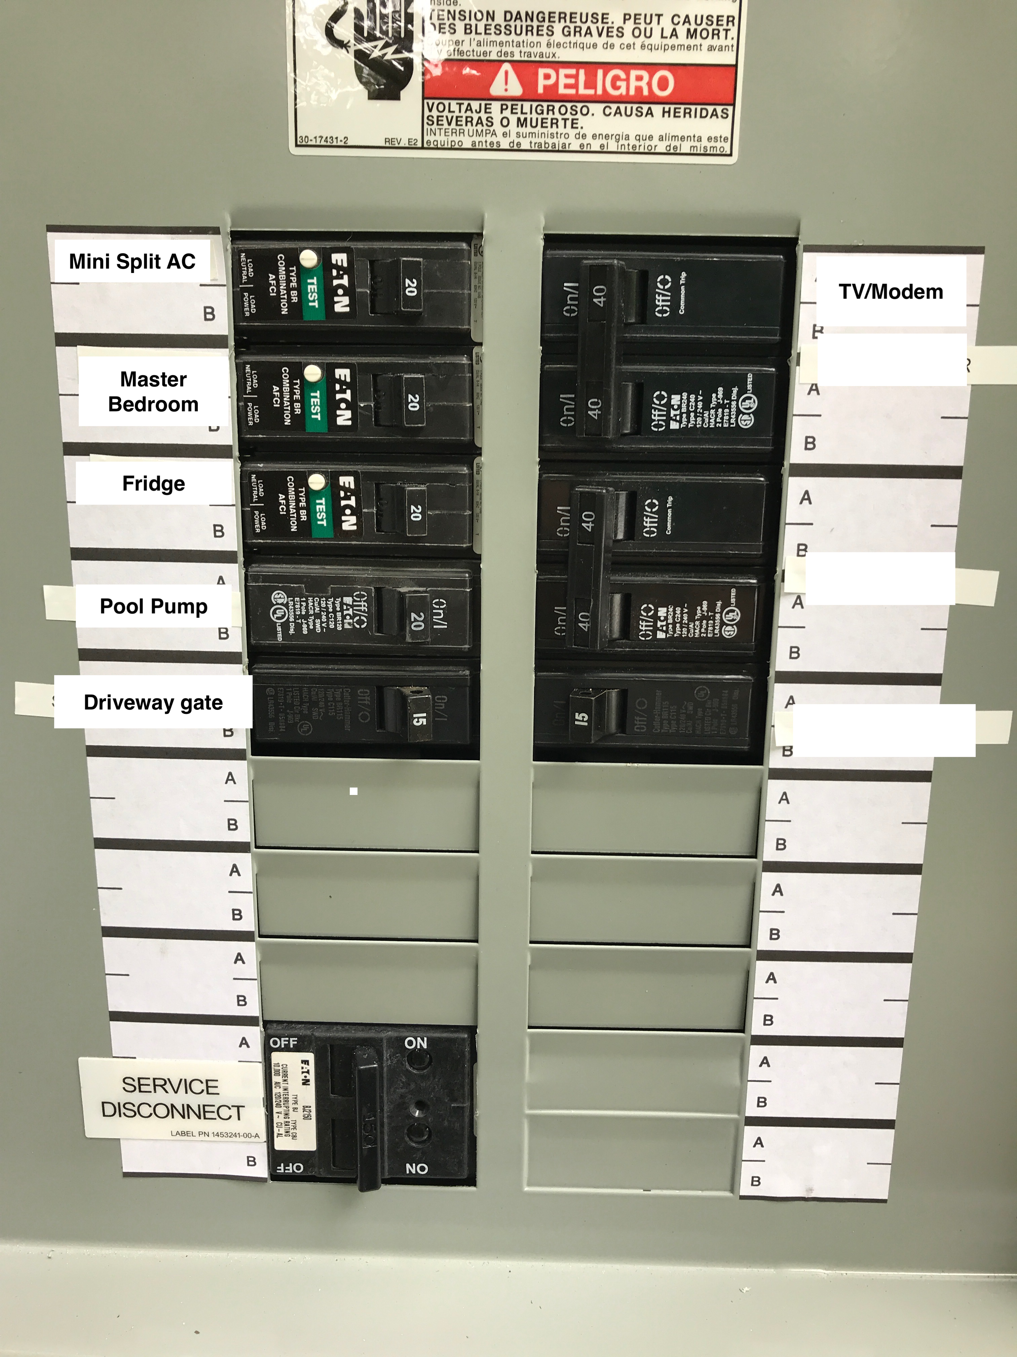
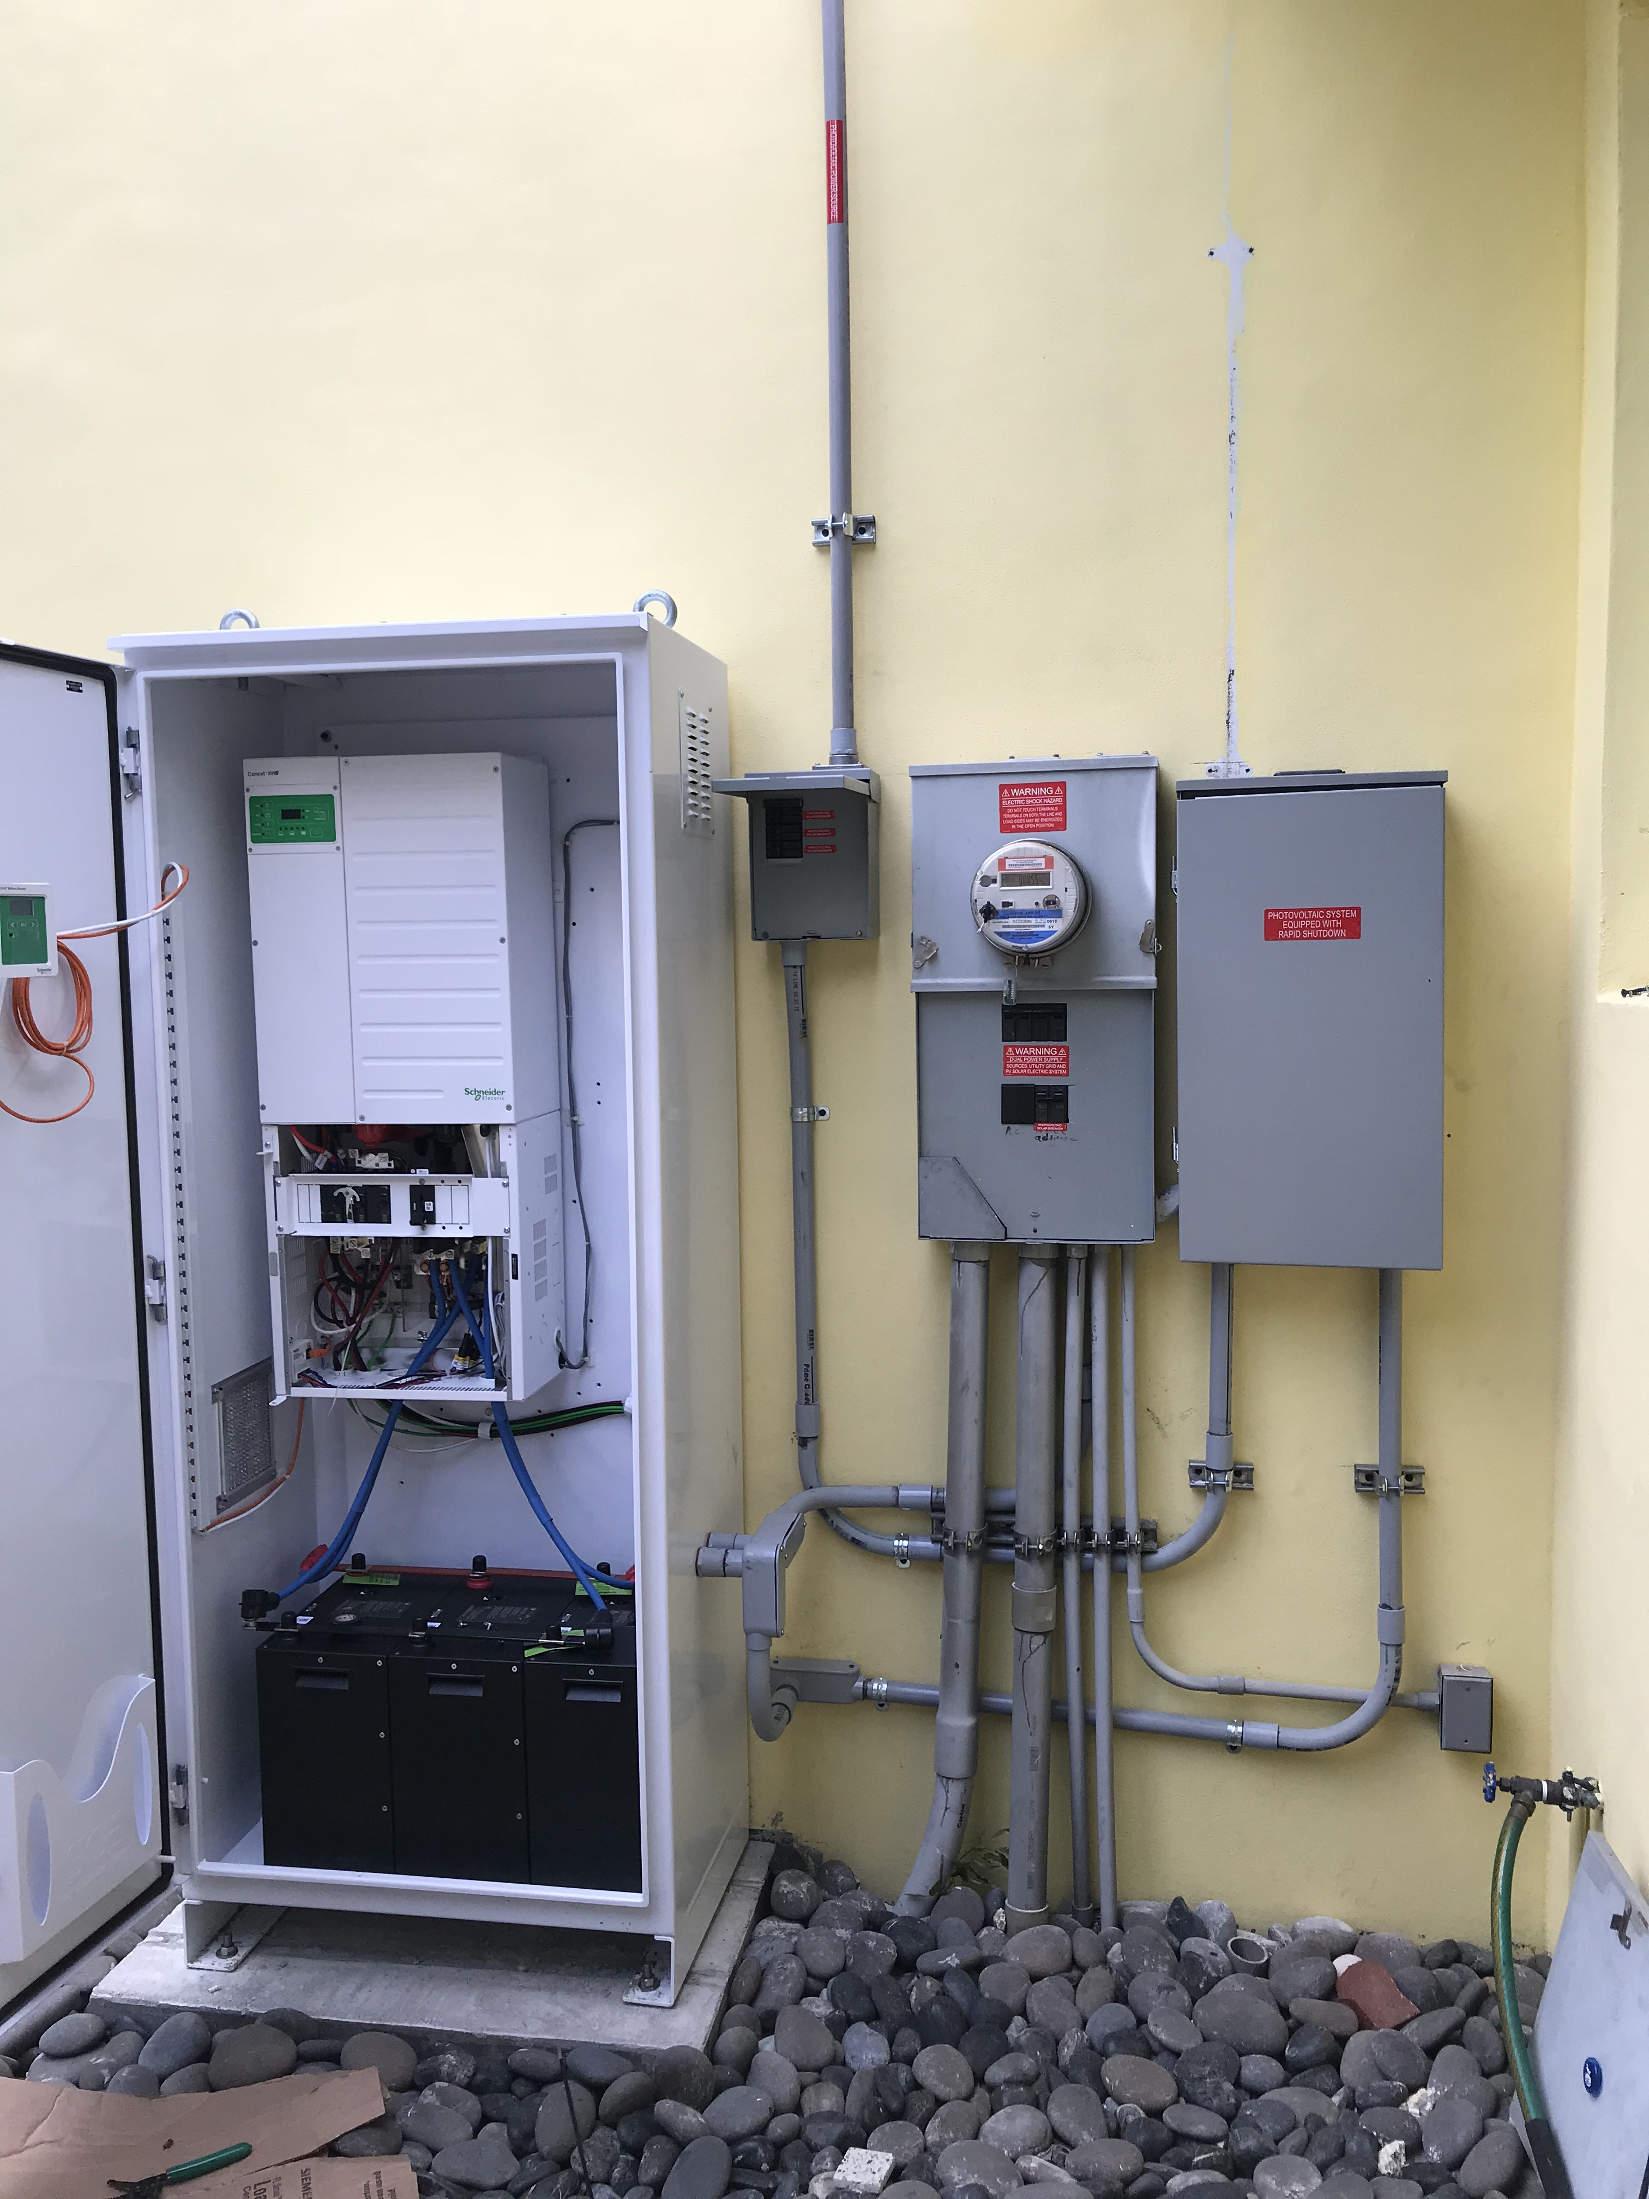
What can batteries power?
A battery tied to critical home loads /sub-panels
Notes:
Target time: 2-3 minutes
Main messages:
When the power goes out the batteries kick in seamlessly
It’s uneconomical for people to power their entire home on batteries right now so you will likely need to choose what to run in an outage
A “backed up or critical loads” sub-panel is installed and circuits you want to power in your home during the outage are put there
When the grid goes out the battery backup system disconnects that sub-panel from the grid and powers it until the grid comes back up
Audience engagement:
What would you back up if you had a storage system?

Slide 12
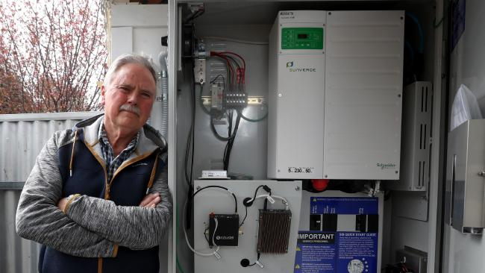
Critical Load Examples
A 6 kWh Battery Bank
Fully re-charged by solar (5.6 kW system) daily
NOTE: No solar = 1 day only
What will run when the power is out:
Fridge; small microwave, mini split/
Some lights; Some outlets
cable modem
What they chose not to power:
Central AC; clothes dryer; hot water heater
The Johnsons lose power from the utility several times of year.
Each time the power is out for the entire day.
Notes:
Main messages:
It’s important to limit your expectations on how much your energy storage can cover while the power is out
What you power depends on your budget and the space you have for batteries
Your installer will help you figure out the right solution for you
Narrative:
Energy storage in the home is right now all about backup power. That means when the power from the utility goes out the energy storage will kick on and run part or all of your home until the utility power returns. How much of your home can run on batteries? That depends on how much you want to spend. It’s very common for homeowners to over-expect how much they can run on their energy storage system. Because energy storage like batteries is still expensive you’re probably going to only power the really important stuff while the grid power is out. Here’s an example of the kinds of things someone might typically power in an emergency power outage.

Slide 13
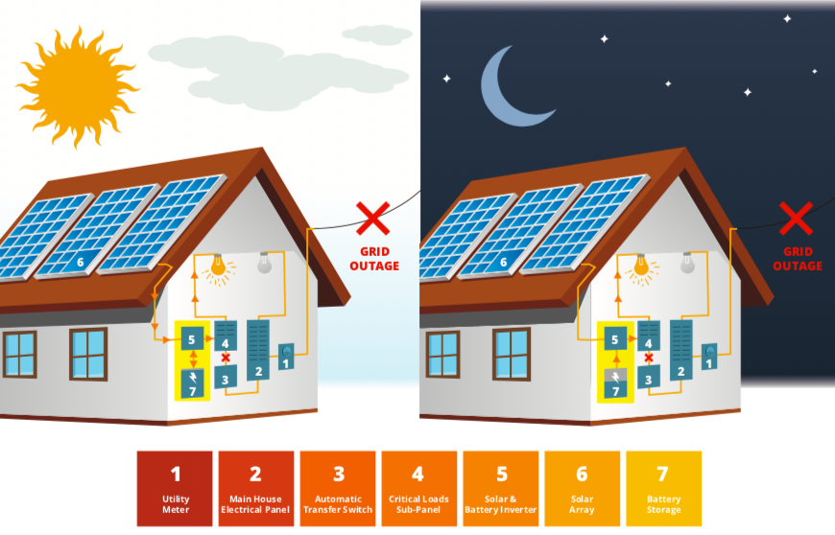
How does storage work with solar?
Solar + Storage:
Solar charges batteries for later
Grid can charge batteries too
Small amounts of energy keep batteries “topped off”
Batteries only kick in (automatically!) when power is out
Notes:
Target time: 1-2 minutes
Main Messages:
Solar is the fuel to keep batteries charged up when the power is out
Narrative:
Just like a generator, when the power goes out your batteries kick in. There’s no need to flip switches. The power just comes on instantaneously and powers the parts of your house you chose to run off your batteries. The solar charges your batteries by day and powers your house too when there’s excess energy. The batteries power your house by night and when there’s not enough solar power to meet your energy needs while the grid is down. When the grid comes back up the batteries shut off and you back to using the grid and solar automatically.
Notes:
Batteries can be installed at the time of solar installation or retrofitted later.
If storage is of interest for later talk to your installer about a battery-ready solar system.
There may be some considerations in the design of your solar system to make installing batteries easier later down the road.
{Only mention for multi-state audiences}
In places where it makes sense economically, solar can charge energy during the day and you can use it at night

Slide 14
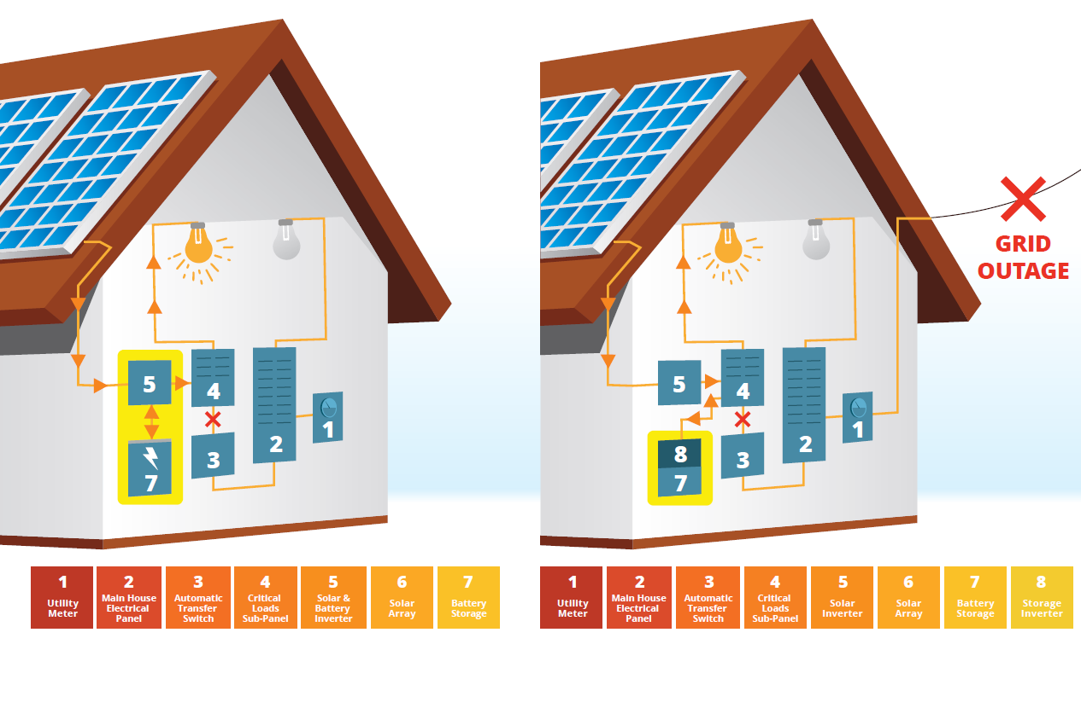
Connecting your batteries to your home
“DC Coupled”
“AC Coupled”
Notes:
Target time: 2 minutes
Main Messages:
There are two ways batteries are connected to solar arrays and to the main electrical system of the home
‘Which is better?’ both configurations are standard practice and the installer will work with you to decide which one is best
What you end up with depends on a number of factors including:
If you install it with solar
The location of your batteries and solar array
Your installer will help you figure it out. We just want you to be aware of the terminology and the basic differences.
Example to share;
"With DC coupled the batteries are more directly connected to the solar panels. With AC coupled the solar is separated from the batteries by your house electric system. Or, put another way, with DC coupled, your solar and your batteries hold hands. With AC coupled, they just wave at each other from across the hall".
Narrative:
This gets technical very quickly but high level, know there are two main ways battery storage can be connected to your solar array. The solar installer will help you determine which one makes the most sense for you and your circumstances.
Notes:
It’s not worth mentioning the financial implications at all during this slide
We have installers who will only do AC coupling for retrofits and others who will only do DC coupling for retrofits and they will go with what their practice is (great variety within the industry)
We just want the homeowners to know that there are variations in configurations and there will be differences industry wide (one isn’t necessarily better than the other) and we just want the homeowner to be aware of the terminology.

Slide 15
Most common home batteries
Lead-acid
Lithium Ion
But wait, there’s more!
Pros:
Lower upfront cost
Tried and true
Cons:
Maintenance requirement
Slow energy discharge (power)
High space requirement
Shorter lifespan
Less usable energy per cycle
Pros:
High energy density
Lower lifetime costs
Longer lifespan
Small space requirement
More usable energy per cycle
Cons:
Higher upfront cost
Newer to market
There are other chemistries used in battery applications, but their deployment is much less common
Notes:
Target time: 1-2 minutes
Main Messages:
Technological innovation is happening and cost savings will be seen more with Lithium Ion batteries than Lead-acid (industry is trending towards LiOn)
Lead acid has been around a while, costs less and can be a great form of backup power
Lithium ion is newer but lasts longer, comes with better warranties and costs more upfront. Can discharge more power without being recharged than the lead-acid (higher depth of discharge).
There are other battery chemistries out there but so far the ones that have been around the longest and/or are being produced at scale are Lead-acid and LiOn
Examples of others (flow batteries, Nickel-Iron (NiFe), others?)
Also mention here that Lithium Ion can be re-programmed later for other purposes if needed/wanted.
Narrative:
We want you to know the different options out there but don’t worry about becoming an expert in them. It’s important to know what options your installer offers, some basic differences between them and the benefits/drawbacks of each.
NOTES:
Usable Energy = Depth of Discharge
Can both batteries be “recycled”? – yes but lead acid recycling is much more commonly available due to automotive batteries
If someone asks about the two different kinds of Lithium Ion available:
Li-ion-NMC = Lithium Nickel Manganese Cobalt Oxide
- More common and less expensive but also the same form that can experience thermal runaway. We have no examples of this happening with home storage though
- Tesla and LG use this
Li-ion-LFP = Lithium Ferrophosphate (LiFePO)
- Less common in currently available offerings, more expensive, and more stable
- Sonnen and Enphase use this

Slide 16
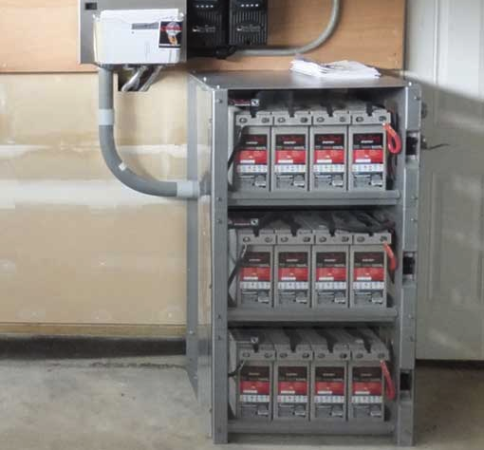
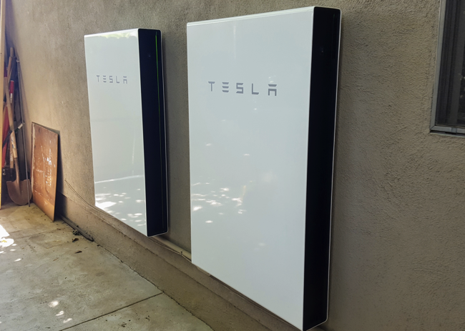
Operations and Maintenance
Space Requirements
Lead Acid
Small, shoe box-sized battery
Wired together in a group
Can sit directly on floor or shelf
Requires more space
Lithium Ion
Single, larger box
Wall-mounted or floor-mounted
Can often also be wired together
Source: Fire Mountain Solar
Source: Clean Technica
Notes:
Target time: 1 minute
Main Messages:
Lead-acid batteries take up more space and depending on local codes, may require special venting
Installer will help determine best location for the battery and its specific chemistry

Slide 17
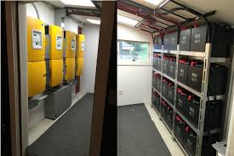
Operations and Maintenance
Siting Considerations
Batteries function best in controlled environments
Specific conditions depends on chemistry:
Lead-acid
Stable temperatures (ideal: 50℉ – 80℉)
No extreme heat or freezing air
Often installed indoors (garage/basement)
Special ventilation required for unsealed batteries
Lithium Ion
Wider temperature range (~32℉ - 120℉)
Some can be installed outdoors in stable climates
Notes:
Target time: 1 minute
Main Messages:
Your installer will help you decide the best place to put your batteries based on available space, electrical codes, and battery type requirements
Point out temperature restrictions that will dictate where the battery goes and how they perform; installer will help you determine the best place to put them on your property
NOTES:
Tesla Powerwall and LG Chem can go outside

Slide 18
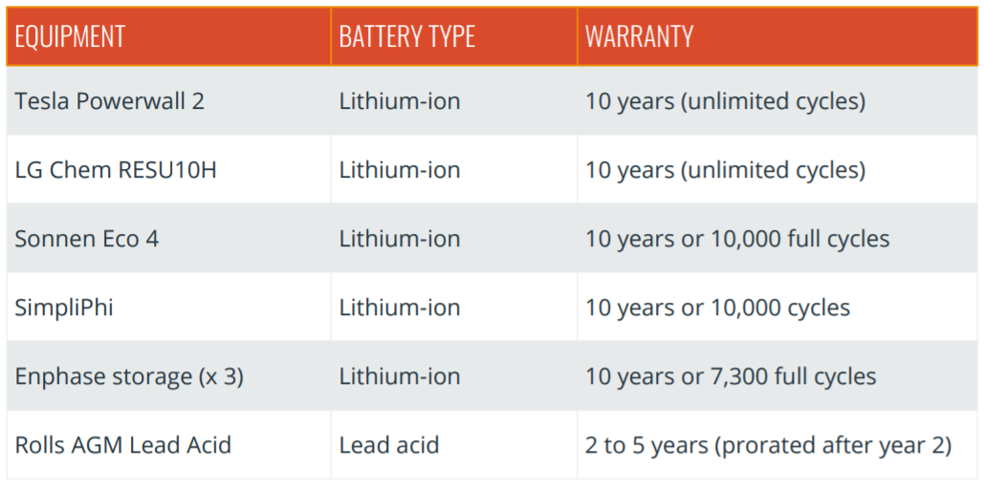
Operations and Maintenance
Installer’s labor should be warranted (wiring)
Note: Solar panels are warranted for 25 years
Source: https://blog.pickmysolar.com/home-battery-backup-comparison-tesla-sonnenbatterie
Notes:
Target time: 1 minute
Main Messages:
Warranties can vary across battery type and manufacturer
10 year warranty is common for Lithium Ion but there are variations (cycles, % of capacity still available by 10 years)

Slide 19
Other considerations
Insurance
Local permitting requirements
Utility requirements
Installer qualifications
Equipment availability
Source: www.24hplans.com
Notes:
Target time: 1-2 minutes
Main Messages:
Government does play a role through permitting and interconnection and there’s not much known about it because that role is still in flux as batteries become more popular
It’s important to understand the experience level of your installer. Are they new to this too? Are you okay with that?
Equipment availability can be a challenge. Ask your installer to clarify if they can quickly get the equipment you want
Additional points to make time permitting:
Batteries are not very common for residential homes so codes have not necessarily caught up.
Be prepared that there may be snags during permitting. Your installer will navigate this with you.
For backup power you shouldn’t need utility approval but that may vary by utility
Do you have an EV? it may be possible to use your EV storage as a temporary backup generator but you should research your options carefully to make sure you can do this with your EV safely and without voiding any warranties
Notes:
Equipment availability: ‘Energy storage only makes up for 3-5% of global battery demand.’ –GreenTech Media

Slide 20
Part 2: Economics
Notes:
That’s the end of technology.

Slide 21
Installing Storage with Solar vs. Later
With Solar
Immediate backup power benefits
May reduce some shared labor and admin costs by paying a contractor once instead of twice
Eligible for solar Federal Tax Credit
Later
Solar now and wait for battery prices to fall further
AC-coupled or retrofit existing solar array
Inverter replace or add
Uncertain eligibility for solar Federal Tax Credit
Notes:
Target time: 2-4 minutes
Main Messages:
Battery prices and technology are changing quickly. If you wait, be aware that your “battery ready” solar array may still require some changes to work with batteries
Sometimes “additional inverter” is built into the battery product so be sure you are comparing the full installation price that includes additional equipment
Batteries must be charged 100% by solar to take 100% of solar tax credit
This isn’t tax advice. Confirm with a tax advisor to understand your situation.
Under “later” when talking about retrofit existing solar array, note that having a DC-coupled system has additional hardware costs associated with it
NOTES:
Tidbit: Electric vehicle batteries may start getting re-purposed for home storage in the future as well which will add to cost declines. They still have life, just aren’t usable for car’s needs
Go through each bullet point specifically. You can punt any Federal Tax credit questions to a later slide

Slide 22
How is storage priced?
Total cost = hardware costs + installation costs + lifetime maintenance costs
Hardware +
Price per kW (power)
OR
Price per kWh (energy)
Note: Depends on battery type and and installation of new inverter
(for AC coupling)
Installation +
Cost of design, installation, and permitting
Additional equipment
Lifetime maintenance
Battery replacement
Associated labor cost
$$$ $$ $
Notes:
Target time: 2 minutes
Main Messages:
Hardware is the storage only
Installation is additional equipment, design, permits, labor, inspection, and overhead
Maintenance is a catch all that acknowledges you may need to contact your installer for help down the road before the battery life is up
Note:
You don’t need to focus on the cost/unit in the hardware section. Just note that there will be a cost and there is no standard industry cost (in $/kW and $/kWh). It’s helpful to note that for the solar homeowners in the room that the $/W that you used for the solar installation doesn’t translate as neatly to the battery installation.

Slide 23
Choose Critical Loads Wisely
A home battery is like your phone.
The heavier the load the faster a battery drains. Texting occasionally uses less energy than streaming YouTube or Netflix.
It’s important to consider what you want to power most when the grid is disconnected.
Notes:
Main messages:
It’s important to limit your expectations on how much your energy storage can cover while the power is out
What you power depends on your budget and the space you have for batteries
Your installer will help you figure out the right solution for you
Narrative:
Energy storage in the home is right now all about backup power. That means when the power from the utility goes out the energy storage will kick on and run part or all of your home until the utility power returns. How much of your home can run on batteries? That depends on how much you want to spend. It’s very common for homeowners to over-expect how much they can run on their energy storage system. Because energy storage like batteries is still expensive you’re probably going to only power the really important stuff while the grid power is out. Here’s an example of the kinds of things someone might typically power in an emergency power outage.

Slide 24
Basic cost estimates (example)
Hardware cost (examples) +
Installation costs +
$1,500 - $5,000 for standalone installation and additional equipment
Maintenance costs
Varies between installers and battery chemistries
Equipment | Cost | Size
Powerwall 2 (Li-ion) + gateway– | $8,800 | 13.5 kWh
Powerwall 1 (Li-ion) | $3,000 | 6.4 kWh
LG Chem (Li-ion) | $6,000 | 6.6 kWh
Sonnen Eco 4 (Li-ion) | $10,000 | 4 kWh
Sealed Lead Acid | $5,200 | 12 kWh
Pricing for our small 6 kWh battery example:
~$6,000 + $4,000 + $1,000
= ~$11,000
https://cleantechnica.com/2018/10/12/tesla-powerwall-price-features-new-coming/
Notes:
Main messages:
Your cost is going to vary (possibly significantly) by the technology you choose and by battery capacity
Mention that some battery offerings come with an inverter built in and some don’t. The total installation cost to consider should include all equipment and install costs
Narrative:
Batteries are still cost prohibitive at this point for many people. Costs are falling rapidly as demand increases for this technology. For you, at this point, it’ll depend on how important it is to keep certain loads running during a grid outage (certain medical equipment, do you experience frequent outages, etc.)

Slide 25
Basic cost estimates
Backup
Power for you
For backup power applications, remember:
Value only when the grid is down
No cost savings/earnings over time
Notes:
Target time: <1 minute
Main Messages:
Backup is what you can get now and there are different technologies that provide that.
Backup power does not make you any money. It will also make your solar array a little less efficient due to energy needed to keep batteries topped off.
Notes:
Emphasize that there is no cost savings/earnings over time regarding your electric bill. In next slide you will talk about cost savings associated with having power during a power outage.

Slide 26
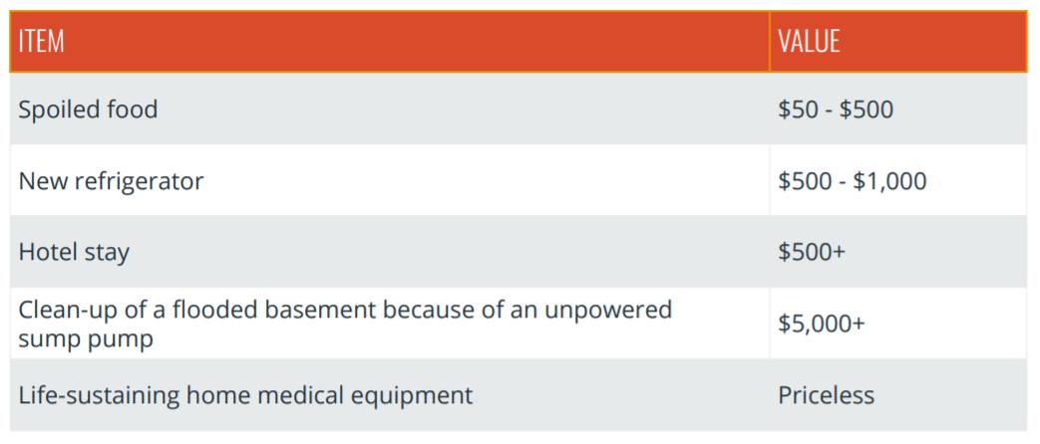
The value of resiliency
Losing power does have a cost
Notes:
Target time: 1 minute
Main Messages:
Backup is what you can get now and there are different technologies that provide that.
Notes:
How much would it cost for you to stay in a hotel in your area for 5 nights? Make the potential cost savings during a power outage more relevant and real.

Slide 27
Federal Tax Credit for Storage
30% federal tax credit available for storage systems that are 100% charged by solar
Value: 30% of the total system cost (hardware + installation) for fully solar-charged batteries
Storage systems that are at least 75% charged by solar are eligible for a portion of the full tax credit
Storage system that are less than 75% charged by solar are ineligible for the tax credit
Notes:
Target time: 1-2 minutes
Main Messages:
Batteries must be charged 100% by solar to take 100% of solar tax credit
This isn’t tax advice. Please consult an account or tax attorney on your particular situation
Tax credit steps down in 2020 to 26% and then 22% in 2021
Your installer should provide you with documentation that displays how your system qualifies for the tax credit. You should ask them for this documentation upfront. Some configurations may be easier to demonstrate than others.
Emphasize that you can take advantage of the tax credit for the battery system even if you have already taken advantage of it for the solar system.
https://www.greentechmedia.com/articles/read/irs-says-that-batteries-can-take-the-federal-tax-credit#gs.LiKlJkw

Slide 28
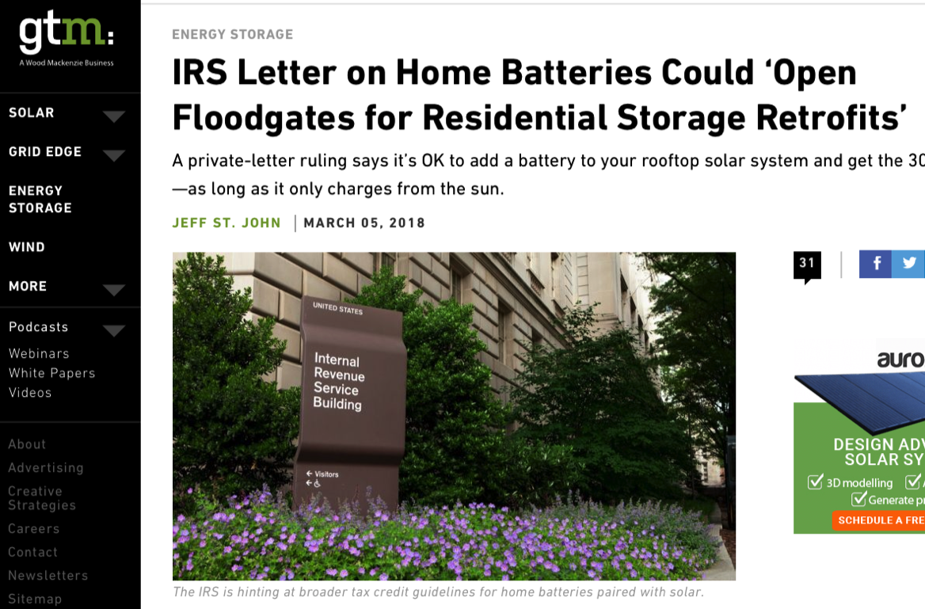
Clarification from the IRS
In March 2018, the IRS issued a private-letter ruling clarifying:
Adding storage to an existing rooftop solar array will qualify for the 30% Federal Tax Credit
Solar charging stipulations still apply
Notes:
Target time: 1 minute (maybe less)
Be sure to note that the private letter ruling can not technically be cited as precedent but it’s a good sign
This isn’t an amendment to the tax code but this is a single ruling by the IRS that indicates that this is the way they will trend when assessing taxes this year.
Recent private letter rulings confirm that the IRS is okay with retrofits as long as charging from the sun happens

Slide 29
AC/DC Coupling and the Tax Credit
DC COUPLING
Easier to prove your battery is only charged by solar electricity (as opposed to utility electricity from the grid) which makes it easier to qualify for 30% Federal Tax Credit
AC COUPLING
More challenging to guarantee your battery is exclusively charged by solar which is an important factor for federal tax credit eligibility.
Notes:
Main messages:
These are the kind of things that might make you think about backup power
There are different chemistries. Lead acid’s been around for a while. Lithium ion is newer. There are trade offs to each but more detail than we can go into here.
(If you want more information than we’re discussing in these slides check out our webinar online)
Narrative:
Not everyone needs energy storage for backup power. Most people who are interested are in places where utility service is sometimes unreliable. They might be considering a generator or have a generator and want to replace it or augment it. If you have reliable utility power that rarely if ever goes out then battery backup power is probably not right for you unless you are motivated by disaster preparedness or if you have sensitive and life-saving medical equipment that most always remained powered.

Slide 30
What to look for
What should be included in your proposal:
Full cost
Payment milestones
Equipment details
Warranties
O&M Plan
Permitting
Pricing guarantee – no hidden fees
Installer information
Notes:
Presentation notes:
-You want to be confident and comfortable with whoever you work with. Make sure that these components are included in the proposal and do the right research to make sure you’re making the right choice for you. Ask about an O&M plan for the system – what you need to do to keep the batteries happy and healthy and what should the installer provide to help keep up the system.

Slide 31
Part 3: Our work

Slide 32
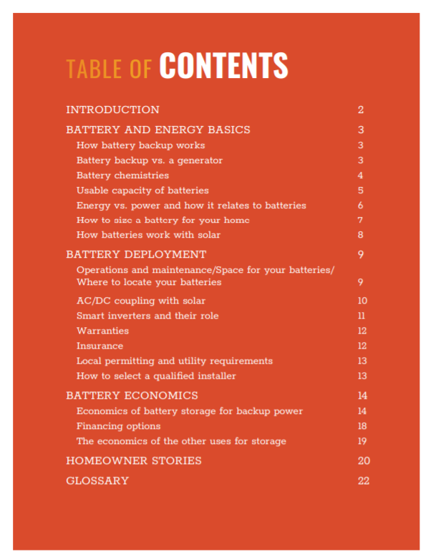
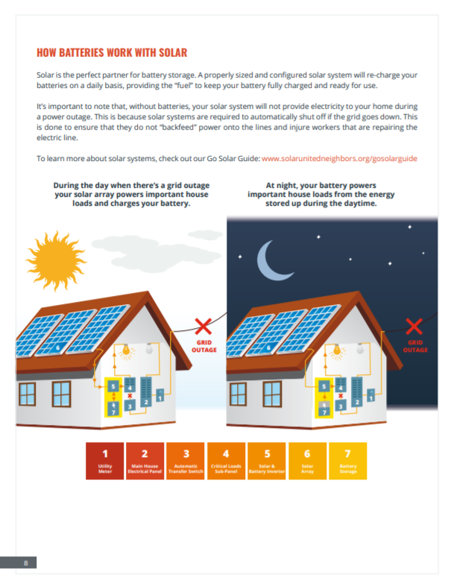
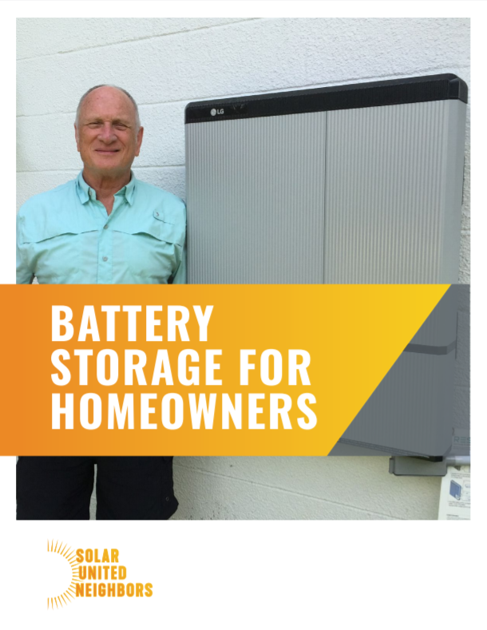
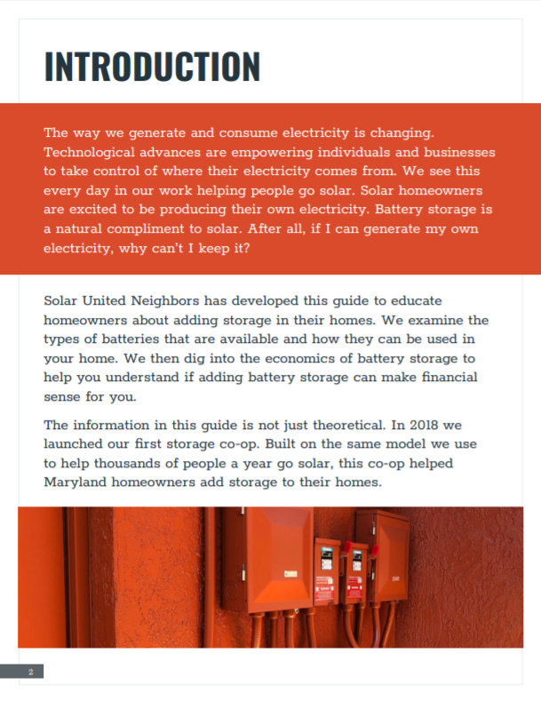
Check out our Residential Storage Guide!
Notes:
Target time: 1 minute

Slide 33
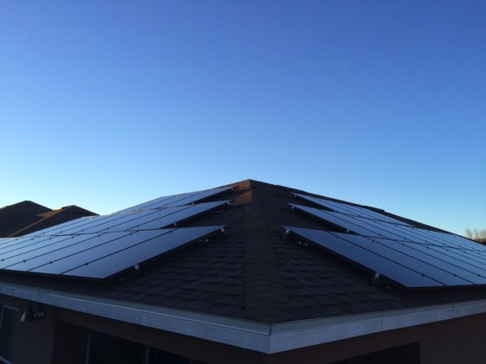
Additional Resources
Additional Resources
Battery Storage for Homeowners Guide
www.solarunitedneighbors.org/storage
Storage Webinar:
bit.ly/sun_storage
Storage Webinar Slides
bit.ly/sun_storage2
Notes:
Notes: other available resources we have available should you be interested in learning more about battery storage.

Slide 34
Thank You!
Join our ListServ:
www.solarunitedneighbors.org/join-our-active-listservs/
Like our Facebook Group:
www.facebook.com/groups/SolarUnitedNeighborsofPennsylvania/
Join a Solar Co-op:
Open for Sign Ups:
Indiana County Solar Co-op
Crawford-Mercer Solar Co-op
Launching this Year:
Allegheny County Solar Co-op
Beaver-Butler Solar Co-op
Monongahela River Solar Co-op
Notes:
Notes: ways to continue to engage with us.

