Slide 1
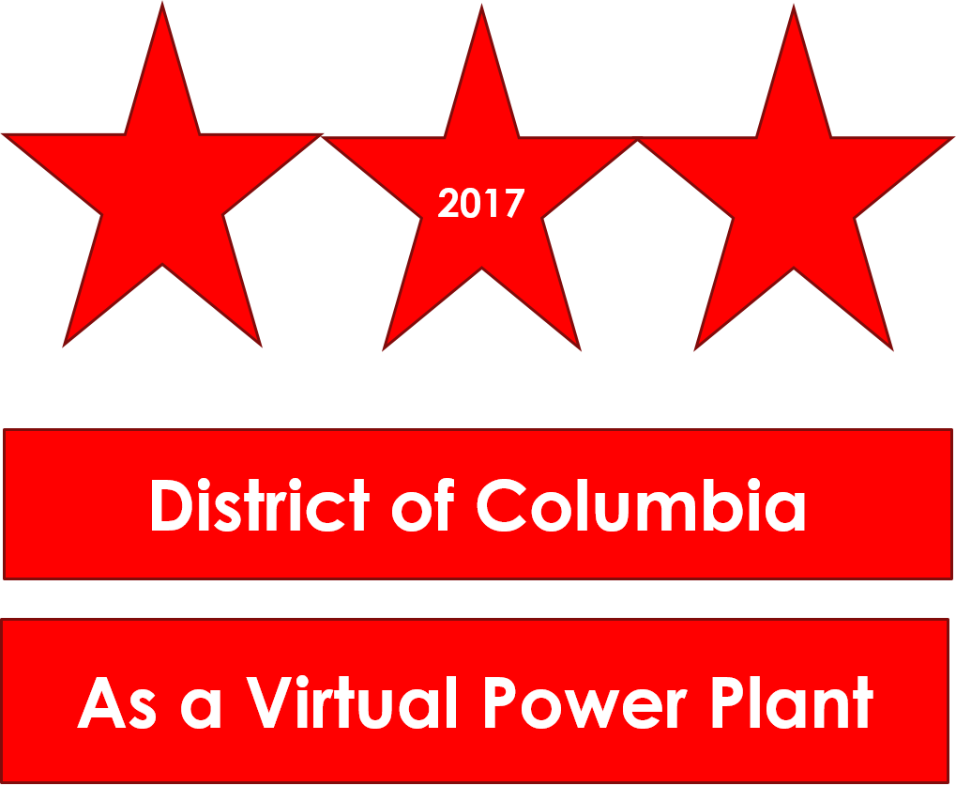
GRID2.0
Larry Martin, PhD
DC Solar United Neighbors Solar Congress June 1, 2019

Slide 2
MEDSIS PROCESS (FC1130) DC PUBLIC SERVICE COMMISSION
GRID2.0
6 WORK GROUPS
DATA
RATES
NO-WIRES ALTERNATIVES
CUSTOMER IMPACT
MICROGRIDS
PILOT S
MET 7-9 TIMES BETWEEN AUG. 2018 & APR. 2019
CHARTERS, GOALS, DISCUSSIONS & RECOMMENDATIONS
FINAL REPORT ISSUED YESTERDAY
https://dcpsc.org/

Slide 3
RECOMMEDATIONS
GRID2.0
42 RECOMMENDATIONS (AND “LEARNINGS”}
NOT CONSENSUS
STAKEHOLDERS COMMENTS INCLUDED
PROCESS TRANSPARENT, BUT DOMINATED BY STAKEHOLDERS BEST ABLE TO PARTICIPATE
KEY RECOMMENDATIONS
UPDATE CAPACITY MAPS MONTHLY & DATA WEBPAGE
ORDER A DISTRIBUTION SYSTEM PLANNING AND NO-WIRES ALTERNATIVE PROCESS
CONVENE WORK GROUP TO DEVELOP DYNAMIC PRICING PROGRAM
VALUE OF DER STUDY
ESTABLISH NEW CATEGORY OF MICROGRID OPERATOR
IMPLEMENT A PILOT SELECTION PROCESS

Slide 4
Virtual Power Plant in DC
GRID2.0
Shift away from a “load following” paradigm to a “supply following” paradigm
Responsive distributed energy resources absorb variable generation and can reduce peak demands
Transactive energy
Enables pro-sumers to buy and sell energy from one another
Flexible
Cost-effective for pro-sumers
Voluntary
Requires Grid Modernization

Slide 5
Virtual Power Plant in DC
GRID2.0
Governed by Core Principles:
Scalability
Reliability
Affordability
Sustainability
Incentivizing distributed energy resources, demand response and efficiency
Local power “sources” can be prioritized
Transactive energy system/Technology-Neutral
Market-driven implementation can be phased-in
Managed by distributed service platform provider

